Slide 1
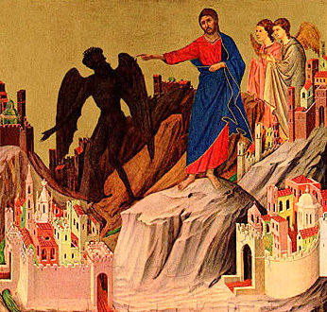
What Can We Learn from the Temptation of Christ?
9th of March 2014

Slide 2
1- He was led by the Spirit
  Then Jesus was led by the Spirit into the wilderness to be tempted by the devil. 2 After fasting forty days and forty nights, he was hungry. Matt 4

Slide 3
2 - He was led into the wilderness
No one, no matter how holy they are, is free from temptation. Even Jesus was tempted.
St Anthony understanding of the three levels of temptation

Slide 4
3 - Fasting is necessary for spiritual maturation and growth.
Holiness is not compatible with gluttony.
2 After fasting forty days and forty nights, he was hungry. 3 The tempter came to him and said, “If you are the Son of God, tell these stones to become bread.” Matt 4

Slide 5
4 - every temptation is based in pride.
The devil says to Jesus, "If You are the Son of God" (vv.3,6).

Slide 6
5 - while the devil is tempting us to be free and independent of God, he will play the other side of the coin at the same time.
he said, “throw yourself down. For it is written:
“‘He will command his angels concerning you, and they will lift you up in their hands, so that you will not strike your foot against a stone.’ Matt 4

Slide 7
6 - if we do not already have the resources to be foolishly independent of God, the devil will entice to go out and get them.
8 Again, the devil took him to a very high mountain and showed him all the kingdoms of the world and their splendor. 9 “All this I will give you,” he said, “if you will bow down and worship me.” Matt 4

Slide 8
7 - Jesus answered every temptation with Scripture
We Orthodox Christians believe that the Mosiac Law, the Prophets, the Gospels, the Epistles, the writings of the Saints and Church Fathers, the creeds and canons of the Ecumenical Councils are the word of God that guides our lives.

Slide 9
8 - Jesus says, "Away with you Satan!"
He showed us we have the power of spoken word to tell the devil to go away. Words, especially in the name of God, have power. Satan must obey them. However, as it says in Luke 4:13, the devil will return at an "opportune" time. In other words, overcoming temptation is not a one time event.

