Slide 1
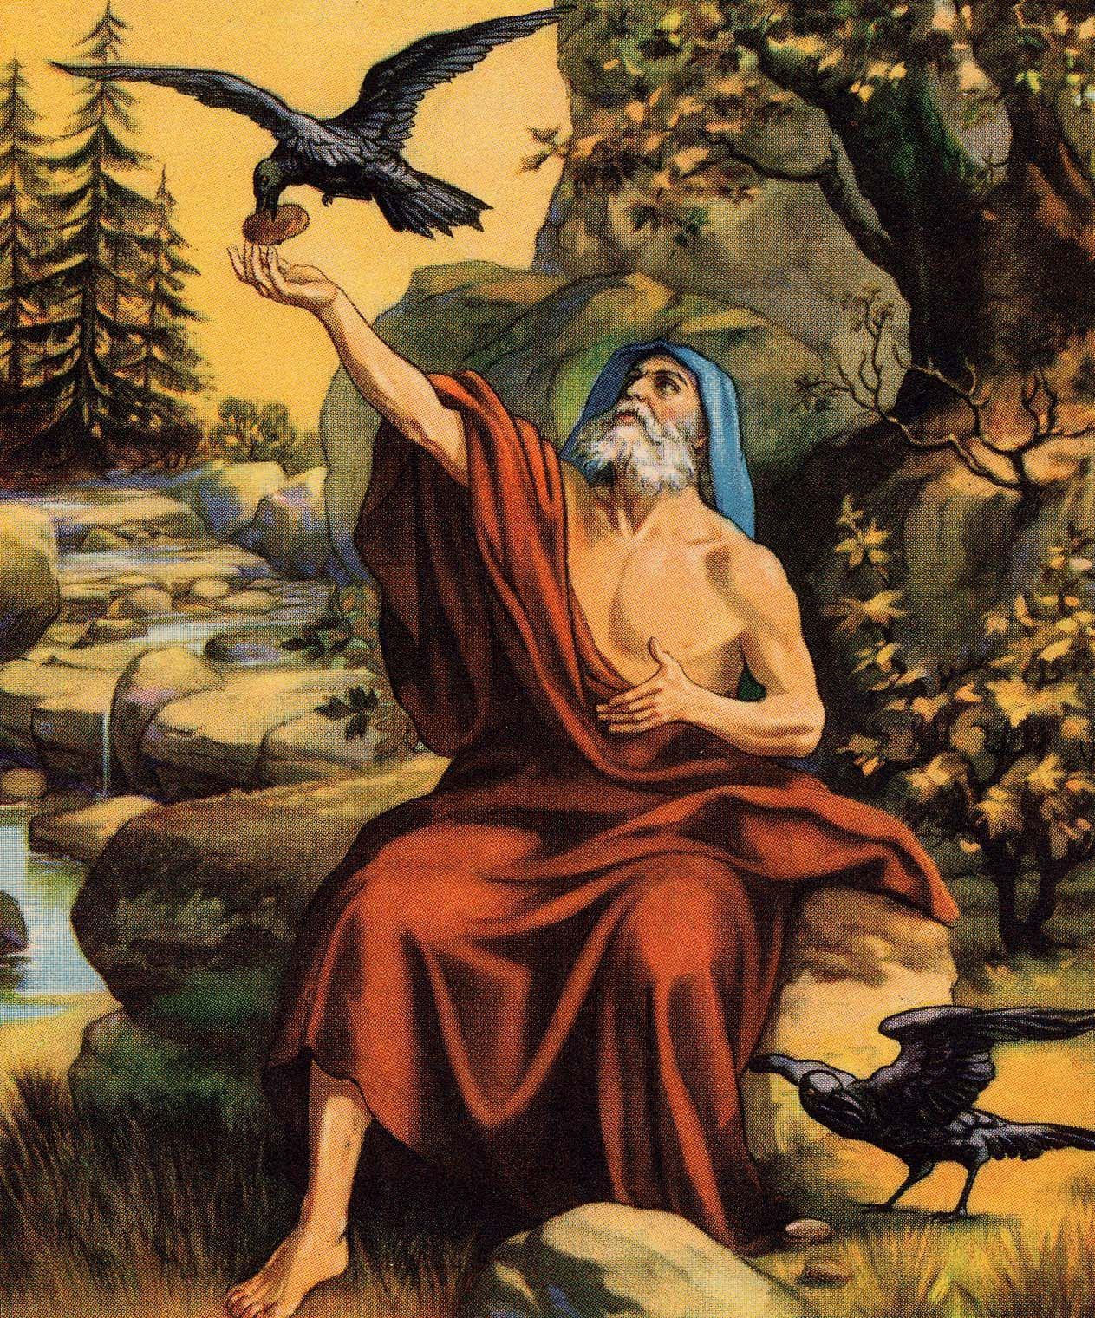
Life of Elijah, Part 4
Light & Life 9-30-2018

Slide 2
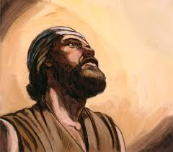
How the mighty are fallen
Bootcamp and being cut down at Cherith
Advanced Training in Zaraphath where he was put in the fiery furnace
Bold Champion in Mt Carmel
I Kings 17 : humility
I Kings 18 : heroism

Slide 3
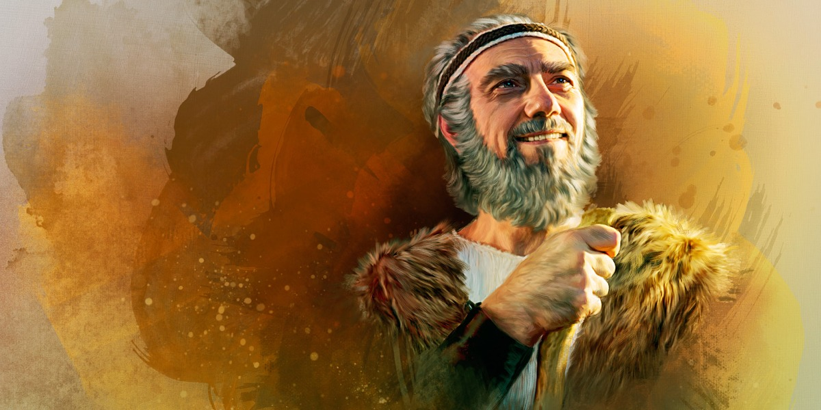
I Kings 19 Humanity
“Elijah was a man with a nature like ours, and he prayed earnestly that it would not rain; and it did not rain on the land for three years and six.” (James 5:17)

Slide 4
And Ahab told Jezebel all that Elijah had done, also how he had executed all the prophets with the sword. ² Then Jezebel sent a messenger to Elijah, saying, “So let the gods do to me, and more also, if I do not make your life as the life of one of them by tomorrow about this time.” ³ And when he saw that, he arose and ran for his life, and went to Beersheba, which belongs to Judah, and left his servant there.
1 Kings 19:1-3

Slide 5
When God gives us a portrait of a man, He paints him warts and all.
Why are we given such a Portrait of Elijah?
Because God is not interested in painting a fake picture about our nature.
Because it is so important for us to know the truth about ourselves
This portrait helps us see the need to glory in God rather than in people.
Perhaps this portrait and reality will help us stop trusting in the lies we tend to believe.

Slide 6
Depression in the Greats
"Depression followed me around like a black dog all of my life." – Winston Churchill
"I am now the most miserable man living. Whether I shall be better, I cannot tell. I awfully forebode I shall not."

Slide 7
FEAR
“And when he saw that, he arose and ran for his life, and went to Beersheba, which belongs to Judah, and left his servant there.”
I Kings 19:3

Slide 8
FAILURE
But he himself went a day’s journey into the wilderness, and came and sat down under a broom tree. And he prayed that he might die, and said, “It is enough! Now, Lord, take my life, for I am no better than my fathers!”
I Kings 19:4

Slide 9
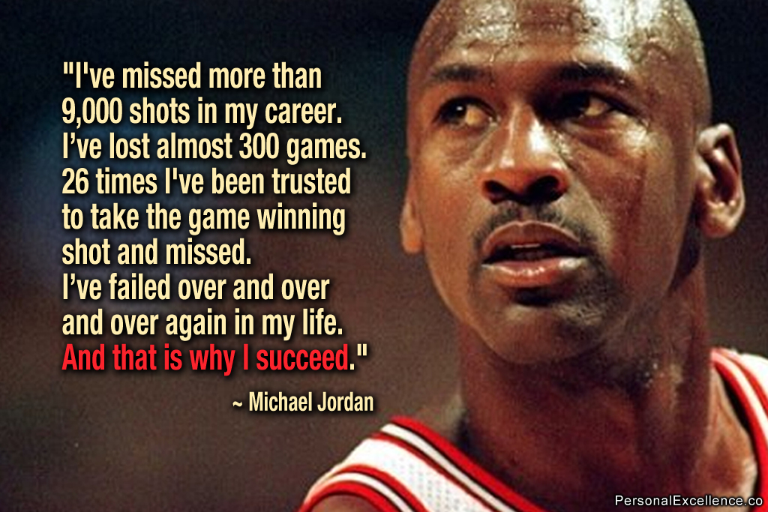
FAILURE

Slide 10
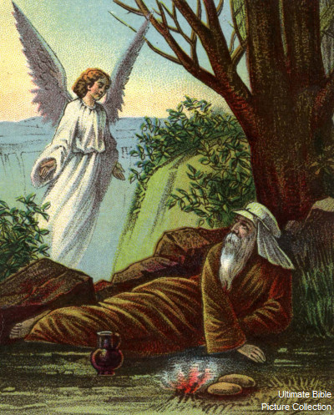
FATIGUE
Then as he lay and slept under a broom tree, suddenly an angel touched him, and said to him, “Arise and eat.”
I Kings 19:5

Slide 11
FUTILITY
So he said, “I have been very zealous for the Lord God of hosts; for the children of Israel have forsaken Your covenant, torn down Your altars, and killed Your prophets with the sword. I alone am left; and they seek to take my life.”
I Kings 19:10

Slide 12
How God deals with Elijah’s depression
1. God allowed Elijah time to rest and receive refreshment. (5-8)
“Then as he lay and slept under a broom tree, suddenly an angel touched him, and said to him, “Arise and eat.” (6) Then he looked, and there by his head was a cake baked on coals, and a jar of water. So he ate and drank, and lay down again. (7) And the angel of the LORD came back the second time, and touched him, and said, “Arise and eat, because the journey is too great for you.” (8) So he arose, and ate and drank; and he went in the strength of that food forty days and forty nights as far as Horeb, the mountain of God.

Slide 13
He needed to face his fears (vv. 9-10)
⁹ And there he went into a cave, and spent the night in that place; and behold, the word of the Lord came to him, and He said to him, “What are you doing here, Elijah?” ¹⁰ So he said, “I have been very zealous for the Lord God of hosts; for the children of Israel have forsaken Your covenant, torn down Your altars, and killed Your prophets with the sword. I alone am left; and they seek to take my life.”

Slide 14
He needed a fresh vision of God (vv. 11-14)
¹¹ Then He said, “Go out, and stand on the mountain before the Lord.” And behold, the Lord passed by, and a great and strong wind tore into the mountains and broke the rocks in pieces before the Lord, but the Lord was not in the wind; and after the wind an earthquake, but the Lord was not in the earthquake; ¹² and after the earthquake a fire, but the Lord was not in the fire; and after the fire a still small voice. ¹³ So it was, when Elijah heard it, that he wrapped his face in his mantle and went out and stood in the entrance of the cave. Suddenly a voice came to him, and said, “What are you doing here, Elijah?” ¹⁴ And he said, “I have been very zealous for the Lord God of hosts; because the children of Israel have forsaken Your covenant, torn down Your altars, and killed Your prophets with the sword. I alone am left; and they seek to take my life.”

Slide 15
^{He needed a fresh commission}
¹⁵ Then the Lord said to him: “Go, return on your way to the Wilderness of Damascus; and when you arrive, anoint Hazael as king over Syria. ¹⁶ Also you shall anoint Jehu the son of Nimshi as king over Israel. And Elisha the son of Shaphat of Abel Meholah you shall anoint as prophet in your place. ¹⁷ It shall be that whoever escapes the sword of Hazael, Jehu will kill; and whoever escapes the sword of Jehu, Elisha will kill. ¹⁸ Yet I have reserved seven thousand in Israel, all whose knees have not bowed to Baal, and every mouth that has not kissed him.”

