Slide 1
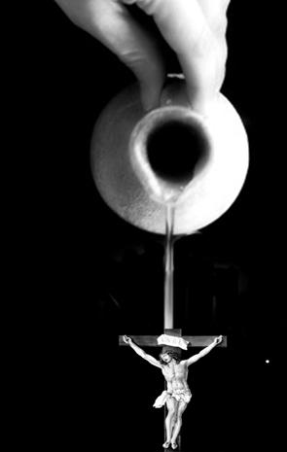
Coming Into Our World
“Kenosis”

Slide 2
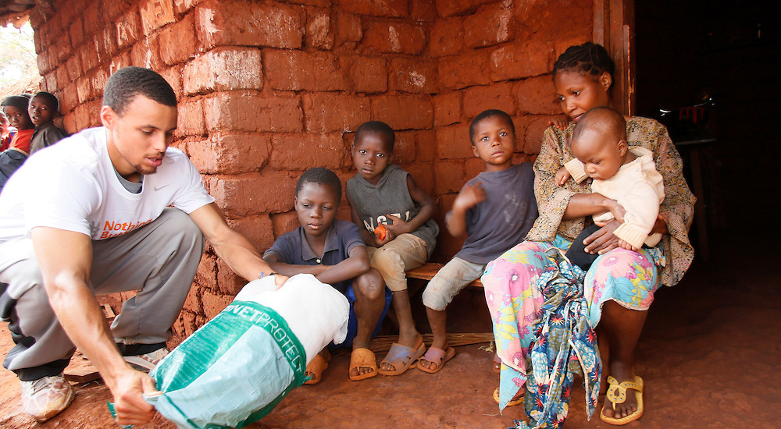
NBA CARES

Slide 3
1 John 2:6
“He who says he abides in Him ought himself also to walk just as He walked.”

Slide 4
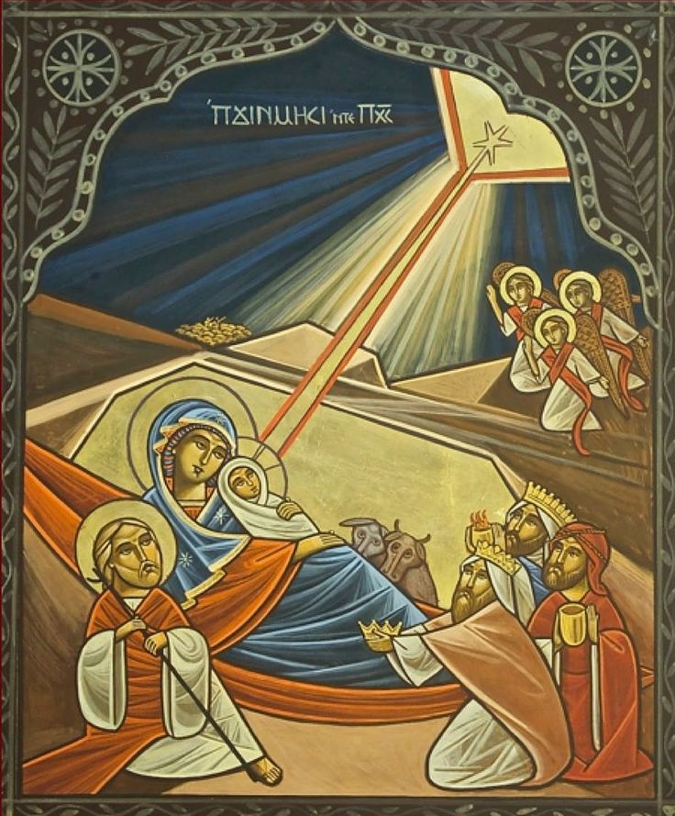
“He took what is ours”

Slide 5
Philippians 2:5-8
“ Let this mind be in you which was also in Christ Jesus, ⁶ who, being in the form of God, did not consider it robbery to be equal with God, ⁷ but made Himself of no reputation, taking the form of a bondservant, and coming in the likeness of men. ⁸ And being found in appearance as a man, He humbled Himself and became obedient to the point of death, even the death of the cross.”

Slide 6
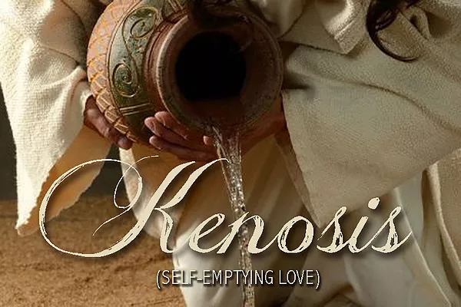
Kenosis

Slide 7
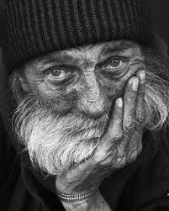

Slide 8
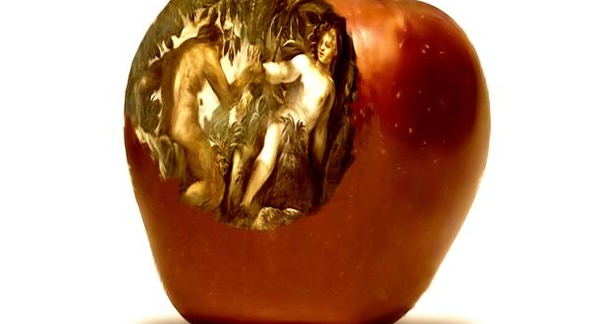
Adam and Corruption

Slide 9
The Divine Dilemma
If you don’t see man in his true condition of destruction, then the solution of the Incarnation doesn’t make any sense

Slide 10
The Divine Dilemma
Man was being abolished and dying into non-existence
God has to be true to His Word

Slide 11
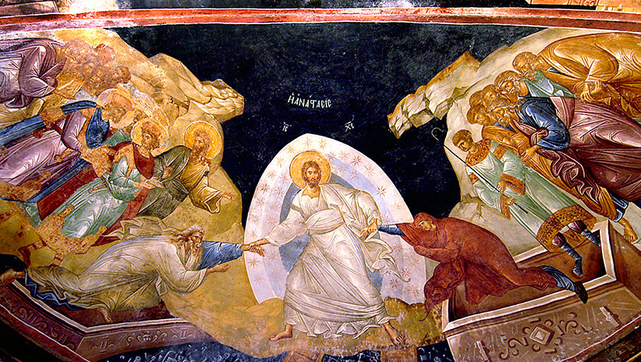
THE ONLY SOLUTION WAS GOING TO BE FROM GOD HIMSELF

Slide 12
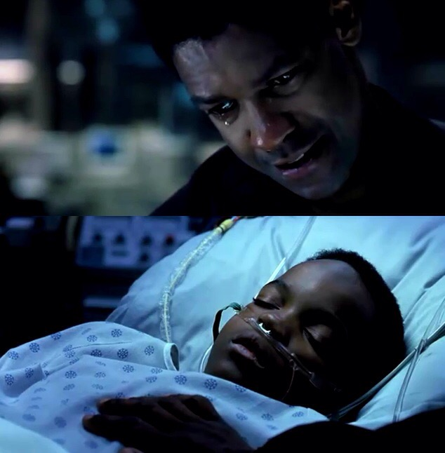
John Q

Slide 13
God didn’t change a thing about His love despite the terrible condition we are in!

Slide 14
Kenosis
As much as God emptied Himself of His majesty, we need to empty ourselves of our egotism, our pride, our own selfishness

Slide 15
1 John 3:6
“By this we know love, because He laid down His life for us. And we also ought to lay down our lives for the brethren.”

