Slide 1
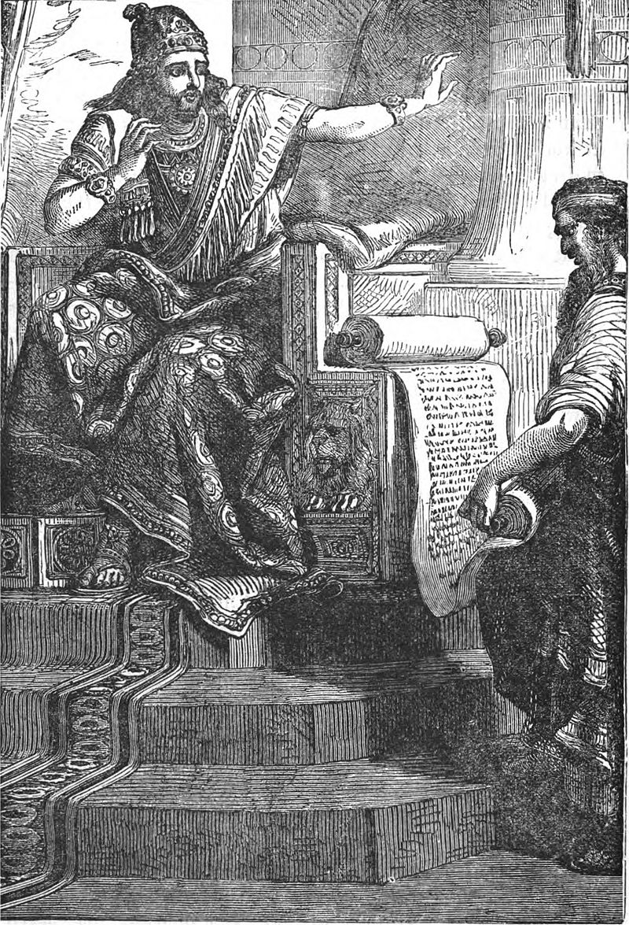
Josiah:
A King and a Repentant Nation

Slide 2
Background
2 Chronicles 33:21-25
Amon was twenty-two years old when he became king, and he reigned two years in Jerusalem. But he did evil in the sight of the Lord, as his father Manasseh had done; for Amon sacrificed to all the carved images which his father Manasseh had made, and served them. And he did not humble himself before the Lord, as his father Manasseh had humbled himself; but Amon trespassed more and more.
Then his servants conspired against him, and killed him in his own house. But the people of the land executed all those who had conspired against King Amon. Then the people of the land made his son Josiah king in his place.

Slide 3
Are you serious?!
2 Chronicles 34:1-2
Josiah was eight years old when he became king, and he reigned thirty-one years in Jerusalem. And he did what was right in the sight of the Lord, and walked in the ways of his father David; he did not turn aside to the right hand or to the left.

Slide 4
Step 1
2 Chronicles 34:3
For in the eighth year of his reign, while he was still young, he began to seek the God of his father David;

Slide 5
Power?
Lamentations 3:27-28
It is good for a man to bear
The yoke in his youth.
Let him sit alone and keep silent,
Because God has laid it on him;

Slide 6
Step 2
2 Chronicles 34:3-7
and in the twelfth year he began to purge Judah and Jerusalem of the high places, the wooden images, the carved images, and the molded images. They broke down the altars of the Baals in his presence, and the incense altars which were above them he cut down; …….., and cleansed Judah and Jerusalem. And so he did in the cities of Manasseh, Ephraim, and Simeon, as far as Naphtali and all around, with axes. When he had broken down the altars and the wooden images, had beaten the carved images into powder, and cut down all the incense altars throughout all the land of Israel, he returned to Jerusalem.

Slide 7
Step 3
2 Chronicles 34:8-10
In the eighteenth year of his reign, when he had purged the land and the temple, he sent Shaphan the son of Azaliah, Maaseiah the governor of the city, and Joah the son of Joahaz the recorder, to repair the house of the Lord his God. When they came to Hilkiah the high priest, they delivered the money that was brought into the house of God, which the Levites who kept the doors had gathered from the hand of Manasseh and Ephraim, from all the remnant of Israel, from all Judah and Benjamin, and which they had brought back to Jerusalem. Then they put it in the hand of the foremen who had the oversight of the house of the Lord; and they gave it to the workmen who worked in the house of the Lord, to repair and restore the house.

Slide 8
Step 4
2 Chronicles 34:14-21
Now when they brought out the money that was brought into the house of the Lord, Hilkiah the priest found the Book of the Law of the Lord given by Moses. Then Hilkiah answered and said to Shaphan the scribe, “I have found the Book of the Law in the house of the Lord.” And Hilkiah gave the book to Shaphan. So Shaphan carried the book to the king, bringing the king word, saying, …...“Hilkiah the priest has given me a book.” And Shaphan read it before the king.
Thus it happened, when the king heard the words of the Law, that he tore his clothes. Then the king commanded Hilkiah, Ahikam the son of Shaphan, Abdon the son of Micah, Shaphan the scribe, and Asaiah a servant of the king, saying, “Go, inquire of the Lord for me, and for those who are left in Israel and Judah, concerning the words of the book that is found; for great is the wrath of the Lord that is poured out on us, because our fathers have not kept the word of the Lord, to do according to all that is written in this book.”

Slide 9
It takes one person
2 Chronicles 34:23-28
“Thus says the Lord God of Israel, ‘Tell the man who sent you to Me, “Thus says the Lord: ‘Behold, I will bring calamity on this place and on its inhabitants, all the curses that are written in the book which they have read before the king of Judah, because they have forsaken Me and burned incense to other gods, that they might provoke Me to anger with all the works of their hands. Therefore My wrath will be poured out on this place, and not be quenched.’ ” ’ But as for the king of Judah, who sent you to inquire of the Lord, in this manner you shall speak to him, ‘Thus says the Lord God of Israel: “Concerning the words which you have heard— because your heart was tender, and you humbled yourself before God when you heard His words against this place and against its inhabitants, and you humbled yourself before Me, and you tore your clothes and wept before Me, I also have heard you,” says the Lord. “Surely I will gather you to your fathers, and you shall be gathered to your grave in peace; and your eyes shall not see all the calamity which I will bring on this place and its inhabitants.” ’ ” So they brought back word to the king.

Slide 10
Step 5
2 Chronicles 35
Now Josiah kept a Passover to the Lord in Jerusalem, and they slaughtered the Passover lambs on the fourteenth day of the first month. ……
So all the service of the Lord was prepared the same day, to keep the Passover and to offer burnt offerings on the altar of the Lord, according to the command of King Josiah. And the children of Israel who were present kept the Passover at that time, and the Feast of Unleavened Bread for seven days. There had been no Passover kept in Israel like that since the days of Samuel the prophet; and none of the kings of Israel had kept such a Passover as Josiah kept, with the priests and the Levites, all Judah and Israel who were present, and the inhabitants of Jerusalem. In the eighteenth year of the reign of Josiah this Passover was kept.

