Slide 1
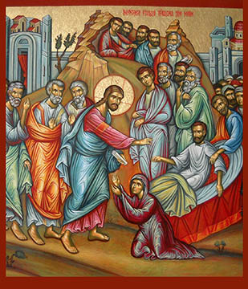
With Jesus in a funeral
4th Sunday of Babah

Slide 2
Escapes from death
Our God is the God of salvation; And to GOD the Lord belong escapes from death. Ps 68:20

Slide 3
Large crowd
11 Now it happened, the day after, that He went into a city called Nain; and many of His disciples went with Him, and a large crowd. 12 And when He came near the gate of the city, behold, a dead man was being carried out, the only son of his mother; and she was a widow. And a large crowd from the city was with her. Lk 7:11,12

Slide 4
Do not Weep
When the Lord saw her, He had compassion on her and said to her, “Do not weep.” LK 7:13

Slide 5
St Cyril of Alexandria
Commentary on Luke, Homily 36. [CGSL 153*.]
Observe how he joins miracle to miracle. In the former instance, the healing of the centurion’s servant, he was present by invitation, but here he draws near without being invited. No one summoned him to restore the dead man to life, but he comes to do so of his own accord.

Slide 6
Arise
Then He came and touched the open coffin, and those who carried him stood still. And He said, “Young man, I say to you, arise.” Lk 7:14

Slide 7
St. Ephrem the Syrian
“The Virgin’s son met the widow’s son. He became like a sponge for her tears and as life for the death of her son. Death turned about in its den and turned its back on the victorious one.”

Slide 8
God has visited His people
Then fear came upon all, and they glorified God, saying, “A great prophet has risen up among us”; and, “God has visited His people.” Lk 7:16

Slide 9
St. Cyprian
“This supernatural bread and this consecrated chalice are for the health and salvation of mankind.”

