Slide 1
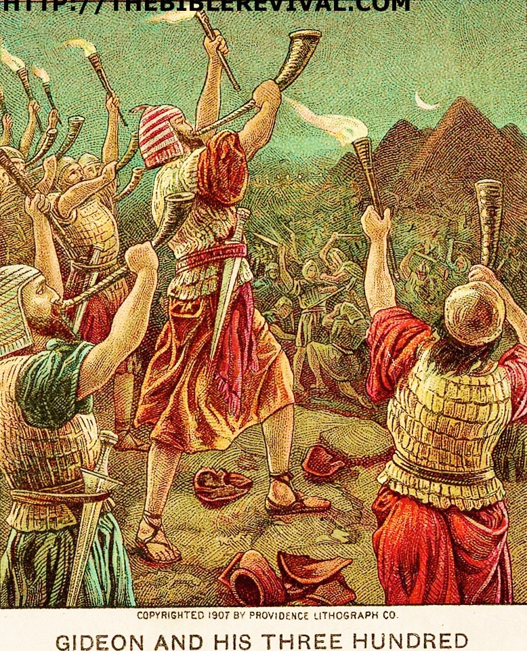
Wars in the Old Testament (2) Case Study : Canaanite Genocide
Saturday 26.09.2015

Slide 2
Dawkins, Richard: The God Delusion. Boston: Houghton Mifflin, 2006. 280.
The Bible story of Joshua’s destruction of Jericho, and the invasion of the Promised Land in general, is morally indistinguishable from Hitler’s invasion of Poland, or Saddam Hussein’s massacres of the Kurds and the Marsh Arabs. The Bible may be an arresting and poetic work of fiction, but it is not the sort of book you should give your children to form their morals. As it happens, the story of Joshua in Jericho is the subject of an interesting experiment in child morality.

Slide 3
Incomplete inequity !!
13 Then He said to Abram: “Know certainly that your descendants will be strangers in a land that is not theirs, and will serve them, and they will afflict them four hundred years.. 16 But in the fourth generation they shall return here, for the iniquity of the Amorites is not yet complete.” Gen 15:13,16

Slide 4
1. The Canaanites were sadistic and depraved
Deuteronomy explains, “They even burn their sons and daughters in the fire to their gods” (Deut. 12:31)

Slide 5
Wright, G. Ernest, and Floyd V. Filson. The Westminster Historical Atlas to the Bible. Philadelphia: Westminster, 1945. 36.
Worship of these gods [Baalism] carried with it some of the most demoralizing practices then in existence. Among them were child sacrifice, a practice long since discarded in Egypt and Babylonia, sacred prostitution, and snake-worship on a scale un­known among other peoples.

Slide 6
Clay Jones, “Why We Don’t Hate Sin so We don’t Understand What Happened to the Canaanites: An Addendum to ‘Divine Genocide’ Arguments,” Philosophia Christi n.s. 11 (2009): 61.
Molech was a Canaanite underworld deity represented as an upright, bull-headed idol with human body in whose belly a fire was stoked and in whose outstretched arms a child was placed that would be burned to death….And it was not just infants; children as old as four were sacrificed

Slide 7
2. The Jews usually didn’t fight offensive wars—only defensive
The Jews were not permitted to conquer anyone they wanted. In fact, when they tried to conquer people without divine approval, they were utterly defeated (1 Sam. 4; Num. 14:41-45; Josh. 7). God was clearly calling the shots on the destruction of Canaan—not the Jews. The king was beneath God—not above him. Moreover, after the war with Canaan, God did not command any other offensive wars in Israel. Even during this time, Israel’s wars were usually defensive (see Ex. 17:8; Num. 21:1; Deut. 3:1; Josh. 10:4; Num. 31:2-3). Copan writes, “All sanctioned Yahweh battles beyond the time of Joshua were defensive ones, including Joshua’s battle to defend Gibeon (Josh. 10-11). Of course, while certain offensive battles took place during the time of the Judges and under David and beyond, these are not commended as ideal or exemplary.”

Slide 8
3. God wasn’t playing favorites
Hear, O Israel! You are crossing over the Jordan today to go in to dispossess nations greater and mightier than you, great cities fortified to heaven, 2 a people great and tall… 4 “Do not say in your heart when the LORD your God has driven them out before you, ‘Because of my righteousness the LORD has brought me in to possess this land,’ but it is because of the wickedness of these nations that the LORD is dispossessing them before you. 5 It is not for your righteousness or for the uprightness of your heart that you are going to possess their land, but it is because of the wickedness of these nations that the LORD your God is driving them out before you, in order to confirm the oath which the LORD swore to your fathers, to Abraham, Isaac and Jacob. 6 “Know, then, it is not because of your righteousness that the LORD your God is giving you this good land to possess, for you are a stubborn people. Deuteronomy 9:1-6

Slide 9
4. God gave the Canaanites an opportunity to change
In fact, God allowed the Jews to rot in slavery for 400 years, so that the Canaanites could have an opportunity to change. He didn’t judge them immediately, because the sins of the Canaanites did “not yet warrant their destruction” (Gen. 15:13; 16 NLT). That is, they were not past the point of no return. However, by the time the Jews came for battle, they were.

Slide 10
5. Diplomacy was the usual method
When Israel would go to war with another nation, they would usually offer a peace treaty first. Deuteronomy 20:10 states: “When you approach a city to fight against it, you shall offer it terms of peace.” If the people surrendered, they were not to be harmed. However, they would become laborers in Israel. This might seem harsh, but don’t forget the ancient Near Eastern context. When the Ammonites surrounded one of the cities of Israel, they required every citizen to gouge out one of their eyes, as a term of peace and surrender (1 Sam. 11:1-2)! This is why the neighboring nations considered the Hebrew kings to be “merciful kings” (1 Kings 20:31).

Slide 11
Special case ..!
This peace treaty was not offered to these seven people groups in Canaan (e.g. Hittites, Amorites, Canaanites, Perizzites, Hivites, and Jubusites), as Deuteronomy 20:16 makes explicit. This was probably because the Jews originally came to King Sihon (of the Amorites) with “words of peace” (Deut. 2:26), but the king was “not willing” to let them even pass through his land (Deut. 2:30). However, those willing to abandon Canaan were probably spared. For instance, Rahab’s entire family was spared from judgment (Josh. 2:13), because she surrendered to the Jews. The remaining Canaanites were killed because they chose to stay.

Slide 12
6. Images in Joshua were mild compared to the ancient Near East
(Josh. 10:24-27) When they brought these kings out to Joshua, Joshua called for all the men of Israel, and said to the chiefs of the men of war who had gone with him, “Come near, put your feet on the necks of these kings.” So they came near and put their feet on their necks. 25 Joshua then said to them, “Do not fear or be dismayed! Be strong and courageous, for thus the LORD will do to all your enemies with whom you fight.” 26 So afterward Joshua struck them and put them to death, and he hanged them on five trees; and they hung on the trees until evening. 27 It came about at sunset that Joshua gave a command, and they took them down from the trees and threw them into the cave where they had hidden themselves, and put large stones over the mouth of the cave, to this very day.

Slide 13
Copan, Paul. Is God a Moral Monster?: Making Sense of the Old Testament God. Grand Rapids, MI: Baker, 2011. 179.
The Neo-Assyrian annals of Ashurnasirpal II (883-859 BC) take pleasure in describing the flaying of live victims, the impaling of others on poles, and the heaped up bodies for show. They boast of how the king mounded bodies and placed heads into piles; the king bragged of gouging out troops’ eyes and cutting off their ears and limbs, followed by his displaying their heads all around a city.

Slide 14
7. “Utterly destroy” might not be absolute language
Take another example. God commanded King Saul, “Go and strike Amalek and utterly destroy all that he has, and do not spare him; but put to death both man and woman, child and infant, ox and sheep, camel and donkey” (1 Sam. 15:3). Of course, Saul complies with this command, and he “utterly destroyed all the people with the edge of the sword” (1 Sam. 15:8). Yet later in the same book, David’s men fought against a number of tribes, including the “utterly destroyed” Amalekites (1 Sam. 28:8; cf. 1 Chron. 4:43). These are not errors in the text. Instead, we may be misinterpreting the text, when we hold that these are absolute statements.

Slide 15
8. What about the women and kids?
There is no archaeological evidence of civilian populations at Jericho or Ai. Given what we know about Canaanite life in the Bronze Age, Jericho and Ai were military strongholds… The use of ‘women’ and ‘young and old’ was merely stock ancient Near Eastern language that could be used even if women and young and old weren’t living there. The language of ‘all’ (“men and women”) at Jericho and Ai is a ‘stereotypical expression for the destruction of all human life in the fort, presumably composed entirely of combatants.’ The text doesn’t require that women and young and old must have been in these cities.
Copan, Paul. Is God a Moral Monster?: Making Sense of the Old Testament God. Grand Rapids, MI: Baker, 2011. 175-176.

Slide 16
Richard Dawkins criticizes, “This merciful restraint by his soldiers infuriated Moses, and he gave orders that all the boy children should be killed, and all the women who were not virgins… Moses was not a great role model for modern moralists.”
At first glance, this story seems barbaric. Dawkins apparently misses the point. The virgin women were spared, because they hadn’t seduced the men (remember Num. 25:1-2). Therefore, the culpable ones were killed, and the innocent ones were spared.

Slide 17
Third, what about the Canaanite children? Why did God kill the kids? As we have already pointed out, children were most likely outside of the judgment on Canaan. Joshua may have been using military war-rhetoric, and these attack sites were military fortresses—not civilian cities. However, even if children were killed, this may have been an act of God’s mercy. If these Canaanite children had grown up in this society, they could have become forced-prostitutes, murderers, or even child sacrifices, roasting on burning altars to Baal! Moreover, they would have most likely been separated from God eternally after death—given their surroundings. Because these Canaanite children died before the age of accountability. they were taken to be directly with God at death. Therefore, while the immediate action may seem barbaric, these children would have been sent into the immediate presence of God—rather than their horrific and barbaric surroundings.

Slide 18
9. God has the right to judge—as the Author and Sustainer of life
All people are going to die at some point. The question is not that they will die; instead, the question is when they will die. God takes every life in the end. This is called death. Since God is the author and sustainer of life, he has rights over human life that we do not. Job said, “Naked I came from my mother’s womb, And naked I shall return there. The LORD gave and the LORD has taken away…” (Job 1:21)

Slide 19
St John Chrysostom (Homilies on Hebrews 27.6)
The name of Jesus [Joshua] was a type. For this reason then, and because of the very name, the creation reverenced him. What then! Was no other person called Jesus [Joshua]? But this man was on this account so called as a type… He brought in the people into the promised land, as Jesus into heaven; not the law; since neither did Moses [enter the promised land] but remained outside. The law has not the power to bring in, but grace.

Slide 20
Origen (Homilies on Joshua 8.7)
You will read in the Holy Scriptures about the battles of the just ones, about the slaughter and carnage of murderers, and that the saints spare none of their deeply rooted enemies. If they do spare them, they are even charged with sin, just as Saul was charged because he preserved the life of Agag king of Amalek. You should understand the wars of the just by the method I have set forth above, that these wars are waged by them against sin. But how will the just ones endure if they reserve even a little bit of sin? Therefore, this is said of them: “They did not leave behind even one who might be saved or might escape.”

