Slide 1
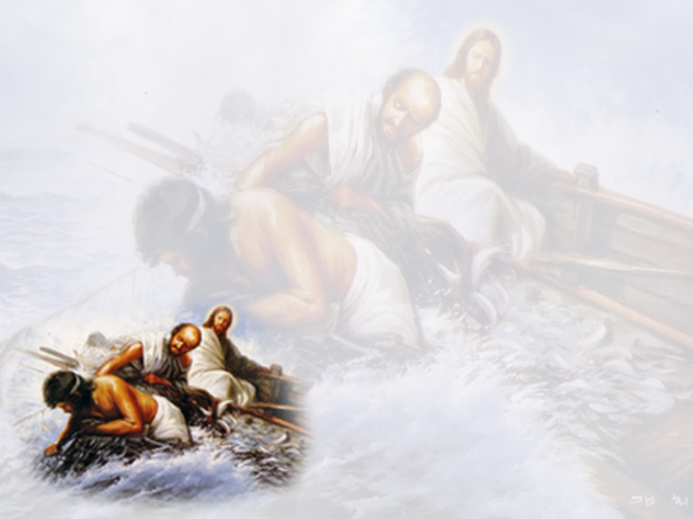
The Moment It Happened
Second Sunday of Babah
October 23, 2007
Luke 5:1-11

Slide 2
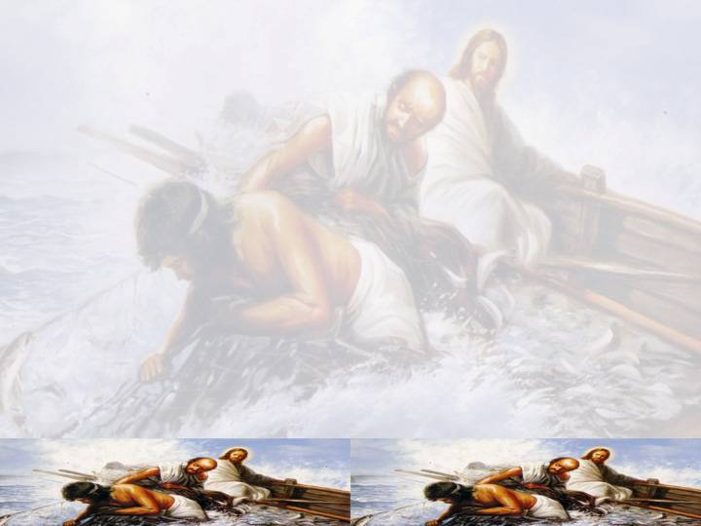
Luke 5:1-2
“So it was, as the multitude pressed about Him to hear the word of God, that He stood by the Lake of Gennesaret, and saw two boats standing by the lake; but the fishermen had gone from them and were washing their nets.

Slide 3
Luke 5:3
“Then He got into one of the boats, which was Simon’s, and asked him to put out a little from the land. And He sat down and taught the multitudes from the boat.”

Slide 4
Luke 5:4
“When He had stopped speaking, He said to Simon, “Launch out into the deep and let down your nets for a catch.”

Slide 5
Luke 5:5
But Simon answered and said to Him, “Master, we have toiled all night and caught nothing;

Slide 6
Luke 5:5
But Simon answered and said to Him, “Master, we have toiled all night and caught nothing; nevertheless at Your word I will let down the net.”

Slide 7
2 Corinthians 4:8-10
“We are hard-pressed on every side, yet not crushed; we are perplexed, but not in despair; persecuted, but not forsaken; struck down, but not destroyed — always carrying about in the body the dying of the Lord Jesus, that the life of Jesus also may be manifested in our body.”

Slide 8
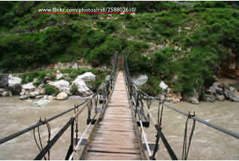
‘Nevertheless’ is the only way to reach the deep

