Slide 1
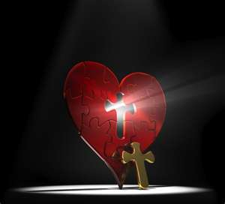
Irrational Love Campaign
The Satisfaction of Being Loved

Slide 2
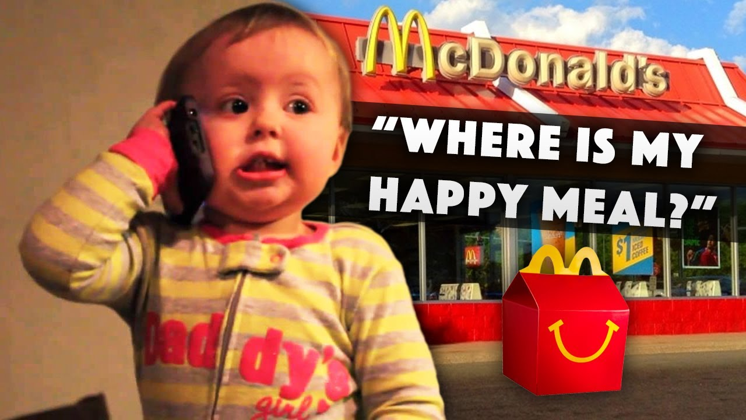
The Pursuit of Happiness

Slide 3
Ecclesiastes 4:7-8
⁷ Then I returned, and I saw vanity under the sun:
⁸ There is one alone, without companion:
He has neither son nor brother.
Yet there is no end to all his labors,
Nor is his eye satisfied with riches.
But he never asks,
“For whom do I toil and deprive myself of good?”
This also is vanity and a ^{[c]}grave misfortune.

Slide 4

Why are we are so discontent?

Slide 5
Romans 8:20-21
²⁰ For the creation was subjected to futility, not willingly, but because of Him who subjected it in hope; ²¹ because the creation itself also will be delivered from the bondage of ^{[a]}corruption into the glorious liberty of the children of God.

Slide 6
Our frustration comes from God Himself.

Slide 7

God’s hope is that we will stop searching for infinite satisfaction from finite objects

Slide 8
Matthew 6:33
“But seek first the kingdom of God and His righteousness, and all these things shall be added to you.”

Slide 9
Exodus 15:23-25
²³ Now when they came to Marah, they could not drink the waters of Marah, for they were bitter. Therefore the name of it was called ^{[d]}Marah. ²⁴ And the people complained against Moses, saying, “What shall we drink?” ²⁵ So he cried out to the Lord, and the Lord showed him a tree. When he cast it into the waters, the waters were made sweet.

Slide 10
Exodus 16:2-3
Then the whole congregation of the children of Israel complained against Moses and Aaron in the wilderness. ³ And the children of Israel said to them, “Oh, that we had died by the hand of the Lord in the land of Egypt, when we sat by the pots of meat and when we ate bread to the full! For you have brought us out into this wilderness to kill this whole assembly with hunger.”

Slide 11
Numbers 11:4-6
Now the mixed multitude who were among them yielded to intense craving; so the children of Israel also wept again and said: “Who will give us meat to eat? ⁵ We remember the fish which we ate freely in Egypt, the cucumbers, the melons, the leeks, the onions, and the garlic; ⁶ but now our whole being is dried up; there is nothing at all except this manna before our eyes!”

Slide 12

One of the primary dangers of ingratitude is that it’s contagious.

Slide 13
Numbers 11:11-12
“Why have You afflicted Your servant? And why have I not found favor in Your sight, that You have laid the ^{[d]}burden of all these people on me? ¹² Did I conceive all these people? Did I beget them, that You should say to me, ‘Carry them in your bosom, as a guardian carries a nursing child,’ to the land which You swore^{[e]} to their fathers?

Slide 14
Numbers 11:18-20
¹⁸ Then you shall say to the people, ^{[f]}‘Consecrate yourselves for tomorrow, and you shall eat meat; for you have wept in the hearing of the Lord, saying, “Who will give us meat to eat? For it was well with us in Egypt.” Therefore the Lord will give you meat, and you shall eat. ¹⁹ You shall eat, not one day, nor two days, nor five days, nor ten days, nor twenty days, ²⁰ but for a whole month, until it comes out of your nostrils and becomes loathsome to you, because you have despised the Lord who is among you, and have wept before Him, saying, “Why did we ever come up out of Egypt?” ’ ”

Slide 15

What are the signs that this discontent is present in our lives?

Slide 16
Contentment can only be found in authentic living that is grounded in His love.

Slide 17
Isaiah 55:1-3
“Ho! Everyone who thirsts,
Come to the waters;
And you who have no money,
Come, buy and eat.
Yes, come, buy wine and milk
Without money and without price.
² Why do you ^{[a]}spend money for what is not bread,
And your wages for what does not satisfy?
Listen carefully to Me, and eat what is good,
And let your soul delight itself in abundance.
³ Incline your ear, and come to Me.
Hear, and your soul shall live;

Slide 18

People who constantly have every appetite gratified from childhood on become the least capable of gratitude.

Slide 19
To become grateful, I must learn that I can handle disappointment and delayed gratification with grace and perseverance.

Slide 20
The experience of frustration and disappointment is irreplaceable in the development of a grateful heart

Slide 21

When the primary motive of gratitude is obligation, it tends to choke out the heart.

Slide 22
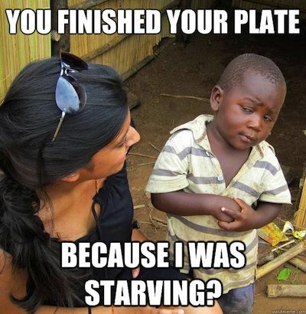
Learning to live in the contentment of being loved means receiving the gift of perspective.

Slide 23
God himself chooses to delight in imperfect gifts— in you and me.

