Slide 1
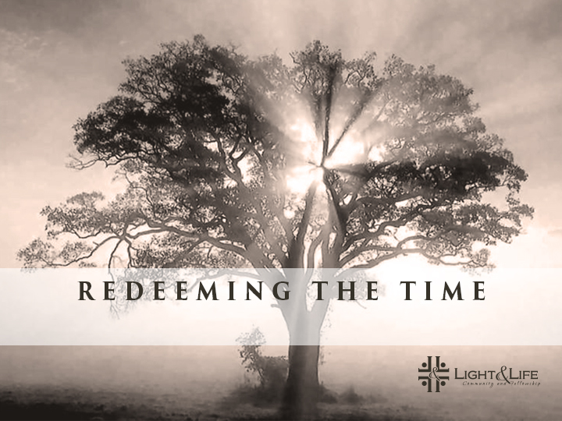
Ingredients for Growth

Slide 2
What are Grace and Truth and why are they so important?

Slide 3

Grace
is the unmerited favor of God toward people

Slide 4
Grace is the first component for growing up in the image of God

Slide 5
St Augustine
It is not that the law is evil but that makes those underwritten guilty by giving commands without providing help to fulfill them. In fact, Grace helps one to become a doer of the law, for without such grace one living under the law will be no more than a hear of the law.

Slide 6
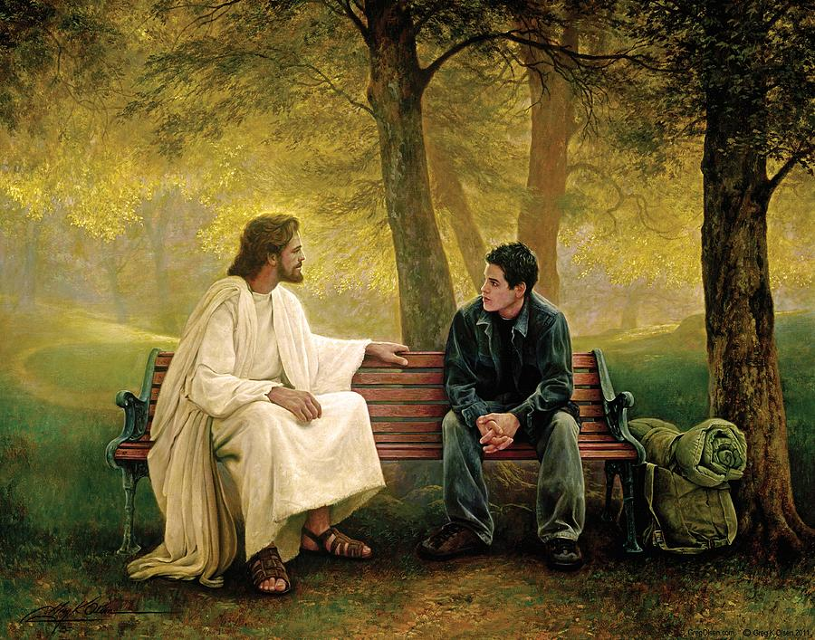
Grace is the relationship aspect of God's character

Slide 7
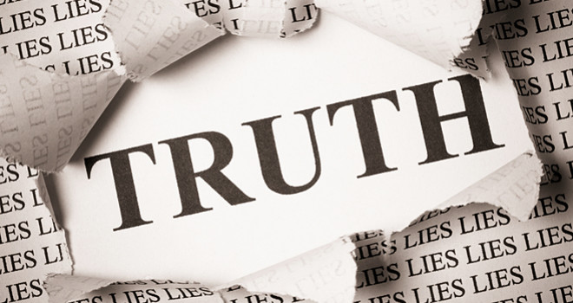

Slide 8
Truth is the structural aspect of God's character

Slide 9
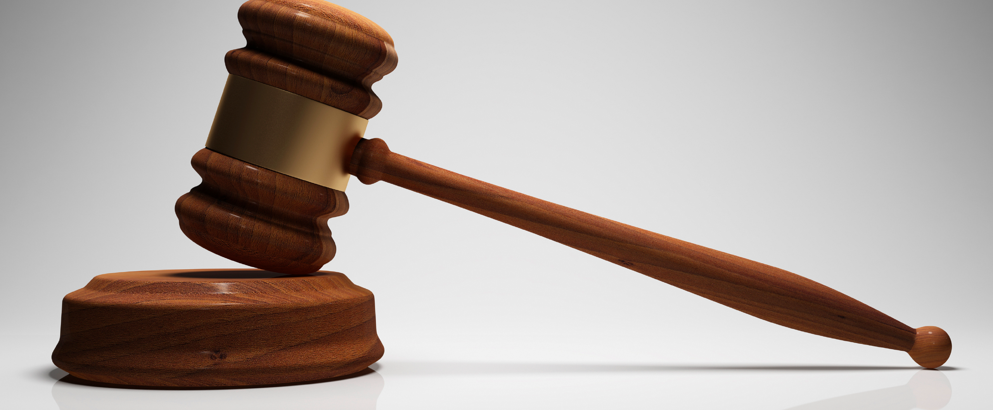
TRUTH WITHOUT GRACE = JUDGEMENT

Slide 10
St Cyril of Alexandria
“The law therefore was condemning the world and showing us subject to punishments, but the Savior rather sets it free for He came not to judge the world but to save the world.”

Slide 11
ROMANS 3:19-20
Now we know that whatever the law says, it says to those who are under the law, that every mouth may be stopped, and all the world may become guilty before God. 20 Therefore by the deeds of the law no flesh will be justified in His sight, for by the law is the knowledge of sin.

Slide 12
Romans 4:15
“because the law brings about wrath; for where there is no law there is no transgression.”

Slide 13
Truth WITHOUT Grace
Getting truth before relationship, brings guilt, anxiety, anger, and painful emotions

Slide 14
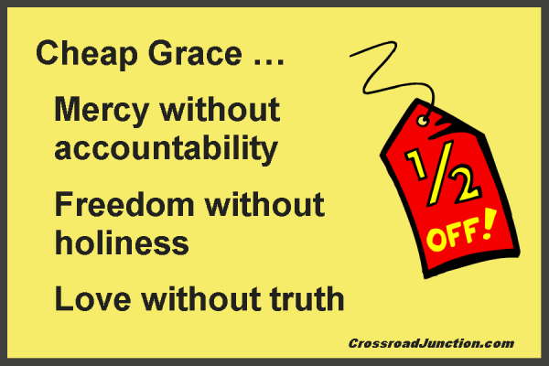
Grace WITHOUT Truth

Slide 15
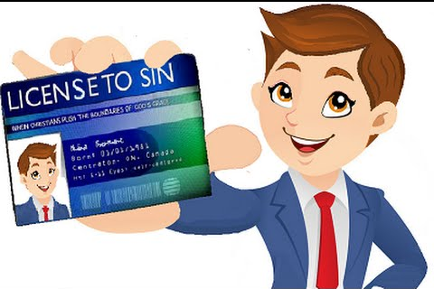
Grace without truth can be called License

Slide 16
Romans 6:15-16
What then? Shall we sin because we are not under law but under grace? Certainly not! 16 Do you not know that to whom you present yourselves slaves to obey, you are that one’s slaves whom you obey, whether of sin leading to death, or of obedience leading to righteousness?

Slide 17
How about mixing Grace and Truth together?
“The Word became flesh and made his dwelling among us. We have seen his glory, the glory of the One and Only, who came from the Father, full of grace and truth. From the fullness of his grace we have all received one blessing after another. For the law was given through Moses; grace and truth came through Jesus Christ” (John 1: 14,16-17)

Slide 18
Failure comes through the law, and redemption through Jesus

Slide 19
Grace, when it is combined with truth, invites the true self, the “me” as I really am, into relationship

Slide 20
Real intimacy always comes in the company of truth.

Slide 21
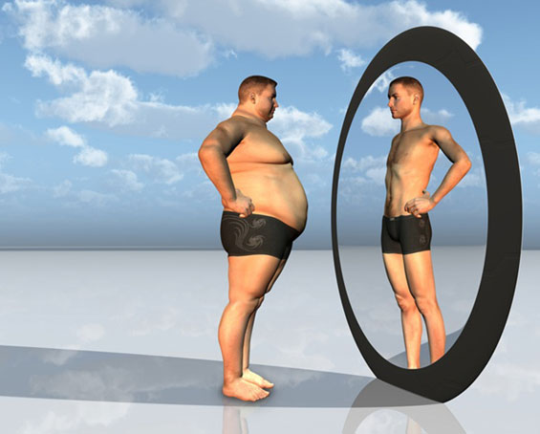
THE REAL SELF VS THE FALSE SELF

Slide 22
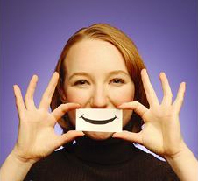
If the true self is in hiding, the false self takes over

Slide 23
The False Self
is the self we present to others, the false front, if you will, that we put up for others to see.

Slide 24

The Barrier of Guilt
Guilt and shame often sends us into hiding

Slide 25
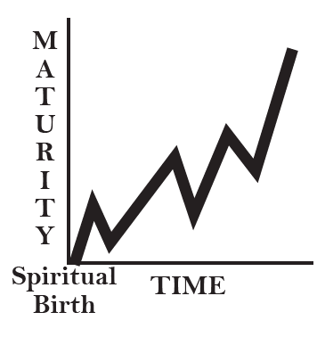
Final Ingredient for Growth
In order for grace and truth to produce fruit, we need time

Slide 26
1 Corinthians 3:1– 2
“Brothers, I could not address you as spiritual but as worldly— mere infants in Christ. I gave you milk, not solid food, for you were not yet ready for it. Indeed, you are still not ready”

Slide 27
Quick growth with no firm root will always be superficial and short-lived.
Deep growth is always slower.

Slide 28
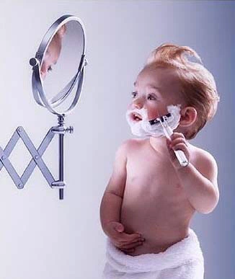
Guaranteed Failure: Growth without Time

Slide 29
Good Time vs Bad Time
Good time : time in which we and our experiences can be affected by grace and truth.
If we have removed some aspect of ourselves from time, grace and truth cannot transform it

Slide 30
GRACE, TRUTH, AND TIME TOGETHER
“My brothers and sisters, whenever you face trials of any kind, consider it nothing but joy, because you know that the testing of your faith produces endurance; and let endurance have its full effect, so that you may be mature and complete, lacking in nothing”
James 1: 2– 4

Slide 31
We have a foundation of grace that gives us freedom to achieve truth over time

