Slide 1
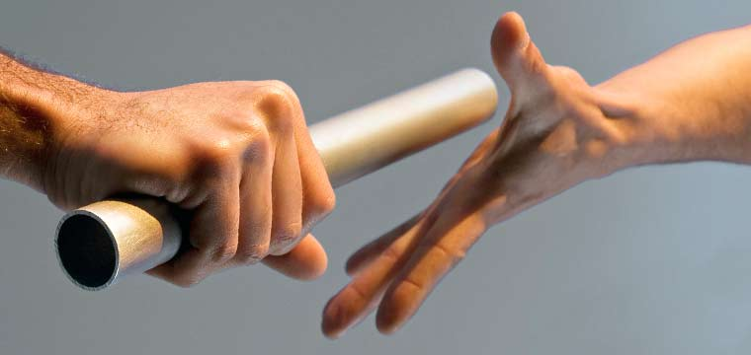
Preserving the Faith
Light & Life
May 28, 2017

Slide 2
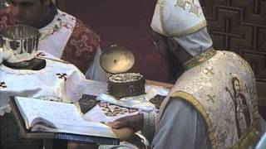
Until the last breath…
“I believe, I believe, I believe and confess to the last breath, that this is the life-giving body of your only-begotten Son, our Lord, God and Savior Jesus Christ…”

Slide 3
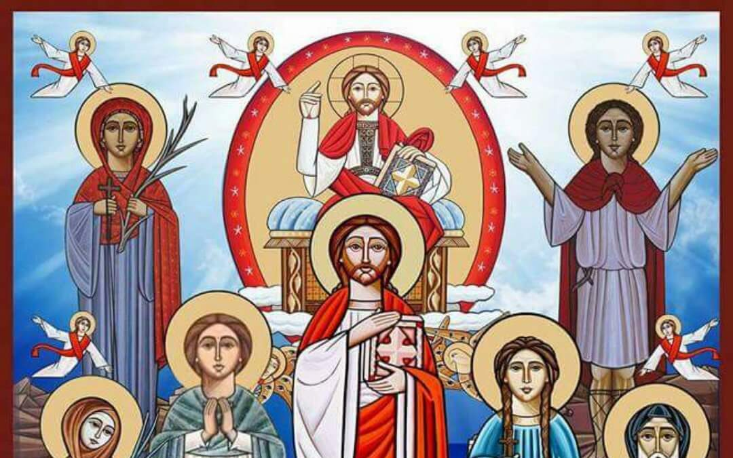

"If the martyrs of the whole world were put on one arm of the balance and the martyrs of Egypt on the other, the balance would tilt in favor of the Egyptians." Tertullian, 3rd century.

Slide 4
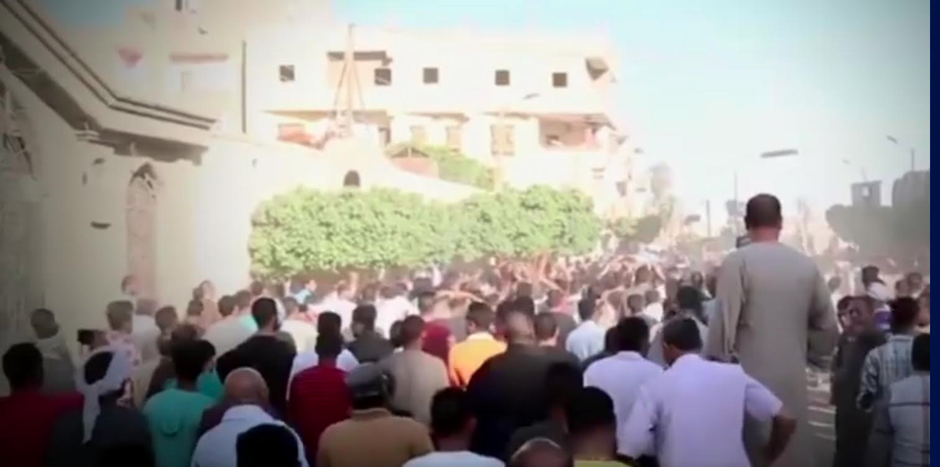

Slide 5

Christian Martyrdom
“For to you it has been granted on behalf of Christ, not only to believe in Him, but also to suffer for His sake” Phil. 1:29
“And if children, then heirs—heirs of God and joint heirs with Christ, if indeed we suffer with Him, that we may also be glorified together. For I consider that the sufferings of this present time are not worthy to be compared with the glory which shall be revealed in us.” Romans 8:17-18

Slide 6
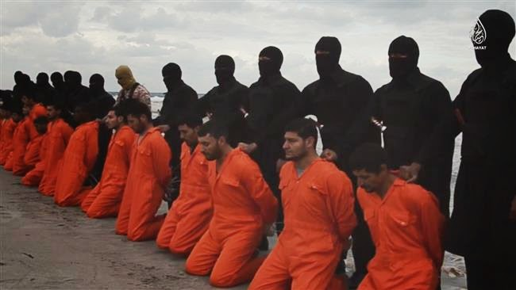
“We call martyrdom perfection, not because the man comes to the end of his life as others, but because he has exhibited the perfect work of love.” St. Clement of Alexandria

Slide 7
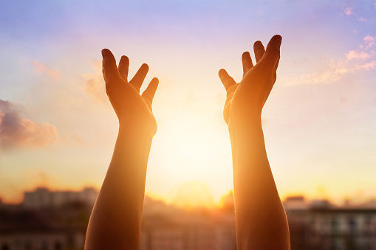
Keeping the Faith
“Beloved, while I was very diligent to write to you concerning our common salvation, I found it necessary to write to you exhorting you to contend earnestly for the faith which was once for all delivered to the saints.” Jude 3

Slide 8
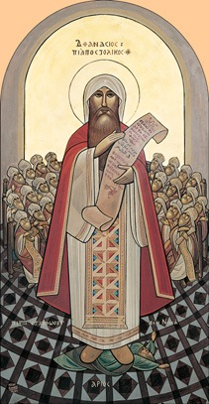
"Let us look at the very tradition, teaching, and faith of the catholic Church from the very beginning, which the Logos [Jesus Christ] gave, the Apostles preached, and the Fathers preserved. Upon this the Church is founded." St. Athanasius, First Letter to Serapion, 28.
“Follow in the footsteps of the flock” Song 1:8

Slide 9
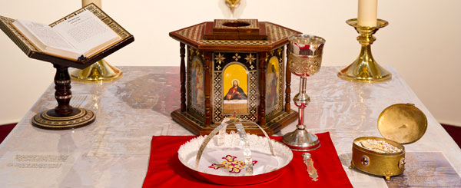
Holy Tradition
Holy scripture
Liturgies
Canons
Creeds
Church Fathers
Icons

Slide 10

The Measuring Stick
"Hold fast that faith which has been believed everywhere, always and by all.” St. Vincent of Lerins
Everywhere
Always
By all

Slide 11
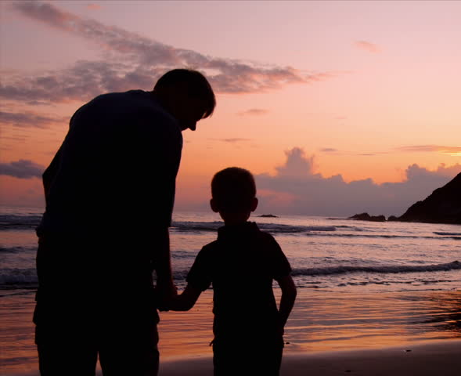
The Way
“Train up a child in the way he should go, and when he is old he will not depart from it.” (Proverbs 22:6)

Slide 12
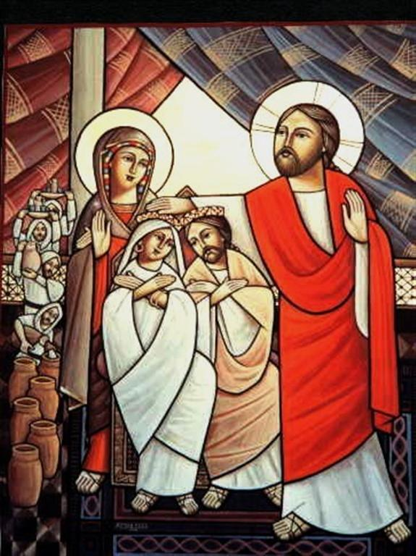
United with the Savior
“Husbands, love your wives, just as Christ also loved the church and gave Himself for her, that He might sanctify and cleanse her with the washing of water by the word, that He might present her to Himself a glorious church, not having spot or wrinkle or any such thing, but that she should be holy and without blemish. So husbands ought to love their own wives as their own bodies; he who loves his wife loves himself.

Slide 13
United with the Savior
For no one ever hated his own flesh, but nourishes and cherishes it, just as the Lord does the church. For we are members of His body, of His flesh and of His bones. ‘For this reason a man shall leave his father and mother and be joined to his wife, and the two shall become one flesh.’ This is a great mystery, but I speak concerning Christ and the church.” Ephesians 5:25-32

Slide 14


Slide 15
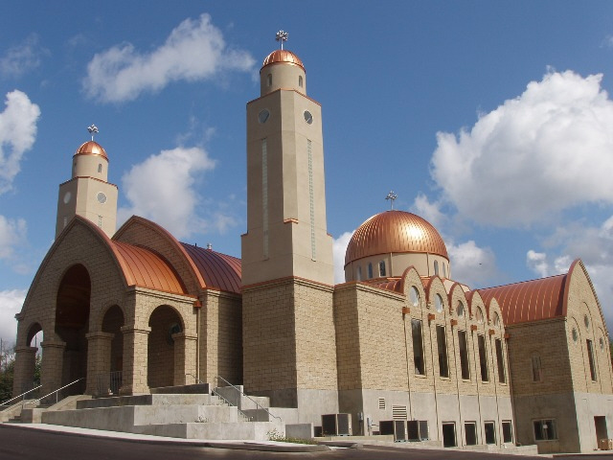
How can I know something is true?
“But if I am delayed, I write so that you may know how you ought to conduct yourself in the house of God, which is the church of the living God, the pillar and ground of the truth.” (1 Timothy 3:15)

Slide 16

The Truth
“Then Saul, still breathing threats and murder against the disciples of the Lord, went to the high priest and asked letters from him to the synagogues of Damascus, so that if he found any who were of the Way, whether men or women, he might bring them bound to Jerusalem….“Saul, Saul, why are you persecuting Me?” Acts 9:1-4

Slide 17
The Truth
“Whether or not I like it is irrelevant. If I love it but its false, I’ll leave. And if I hate it but its true, I must conform.”

Slide 18
The Truth
“The creed does not belong to you unless you have lived it.” St. Philaret of Moscow

Slide 19
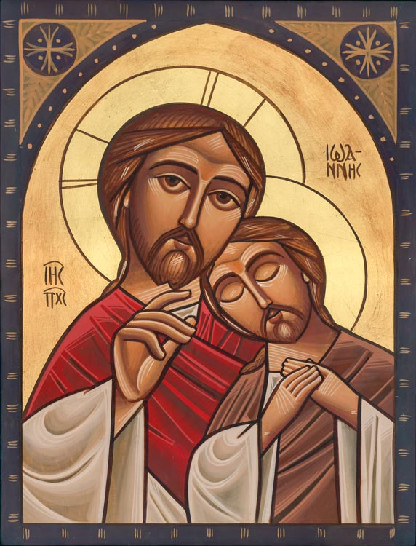
The Life
“the life was manifested, and we have seen, and bear witness, and declare to you that eternal life which was with the Father and was manifested to us” (1 John 1:2)

Slide 20
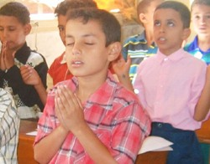
The Life
"A true theologian is one who prays. And one who prays is a true theologian." Evagrius of Pontus, 4th century.

Slide 21
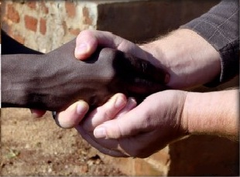
The Life
“Our life and our death is with our neighbor. If we gain our brother, we have gained God, but if we scandalize our brother, we have sinned against Christ.” St. Antony the Great

Slide 22
Orthodox Life
Orthodox Life
Liturgia (Liturgy)
Martyria (Witness)
Diakonia (Service)
Koinonia (Fellowship)

Slide 23
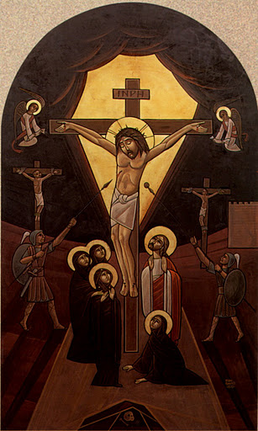
The Link
“I am the way, the truth and the life." John 14:6

Slide 24
How can I understand the Faith?

Slide 25
How can I understand the Faith?
Through the life of the Church.

Slide 26
How can I preserve the Faith?
Use it

Slide 27
How can I preserve the Faith?
Use it
Pass it down as I received it

Slide 28

Struggle
“Yes, and all who desire to live godly in Christ Jesus will suffer persecution.” 2 Timothy 3:12

Slide 29
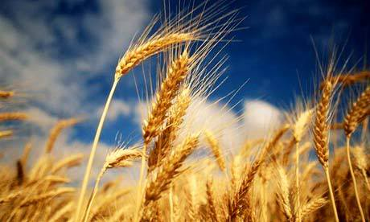
A Grain of Wheat…
“Most assuredly, I say to you, unless a grain of wheat falls into the ground and dies, it remains alone; but if it dies, it produces much grain.” John 12:24

