Slide 1




Your personal prayer trainer
Part 3

Slide 2
Matthew 26:40-41
“What! Could you not watch with Me one hour? Watch and pray, lest you enter into temptation. The spirit indeed is willing, but the flesh is weak.” Matthew 26:40-41

Slide 3
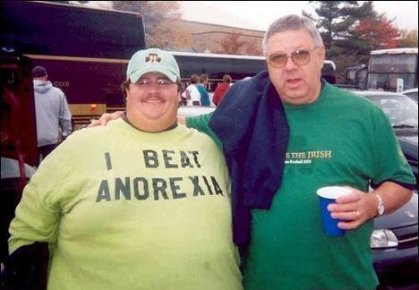

Slide 4

The AGPEYA (Book of Hours) is your personal prayer trainer.

Slide 5
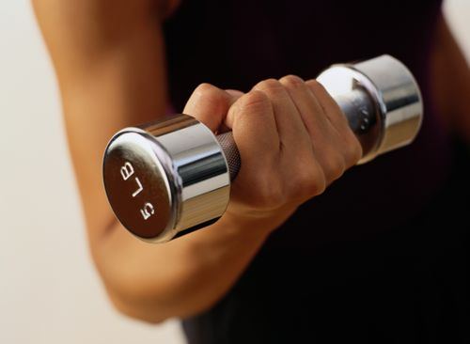
1. Gives the DISCIPLINE I need

Slide 6
Acts 3:1
“Now Peter and John went up together to the temple at the hour of prayer, the ninth hour.”

Slide 7
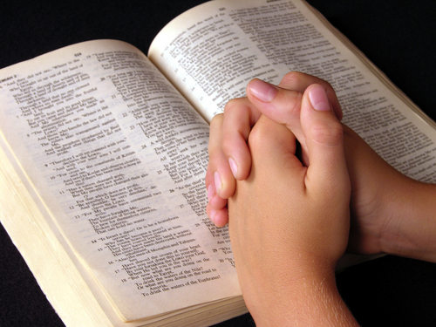
2. Provides me with best WORDS

Slide 8
Romans 8:26
“Likewise the Spirit also helps in our weaknesses. For we do not know what we should pray for as we ought,”

Slide 9
Luke 11:1
"Lord, teach us to pray, as John also taught his disciples."

Slide 10
“…let the light of Your face shine upon us and the light of Your divine knowledge enlighten us” Absolution of the First Hour

Slide 11
“Lord, abolish for us the power of the adversary and all his evil armies, as Your Only-Begotten Son has trampled on them by the power of His life giving cross. Accept us unto You, O our Lord, Jesus Christ, as You accepted the Thief at Your right, while You were hung on the cross.” Absolution of the Ninth Hour

Slide 12
“purify our souls, cleanse bodies, straighten our thoughts, heal our sicknesses, forgive us our sins, deliver from every sadness and heartache” Conclusion of Every Hour

Slide 13
“O Christ our Good Lord, Who is long-suffering, plenteous in mercy and most compassionate, Who loves the righteous and has mercy on sinners, of whom I am the first; Who does not wish the death of a sinner, but rather to return and live” Conclusion of Every Hour

Slide 14
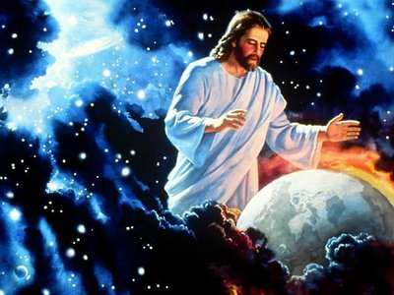
3. Moves focus from my SELF to my GOD

Slide 15
Psalm 3:1-3
“Lord, how they have increased who trouble me! Many are they who rise up against me. Many are they who say of me, ‘There is no help for him in God.” But You, O Lord, are a shield for me, my glory and the One who lifts up my head.”

Slide 16
How should I pray the agpeya?

Slide 17
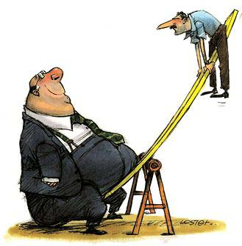
How should I pray the agpeya?
Remember to balance form & spirit

Slide 18
How should I pray the agpeya?
Pray with a spirit of fear & humility

Slide 19
How should I pray the agpeya?
Pray with a spirit of fear & humility
Pray even when I don’t want to

Slide 20
How should I pray the agpeya?
Pray with a spirit of fear & humility
Pray even when I don’t want to
Pray using all of my senses

Slide 21
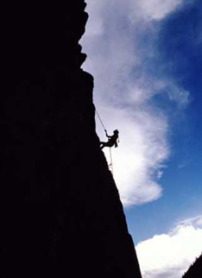

Slide 22
“Call to Me, and I will answer you, and show you great and mighty things, which you do not know.”
Jeremiah 33:3

