Slide 1
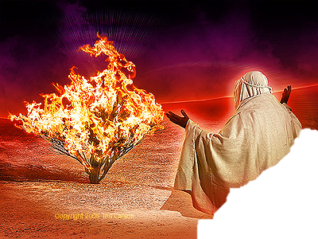
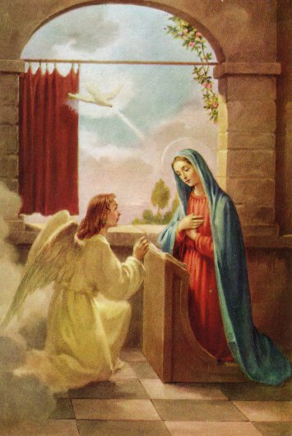

Old Eve
Vs.
New Eve

Slide 2
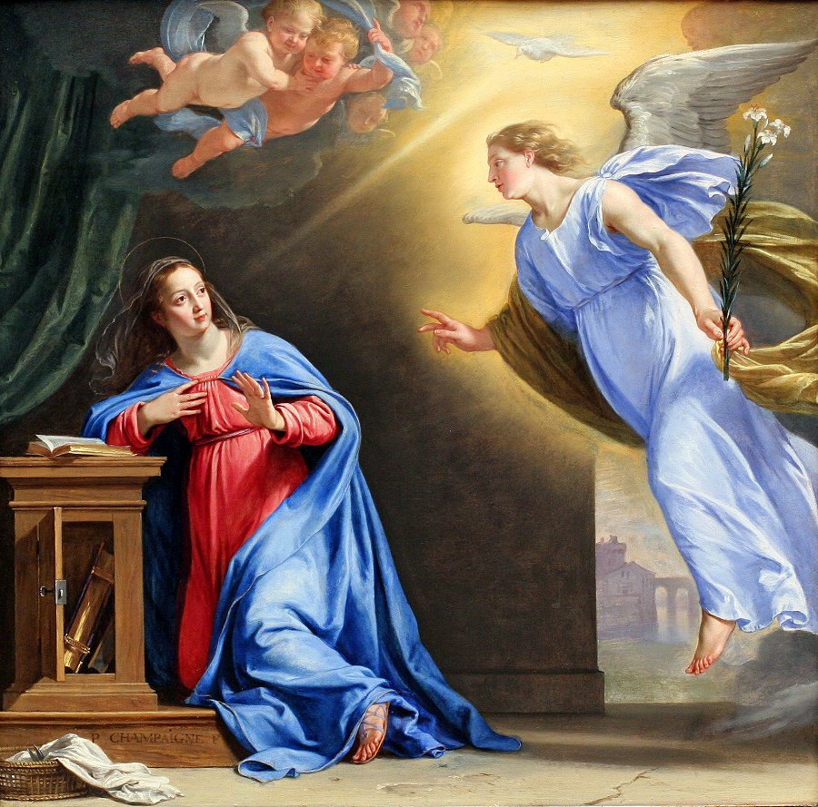
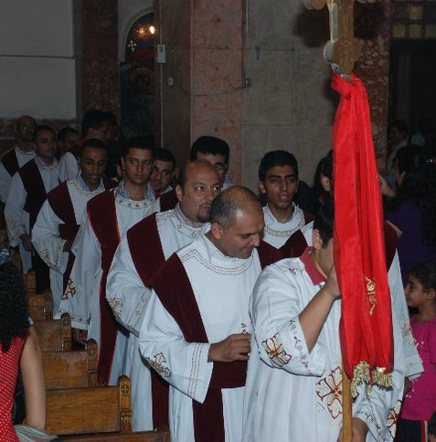
Feast of Annunciation
First major feast for the Lord Jesus
  Orthodox Church celebrates 7 major feast and 7 minor feasts
Feast is 9 months ahead of the coming Christmas
Deacons pray using a happy tone

Slide 3
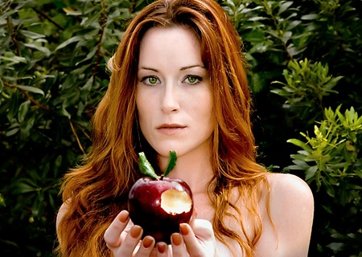
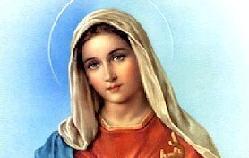

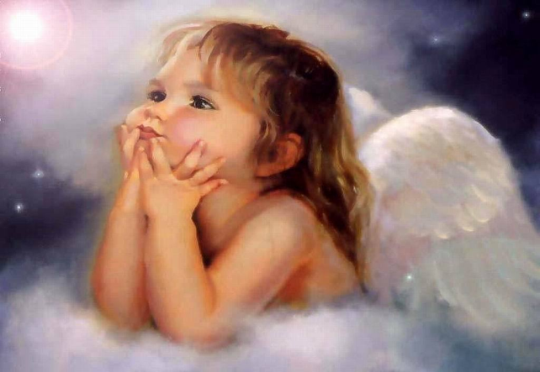


Annunciation is a correction of Human’s fall

Slide 4

the life was manifested, and we have seen, and bear witness
Serpent talks to Eve
Eve listens to the message and
accept it
The fall of the Human being in
slavery to the sin

Slide 5
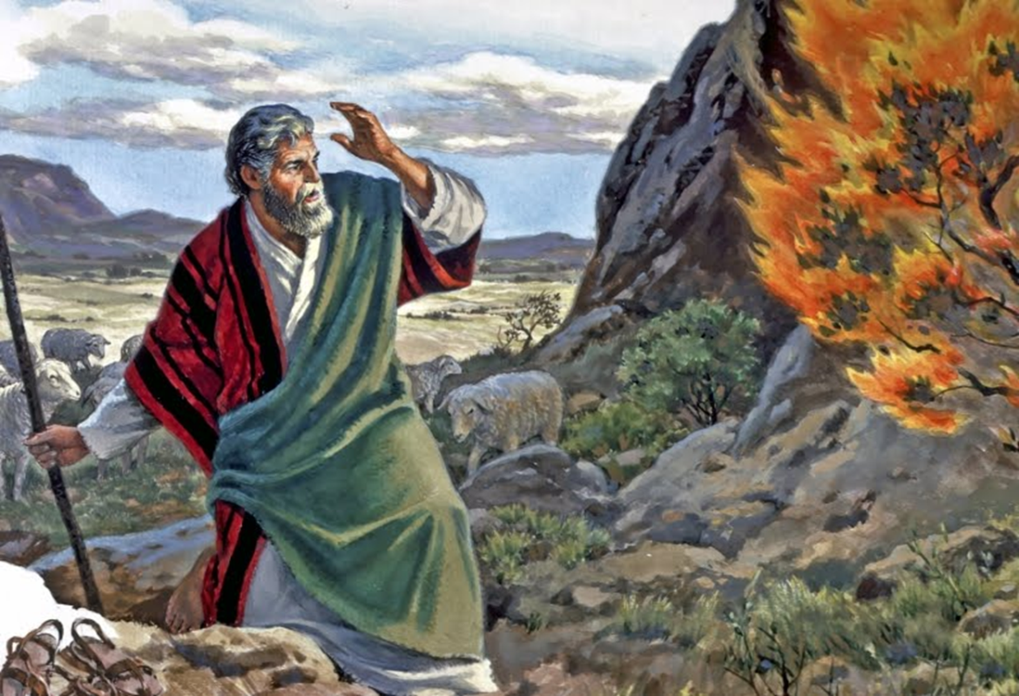
the life was manifested, and we have seen, and bear witness
God talks to Moses in the bush
Moses listens to the message and accept it
Hebrews are saved from slavery in Egypt

Slide 6
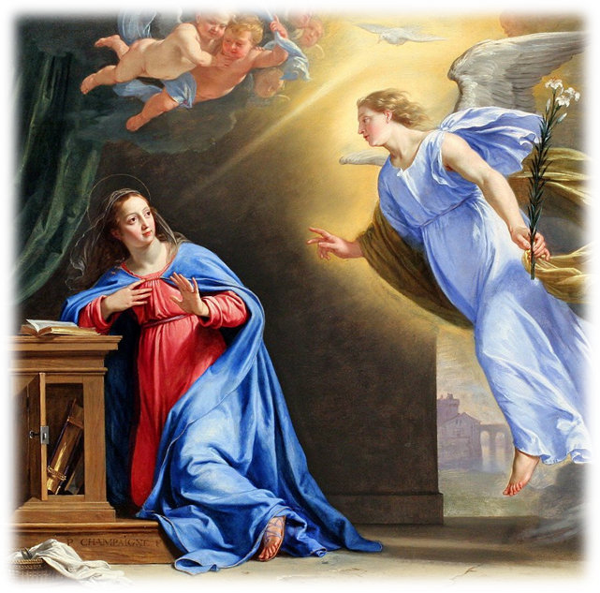
the life was manifested, and we have seen, and bear witness
Gabriel, the angel, announce to V. Mary the joyful message
Virgin Mary listens to the message and accept it
Human being receives the
salvation

Slide 7
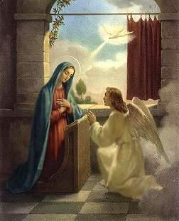
Verse to learn
Psalm 45:10-11
Listen, O daughter,
Consider and incline your ear;
Forget your own people also, and your father's house;
So the King will greatly desire your beauty;
Because He is your Lord.

