Slide 1
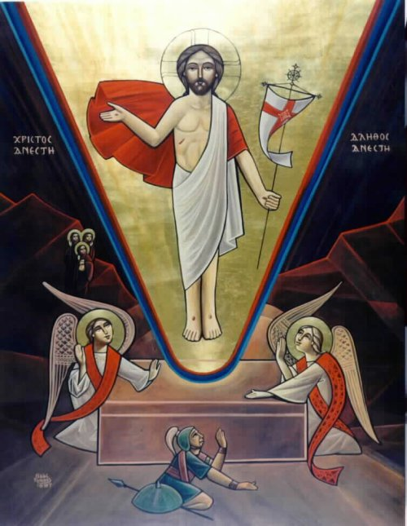
The I Am Gospels – Who HE Is and Who We Are

Slide 2
The Journey of the holy Fifty

Slide 3
Experiencing Christ in the Holy Fifty
Day 1 – Feast of the Resurrection | “He is Risen, He is Not Here”
Day 8 – Feast of the New Sunday “Thomas Sunday” | “Blessed are those who have not seen and yet have believed.”
Week 2 | “ I am the Bread which came down from heaven.”
Week 3 | “The water that I shall give… …a fountain of water springing up into everlasting life.”
Week 4 | “I have come as a light into the world…”
Week 5 | “I am The Way, The Truth and the Life”
Day 40 – Feast of the Ascension | “Behold, I send the Promise of My Father upon You;”
Week 6 | “…I have overcome the world”
Week 7 – Feast of Pentecost | “When the Helper comes….”

Slide 4
I Be in the I AM
God is I AM.
thus
we are I BE_

Slide 5
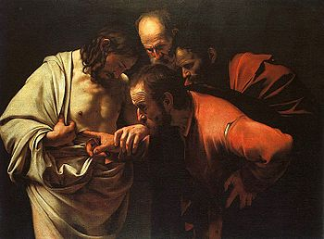
Thomas Sunday – I BELIEVE

Slide 6
The New Creation
So Jesus said to them again, “Peace to you! As the Father has sent Me, I also send you.” And when He had said this, He breathed on them, and said to them, “Receive the Holy Spirit. If you forgive the sins of any, they are forgiven them; if you retain the sins of any, they are retained.”
John 20: 21-23

Slide 7
Thomas Sunday – I BELIEVE
The Church celebrates this important event because it is considered a day when the truth of the Resurrection is clearly affirmed. Initially, even the disciples, after they witnessed Christ, thought that He was a phantom or a spirit; however, after He proved the reality of His resurrected Body, they believed. Importantly, the Church looks at this day as a confirmation of the resurrection of the Lord of glory; hence, the church uses and considers it a vital aid to every person who requires seeing before believing.

Slide 8
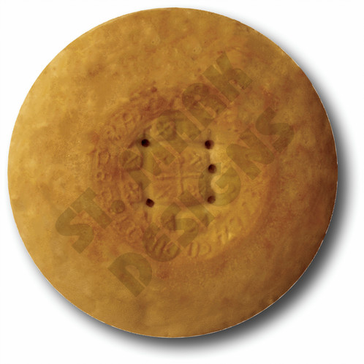
"I AM The Bread of Life" - I Be HUNGRY

Slide 9
The Bread for the New Creation
"I am the bread of life. He who comes to Me shall never hunger, and he who believes in Me shall never thirst. But I said to you that you have seen Me and yet do not believe. All that the Father gives Me will come to Me, and the one who comes to Me I will by no means cast out.
John 6:35- 37

Slide 10
I BE HUNGRY – Eat 2 Meals
Daily Meal – But He answered and said, “It is written, Man shall not live by bread alone, but by every word that proceeds from the mouth of God. ” Matt 4:4
Feast Meal - The cup of blessing which we bless, is it not the communion of the blood of Christ? The bread which we break, is it not the communion of the body of Christ? For we, though many, are one bread and one body; for we all partake of that one bread. 1 Cor

Slide 11
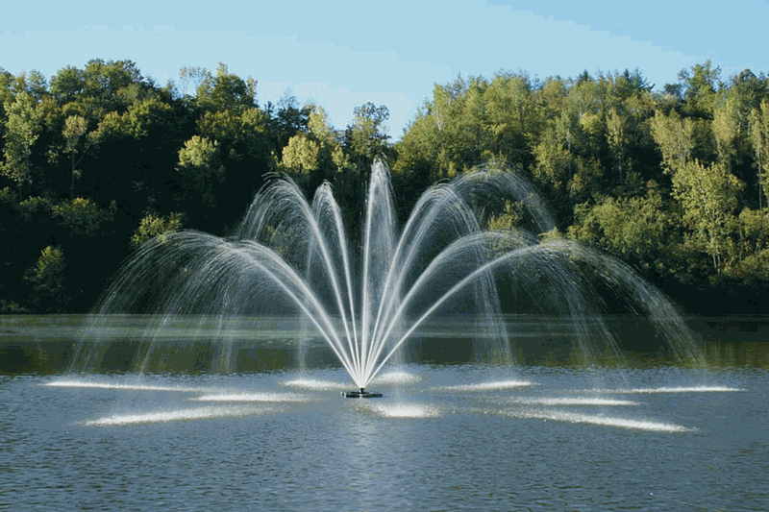
LivIng Water – I BE A Fountain

Slide 12
The Living Water
Jesus answered and said to her, “If you knew the gift of God, and who it is who says to you, ‘Give Me a drink,’ you would have asked Him, and He would have given you living water.” John 4:10
Jesus answered and said to her, “Whoever drinks of this water will thirst again, but whoever drinks of the water that I shall give him will never thirst. But the water that I shall give him will become in him a fountain of water springing up into everlasting life.” The woman said to Him, “Sir, give me this water, that I may not thirst, nor come here to draw.” John 4:13-15

Slide 13
The Fountain supplies the Water
And many of the Samaritans of that city believed in Him because of the word of the woman who testified, “He told me all that I ever did.” So when the Samaritans had come to Him, they urged Him to stay with them; and He stayed there two days. And many more believed because of His own word. Then they said to the woman, “Now we believe, not because of what you said, for we ourselves have heard Him and we know that this is indeed the Christ, the Savior of the world. John 4:39-42

Slide 14

LiGht of the World – I BE SANCTIFIED

Slide 15
Walk While You Have the Light
“A little while longer the light is with you. Walk while you have the light, lest darkness overtake you; he who walks in darkness does not know where he is going. While you have the light, believe in the light, that you may become sons of light.”
John 12:35-36
"I have come as a light into the world, that whoever believes in Me should not abide in darkness."
John 12:46

Slide 16
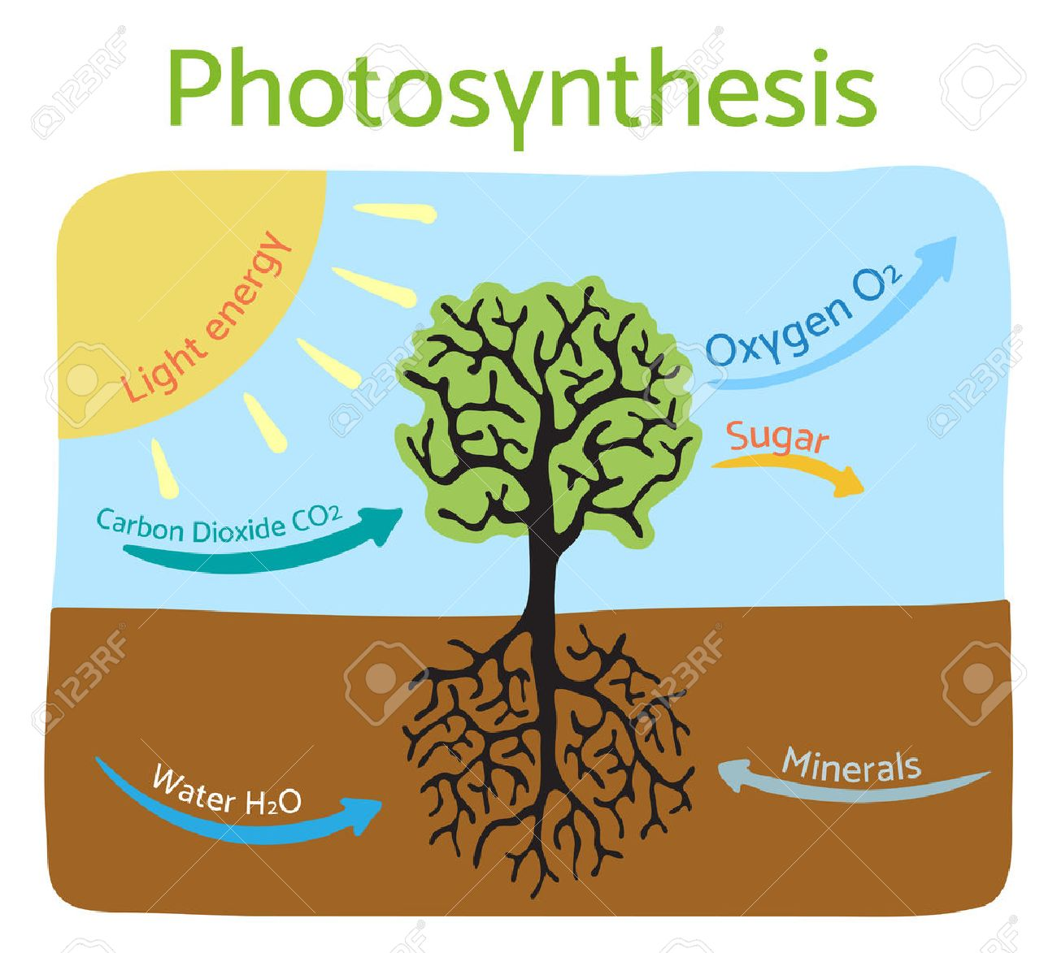
Confession = Human Photosynthesis

Slide 17

The Way, the truth, the Life – I BE A GUIDE, Bold & Hopeful

Slide 18
One Way to The Father
Thomas said to Him, “Lord, we do not know where You are going, and how can we know the way?”
Jesus said to him, “I am the way, the truth, and the life. No one comes to the Father except through Me.
“If you had known Me, you would have known My Father also; and from now on you know Him and have seen Him.
John 14: 5-7

Slide 19
One Way to The Father
Therefore, brethren, having boldness to enter the Holiest by the blood of Jesus, by a new and living way which He consecrated for us, through the veil, that is, His flesh, and having a High Priest over the house of God, let us draw near with a true heart in full assurance of faith, having our hearts sprinkled from an evil conscience and our bodies washed with pure water. Let us hold fast the confession of our hope without wavering, for He who promised is faithful. And let us consider one another in order to stir up love and good works, not forsaking the assembling of ourselves together, as is the manner of some, but exhorting one another, and so much the more as you see the Day approaching.
Hebrews 10:19 -35

Slide 20
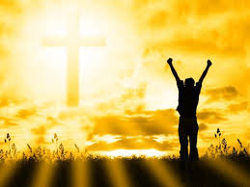
I HAVE Overcome The World – BE JOYFUL

Slide 21
Christ is Our Victory
These things I have spoken to you, that in Me you may have peace. In the world you will have tribulation; but be of good cheer, I have overcome the world.”
John 16:33

Slide 22
Claim Your Victory by Him
But thanks be to God, who gives us the victory through our Lord Jesus Christ.
Therefore, my beloved brethren, be steadfast, immovable, always abounding in the work of the Lord, knowing that your labor is not in vain in the Lord.
1 Corinthians 15:57-58

Slide 23
Joy = Proof
Rejoice in the Lord always. Again I will say, rejoice!
Let your gentleness be known to all men. The Lord is at hand.
Be anxious for nothing, but in everything by prayer and supplication, with thanksgiving, let your requests be made known to God; and the peace of God, which surpasses all understanding, will guard your hearts and minds through Christ Jesus.
Philippians 4:4-6

Slide 24
Meditate On These Things
Finally, brethren, whatever things are true, whatever things are noble, whatever things are just, whatever things pure, whatever things are lovely, whatever things are of good report, if there is any virtue and if there is anything praiseworthy—meditate on these things. The things which you learned and received and heard and saw in me, these do, and the God of peace will be with you.
Philippians 4:8-9

