Slide 1
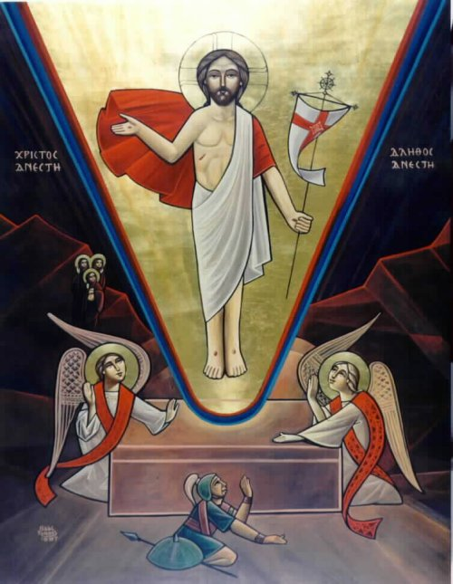
The I Am Gospels – Who HE Is and Who We Are

Slide 2
The Journey of the holy Fifty

Slide 3
Experiencing Christ in the Holy Fifty
Day 1 – Feast of the Resurrection | “He is Risen, He is Not Here”
Day 8 – Feast of the New Sunday “Thomas Sunday” | “Blessed are those who have not seen and yet have believed.”
Week 2 | “ I am the Bread which came down from heaven.”
Week 3 | “The water that I shall give… …a fountain of water springing up into everlasting life.”
Week 4 | “I have come as a light into the world…”
Week 5 | “I am The Way, The Truth and the Life”
Day 40 – Feast of the Ascension | “Behold, I send the Promise of My Father upon You;”
Week 6 | “…I have overcome the world”
Week 7 – Feast of Pentecost | “When the Helper comes….”

Slide 4
I Be in the I AM
God is I AM.
thus
we are I BE_

Slide 5
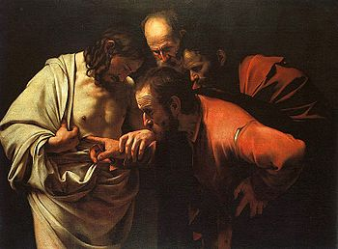
Thomas Sunday – I BELIEVE

Slide 6
Resurrection = Power Towards Us
that the God of our Lord Jesus Christ, the Father of glory, may give to you the spirit of wisdom and revelation in the knowledge of Him, the eyes of your understanding being enlightened; that you may know what is the hope of His calling, what are the riches of the glory of His inheritance in the saints, and what is the exceeding greatness of His power toward us who believe, to the working of His mighty power which He worked in Christ when He raised Him from the dead and seated Him at His right hand in the heavenly places,
Eph 1:17-20

Slide 7
The Day of New Creation
Reading | Passage | Theme | Key Verse
Pauline Epistle | Eph 4:20 -32 | A New Man | …and be renewed in the spirit of your mind, and that you put on the new man which was created according to God…
Liturgy Gospel | Jn 20:19-31 | A New Blessing | “Thomas, because you have seen Me, you have believed. Blessed are those who have not seen and yet have believed.”
The storyline of the Scriptures is the story of the new creation through the death and resurrection of Christ. By His death on the cross, Jesus brought about the new creation.

Slide 8
The First Creation
Then God said, “Let Us make man in Our image, according to Our likeness; let them have dominion over the fish of the sea, over the birds of the air, and over the cattle, over all the earth and over every creeping thing that creeps on the earth.” So God created man His own image; in the image of God He created him; male and female He created them. Then God blessed them, and God said to them, “Be fruitful and multiply; fill the earth and subdue it; have dominion over the fish of the sea, over the birds of the air, and over every living thing that moves on the earth.” Gen 1: 26 – 28
And the Lord God formed man of the dust of the ground, and breathed into his Gen. nostrils the breath of life; and man became a living being. Gen 2:7

Slide 9
The New Creation
So Jesus said to them again, “Peace to you! As the Father has sent Me, I also send you.” And when He had said this, He breathed on them, and said to them, “Receive the Holy Spirit. If you forgive the sins of any, they are forgiven them; if you retain the sins of any, they are retained.” John 20: 21-23

Slide 10
Thomas Sunday – I BELIEVE
Truly, Thomas is a characterization of a great deal of people who have willingly submitted to worldly concerns; hence, they do not believe unless they see or hear. For this very reason, the Lord of glory is encouraging faith in these people. He even came especially to remove their doubts and strengthen their faith.
The Church celebrates this important event because it is considered a day when the truth of the Resurrection is clearly affirmed. Initially, even the disciples, after they witnessed Christ, thought that He was a phantom or a spirit; however, after He proved the reality of His resurrected Body, they believed. Importantly, the Church looks at this day as a confirmation of the resurrection of the Lord of glory; hence, the church uses and considers it a vital aid to every person who requires seeing before believing.

Slide 11
No Resurrection … No Faith… No Life
But if there is no resurrection of the dead, then Christ is not risen. And if Christ is not risen, then our preaching is empty and your faith is also empty. Yes, and we are found false witnesses of God, because we have testified of God that He raised up Christ, whom He did not raise up—if in fact the dead do not rise. For if the dead do not rise, then Christ is not risen. And if Christ is not risen, your faith is futile; you are still in your sins! Then also those who have fallen asleep in Christ have perished. if in this life only we have hope in Christ, we are of all men the most pitiable.
But now Christ is risen from the dead, and has become the firstfruits of those who have fallen asleep. 1 Cor 15:13 -20

Slide 12
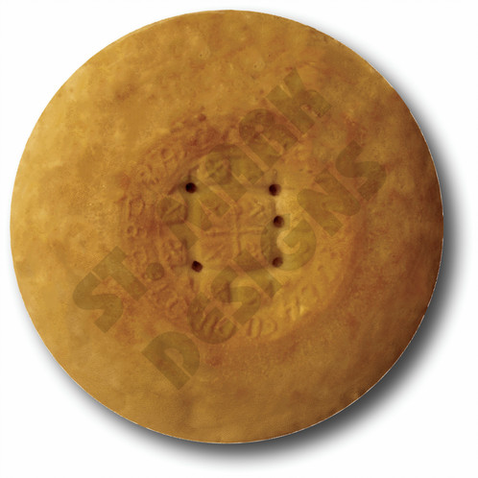
"I AM The Bread of Life" - I Be HUNGRY

Slide 13
The Bread for the New Creation
"I am the bread of life. He who comes to Me shall never hunger, and he who believes in Me shall never thirst. But I said to you that you have seen Me and yet do not believe. All that the Father gives Me will come to Me, and the one who comes to Me I will by no means cast out. For I have come down from heaven, not to do My own will, but the will of Him who sent Me. This is the will of the Father who sent Me, that of all He has given Me I should lose nothing, but should raise it up at the last day. And this is the will of Him who sent Me, that everyone who sees the Son and believes in Him may have everlasting life; and I will raise him up at the last day.” – John 6:35- 40

Slide 14
The Bread for the New Creation
Most assuredly, I say to you, he who believes in Me has everlasting life. I am the bread of life. Your fathers ate the manna in the wilderness, and are dead. This is the bread which comes down from heaven, that one may eat of it and not die. I am the living bread which came down from heaven. If anyone eats of this bread, he will live forever; the bread that I shall give is My flesh, which I shall give for the life of the world.” – John 6:47-51

Slide 15
I BE HUNGRY – Eat 2 Meals
Daily Meal – But He answered and said, “It is written, Man shall not live by bread alone, but by every word that proceeds from the mouth of God. ” Matt 4:4
Feast Meal - The cup of blessing which we bless, is it not the communion of the blood of Christ? The bread which we break, is it not the communion of the body of Christ? For we, though many, are one bread and one body; for we all partake of that one bread. 1 Cor

Slide 16
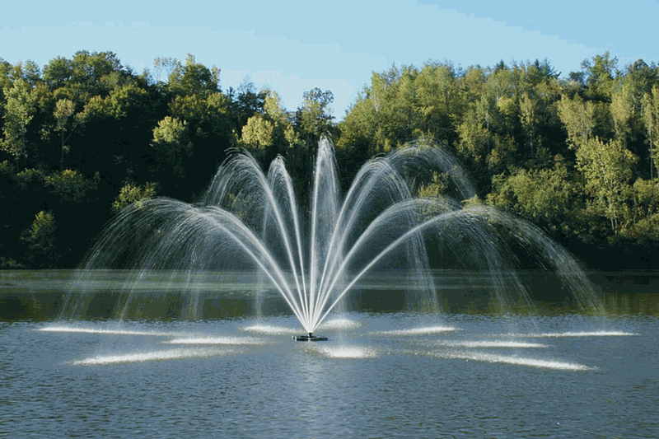
LivIng Water – I BE A Fountain

Slide 17
The Living Water
Jesus answered and said to her, “If you knew the gift of God, and who it is who says to you, ‘Give Me a drink,’ you would have asked Him, and He would have given you living water.” John 4:10
Jesus answered and said to her, “Whoever drinks of this water will thirst again, but whoever drinks of the water that I shall give him will never thirst. But the water that I shall give him will become in him a fountain of water springing up into everlasting life.” The woman said to Him, “Sir, give me this water, that I may not thirst, nor come here to draw.” John 4:13-15

Slide 18
The Fountain supplies the Water
And many of the Samaritans of that city believed in Him because of the word of the woman who testified, “He told me all that I ever did.” So when the Samaritans had come to Him, they urged Him to stay with them; and He stayed there two days. And many more believed because of His own word. Then they said to the woman, “Now we believe, not because of what you said, for we ourselves have heard Him and we know that this is indeed the Christ, the Savior of the world. John 4:39-42

Slide 19
BE A FOUNTAIN
Therefore, as the elect of God, holy and beloved, put on tender mercies, kindness, humility, meekness, longsuffering; bearing with one another, and forgiving one another, if anyone has a complaint against another; even as Christ forgave you, so you also must do. above all these things put on love, which is the bond of perfection. And let the peace of God rule in your hearts, to which also you were called in one body; and be thankful. Let the word of Christ dwell in you richly in all wisdom, teaching and admonishing one another in psalms and hymns and spiritual songs, singing with grace in your hearts to the Lord. And whatever you do in word or deed, do all in the name of the Lord Jesus, giving thanks to God the Father through Him. Col.3: 12 - 17

Slide 20
Let Love Flow
And we also ought to lay down our lives for the brethren. whoever has this world’s goods, and sees his brother in need, and shuts up his heart from him, how does the love of God abide in him? My little children, let us not love in word or in tongue, but in deed and in truth.
And by this we know that we are of the truth, and shall assure our hearts before Him. For if our heart condemns us, God is greater than our heart, and knows all things. Beloved, if our heart does not condemn us, we have confidence toward God. And whatever we ask we receive from Him, because we keep His commandments and do those things that are pleasing in His sight.
And this is His commandment: that we should believe on the name of His Son Jesus Christ and love one another, as He gave us commandment.
1 John 3:18-23

