Slide 1
Headed in the Same Direction
December 31, 2018

Slide 2
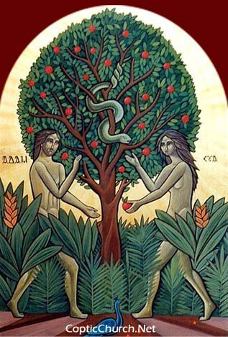
Before the fall: “this is bone of my bones and flesh of my flesh.” (Genesis 2:23)

Slide 3
Before the fall: “this is bone of my bones and flesh of my flesh.” (Genesis 2:23)
After the fall: “The woman whom You gave to be with me, she gave me of the tree, and I ate.” (Genesis 3:12)

Slide 4

St. Mark’s 2019 Theme is UNITY!

Slide 5
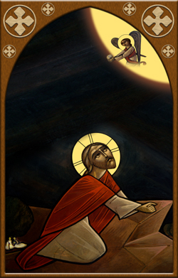
20 “I do not pray for these alone, but also for those who will believe in Me through their word; 21 that they all may be one, as You, Father, are in Me, and I in You; that they also may be one in Us, that the world may believe that You sent Me. 22 And the glory which You gave Me I have given them, that they may be one just as We are one: 23 I in them, and You in Me; that they may be made perfect in one, and that the world may know that You have sent Me, and have loved them as You have loved Me. (John 17:20-23)

Slide 6

What’s the goal?
13 till we all come to the unity of the faith and of the knowledge of the Son of God, to a perfect man, to the measure of the stature of the fullness of Christ; (Ephesians 4:13)

Slide 7
Edifying of the body
11 And He Himself gave some to be apostles, some prophets, some evangelists, and some pastors and teachers, 12 for the equipping of the saints for the work of ministry, for the edifying of the body of Christ, 13 till we all come to the unity of the faith and of the knowledge of the Son of God, to a perfect man, to the measure of the stature of the fullness of Christ; (Eph. 4:11-13)

Slide 8
How can I fulfill my role within the body?
1) Offer personal repentance (getting right with God)

Slide 9
How can I fulfill my role within the body?
1) Offer personal repentance
Therefore, to him who knows to do good and does not do it, to him it is sin. (James 4:17)

Slide 10
How can I fulfill my role within the body?
1) Offer personal repentance
“By your sin you have wounded the body of Christ with a wound which no one can heal except you; and if you do not come back this Body remains wounded.” (St. Justin Martyr)

Slide 11
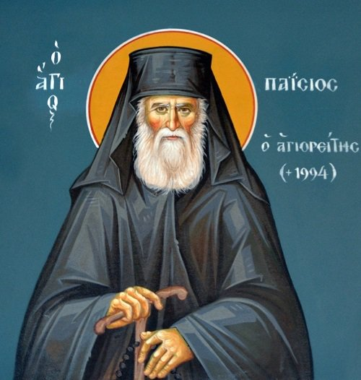
"If you want to help the Church, it is better to try to correct yourself, rather than be looking to correct others. If you manage to correct yourself, one small part of the Church is immediately corrected. Naturally, if everyone did the same, the body of the Church would be in good health. But, today, people concern themselves with anything but themselves. You see, judging others is easy, whereas working on yourself takes effort." (Elder Paisios of Mount Athos)

Slide 12
How can I fulfill my role within the body?
1) Offer personal repentance (getting right with God)
2) Reconciliation (getting right with others)

Slide 13

A different standard…
Whoever hates his brother is a murderer, and you know that no murderer has eternal life abiding in him. (1 John 3:15)
If someone says, “I love God,” and hates his brother, he is a liar; for he who does not love his brother whom he has seen, how can he love God whom he has not seen? (1 John 4:20)

Slide 14
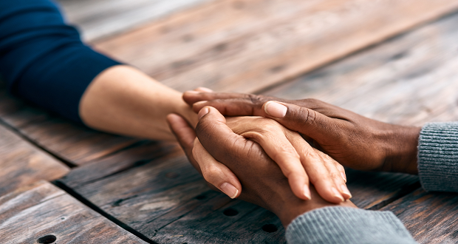
Blessed are the peacemakers, For they shall be called sons of God. (Matt. 5:9)

Slide 15
Blessed are the peacemakers, For they shall be called sons of God. (Matt. 5:9)
Brethren, if a man is overtaken in any trespass, you who are spiritual restore such a one in a spirit of gentleness, considering yourself lest you also be tempted (Gal. 6:1)

Slide 16
How can I fulfill my role within the body?
1) Offer personal repentance (getting right with God)
2) Reconciliation (getting right with others)
3) Be an active participant in the Church

Slide 17
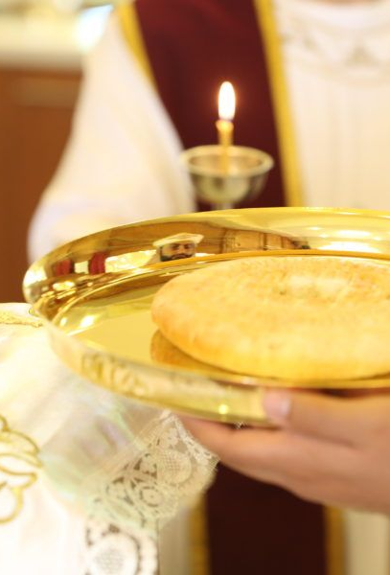
Let us learn the wonder of this sacrament, the purpose of its institution, the effects it produces. We become a single body, according to Scripture, members of His flesh and bone of His bones. This is what is brought about by the food that He gives us. He blends Himself with us so that we may all become one single entity in the way the body is joined to the head. (St. John Chrysostom, Homily on John, 46)

Slide 18
Make us all worthy, O our Master, to partake of Your holies unto the purification of our souls, our bodies, and our spirits that we may become one body and one spirit, and may have a share and an inheritance with all the saints who have pleased You since the beginning.
53 Then Jesus said to them, “Most assuredly, I say to you, unless you eat the flesh of the Son of Man and drink His blood, you have no life in you. (John 6:53)

Slide 19
13 till we all come to the unity of the faith and of the knowledge of the Son of God, to a perfect man, to the measure of the stature of the fullness of Christ; 14 that we should no longer be children, tossed to and fro and carried about with every wind of doctrine, by the trickery of men, in the cunning craftiness of deceitful plotting, 15 but, speaking the truth in love, may grow up in all things into Him who is the head—Christ— 16 from whom the whole body, joined and knit together by what every joint supplies, according to the effective working by which every part does its share, causes growth of the body for the edifying of itself in love. (Eph. 4:13-16)

