Slide 1
Irrational Love Series Campaign
God Seeks those who Hide

Slide 2
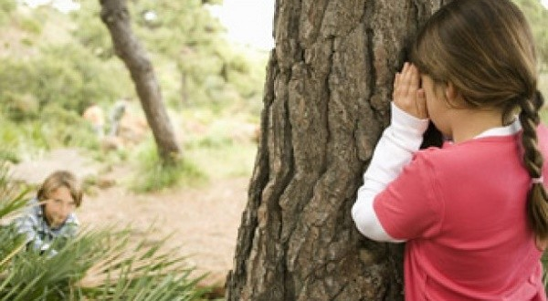
Hide and Go Seek

Slide 3
Genesis 3:8-11
⁸ And they heard the sound of the Lord God walking in the garden in the cool of the day, and Adam and his wife hid themselves from the presence of the Lord God among the trees of the garden.
⁹ Then the Lord God called to Adam and said to him, “Where are you?”
¹⁰ So he said, “I heard Your voice in the garden, and I was afraid because I was naked; and I hid myself.”
¹¹ And He said, “Who told you that you were naked?

Slide 4
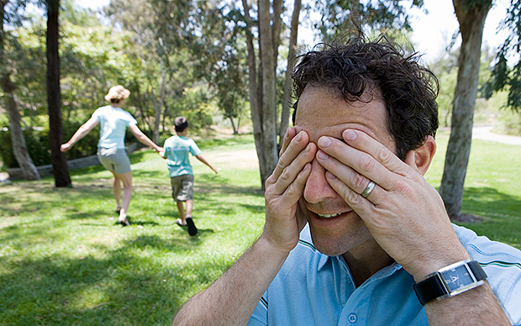
The seeker deliberately allows those who hide to get away.

Slide 5
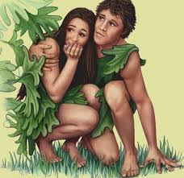
Hiddenness is always the first response to an awareness that I have sinned.

Slide 6
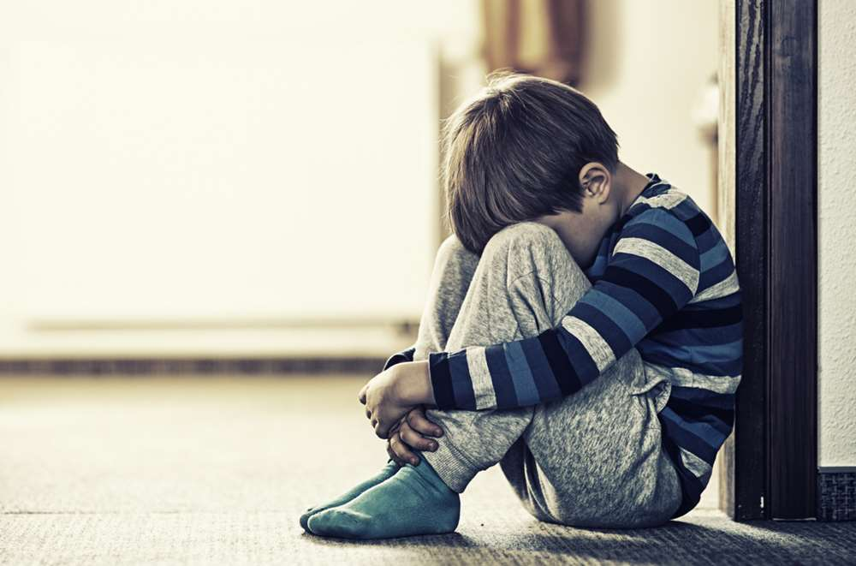
I hide because I don’t want to be exposed in my fallenness

Slide 7
I can only be fully loved if I am fully known

Slide 8

The kind of presence God desires cannot be forced

Slide 9
I cannot make it out of hiding on my own
I need to be sought

Slide 10
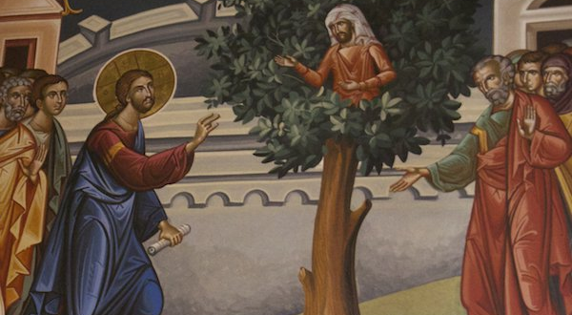
Zaccheus

Slide 11

The human heart can’t deal with the guilt of secret shame.

Slide 12
The sign of a life that has truly been found is that the primary desire in response to sin becomes the desire to make things right

