Slide 1
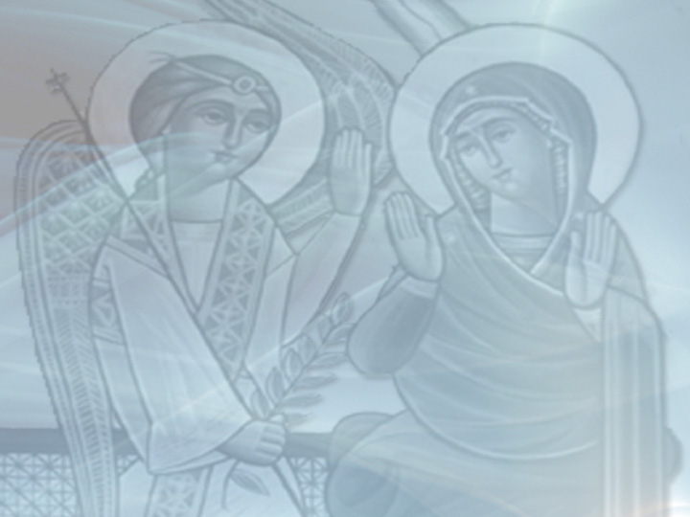
Ready to Wait
First Sunday of Kiahk
December 12, 2010
Luke 1:1-25

Slide 2
Romans 1:1-17
James 1:1-18
Acts 1:1-14
Luke 1:1-25
Notice a pattern???

Slide 3
Romans 1:1-17
James 1:1-18
Acts 1:1-14
Luke 1:1-25
Notice a pattern???
Today is the beginning!

Slide 4
How long, O Lord? Will You forget me forever? How long will You hide Your face from me?. Consider and hear me, O Lord my God.
From heaven the Lord viewed the earth to hear the groaning of the prisoner. To declare the name of the Lord in Zion, and His praise in Jerusalem.
You will arise and have mercy on Zion; For the time to favor her, Yes, the set time, has come. For the Lord shall build up Zion; He shall appear in His glory.

Slide 5
Today we receive the promise
but we must WAIT for the fulfillment
“But behold, you will be mute and not able to speak until the day these things take place, because you did not believe my words which will be fulfilled in their own time.” Luke 1:20

Slide 6
“My brethren, count it all joy when you fall into various trials, knowing that the testing of your faith produces patience. But let patience have its perfect work, that you may be perfect and complete, lacking nothing.” James 1:2-4

Slide 7
“My brethren, count it all joy when you fall into various trials, knowing that the testing of your faith produces patience. But let patience have its perfect work, that you may be perfect and complete, lacking nothing.” James 1:2-4
Waiting on Lord patiently opens doors to blessing that hurrying shuts

Slide 8
Luke 1:6-7
“And they were both righteous before God, walking in all the commandments and ordinances of the Lord blameless.

Slide 9
Luke 1:6-7
“And they were both righteous before God, walking in all the commandments and ordinances of the Lord blameless.
But they had no child, because Elizabeth was barren, and they were both well advanced in years.”

Slide 10
Don’t ask WHEN?

Slide 11
Don’t ask WHEN?
“Therefore, when they had come together, they asked Him, saying, “Lord, will You at this time restore the kingdom to Israel?” And He said to them, “It is not for you to know times or seasons which the Father has put in His own authority.” Acts 1:6-7

Slide 12
Don’t ask WHEN?
Don’t ask HOW?

Slide 13
Don’t ask WHEN?
Don’t ask HOW?
“And the angel answered and said to him, “I am Gabriel, who stands in the presence of God, and was sent to speak to you and bring you these glad tidings.” Luke 1:19

Slide 14
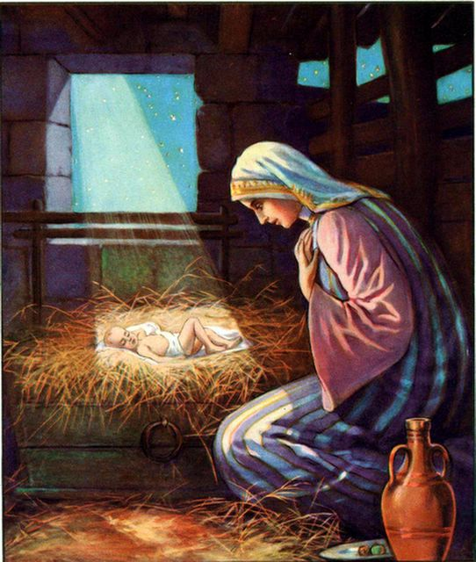
Are you ready to wait?

