Slide 1
Keep Your Eyes on the Prize
Fourth Sunday of Mesra
August 29, 2010
Mark 13:3-37

Slide 2
How????
“But when you hear of wars and rumors of wars, do not be troubled; for such things must happen, but the end is not yet.” Mark 13:7

Slide 3
Isn’t it bad to be confident in heaven?

Slide 4
Isn’t it bad to be confident in heaven?
Thinking about heaven will change
how I live on earth.

Slide 5
Isn’t it bad to be confident in heaven?
Thinking about heaven will change
how I live on earth.

Slide 6
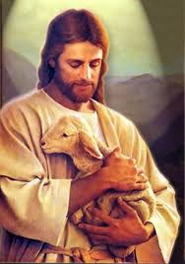
“looking unto Jesus, the author and finisher of our faith” Hebrews 12:2

