Slide 1
Fasting as Feasting
Light and Life
11/19/2017

Slide 2
St. Athanasius the Great
“Devils take great delight in fullness, and drunkenness and bodily comfort. Fasting possesses great power and it works glorious things. To fast is to banquet (feast) with angels.”

Slide 3
Better and fatter
¹⁵ And at the end of ten days their features appeared better and fatter in flesh than all the young men who ate the portion of the king’s delicacies. ¹⁶ Thus the steward took away their portion of delicacies and the wine that they were to drink, and gave them vegetables. Dan 1:15,16

Slide 4
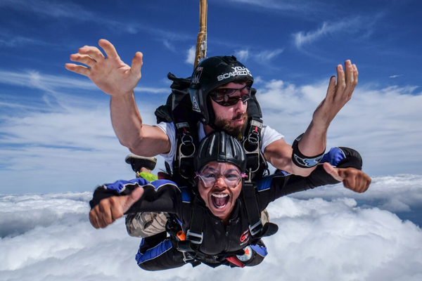
Skydiving

Slide 5
Tendem Skydive
For your first time skydiving, we typically recommend a tandem skydive. Tandem skydiving allows you to experience the thrill of skydiving with no prior experience required. We’ll team you up with one of our highly experienced tandem skydiving instructors who will accompany you throughout your entire skydive.

Slide 6
By His means and in Him St Cyril On Luke sermon 12
Having taken the form of a slave, and being made in the likeness of men: for so did He as one of us set Himself as an avenger in our stead, against that murderous and rebellious serpent, who had brought sin upon us, and thereby had caused corruption and death to reign over the dwellers upon earth, that we by His means, and in Him, might gain the victory, whereas of old we were vanquished, and fallen in Adam.

Slide 7
Human Nature, as victorious in Him St Cyril On Luke sermon 12
And in very truth there was no one of those upon earth who could rise up against his power; but the Son rose up against him, and contended with him, having been made like unto us. And therefore, as I said, human nature, as victorious in Him, wins the crown.

Slide 8
He gained victory in our behalf St Cyril On Luke sermon 12
Having left the habitations of cities, He dwelt in deserts: there He fasted, being tempted of Satan; there He gained victory in our behalf: there He crushed the heads of the dragons

Slide 9
Cambridge Dictionary
Feast : A large, special meal, often for many people, to celebrate someone or something

Slide 10
Examples of Fasting as Feasting The Eucharist
Fasting before liturgy
Fasting before a Feast
Fasting on Wednesday and Friday

Slide 11
The 3 Cs
You are always making “choices”
Which lead to “Challenges”
And when you steadfast, you are in a journey of “Change” from glory to glory

Slide 12
St Athanasius Paschal letters IV, V
We do not celebrate these days in the character of mourners; but as refreshing ourselves with spiritual food, we impose silence on our fleshly lusts. For by these means we all have strength to overcome adversaries, like Judith, when, first having occupied herself with fasting and prayers, she overcame the enemies.(Letter IV) Let us thus engage in the holy fasts, as having been prescribed by Him, and by means of which we attain the way to God. (Letter V)

