Slide 1
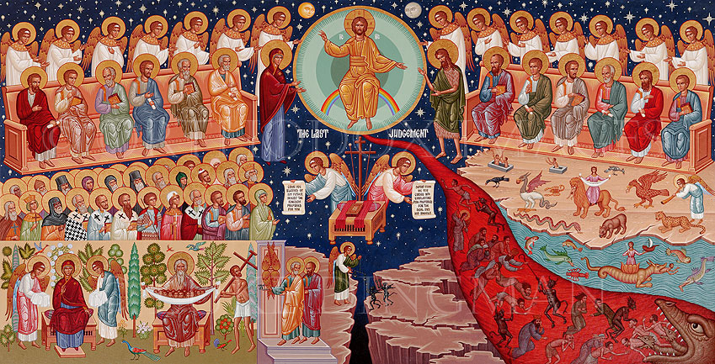
Do not be deceived
1st Sunday of Nassi

Slide 2
12 looking for and hastening the coming of the day of God, because of which the heavens will be dissolved, being on fire, and the elements will melt with fervent heat? 2 Pet 3:12

Slide 3
1. Warning and Encouragement
3 Let no one deceive you by any means; for that Day will not come unless the falling away comes first, and the man of sin is revealed, the son of perdition, 4 who opposes and exalts himself above all that is called God or that is worshiped, so that he sits as God in the temple of God, showing himself that he is God. 2 Thess 2:3,4

Slide 4
Warning and Encouragement
13 But we are bound to give thanks to God always for you, brethren beloved by the Lord, because God from the beginning chose you for salvation through sanctification by the Spirit and belief in the truth, 14 to which He called you by our gospel, for the obtaining of the glory of our Lord Jesus Christ. 15 Therefore, brethren, stand fast and hold the traditions which you were taught, whether by word or our epistle. 2 Thess 2:13-15

Slide 5
2. Scoffers Vs God’s longsuffering
3 knowing this first: that scoffers will come in the last days, walking according to their own lusts, 4 and saying, “Where is the promise of His coming? For since the fathers fell asleep, all things continue as they were from the beginning of creation.” 5 For this they willfully forget: that by the word of God the heavens were of old, and the earth standing out of water …… 9 The Lord is not slack concerning His promise, as some count slackness, but his longsuffering toward us, not willing that any should perish but that all should come to repentance. 2 Pet 3:3- 9

Slide 6
(St. Mark the Hermit)
The Lord hides in His commandments; Whoever seeks Him in them will find Him.

Slide 7
3. The time of the Spirit
For these are not drunk, as you suppose, since it is only the third hour of the day. But this is what was spoken by the prophet Joel: ‘And it shall come to pass in the last days, says God, That I will pour out of My Spirit on all flesh; Your sons and your daughters shall prophesy, Your young men shall see visions, Your old men shall dream dreams. And on My menservants and on My maidservants I will pour out My Spirit in those days; And they shall prophesy. I will show wonders in heaven above And signs in the earth beneath: Acts 2:15-21

Slide 8
4. The false beauty of the stone temple
Then Jesus went out and departed from the temple, and His disciples came up to show Him the buildings of the temple. 2 And Jesus said to them, “Do you not see all these things? Assuredly, I say to you, not one stone shall be left here upon another, that shall not be thrown down.” Matt 24:1-3

Slide 9
5. The real beauty of the temple of His body
19 Jesus answered and said to them, “Destroy this temple, and in three days I will raise it up.” 20 Then the Jews said, “It has taken forty-six years to build this temple, and will You raise it up in three days?”21 But He was speaking of the temple of His body. Jn 2:19-2122
And unless those days were shortened, no flesh would be saved; but for the elect’s sake those days will be shortened. Matt 24:22

Slide 10
(St. Augustine)
All who distance themselves from You, the true Light, will go deep into the darkness of sin; thus, will be unable to discern the traps set for them along the way.

