Slide 1
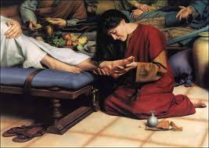
a crown of beauty instead of ashes
4th Sunday o Tout

Slide 2
Some sat in darkness and the deepest gloom,
prisoners suffering in iron chains,
for they had rebelled against the words of God
and despised the counsel of the Most High.
So he subjected them to bitter labor;
they stumbled, and there was no one to help. Ps 107:10-12

Slide 3
1. The Shame of the past
When a woman who had lived a sinful life in that town learned that Jesus was eating at the Pharisee's house, she brought an alabaster jar of perfume, V37

Slide 4
2. The Gift of the Dust
she brought an alabaster jar of perfume, and as she stood behind him at his feet weeping, she began to wet his feet with her tears. Then she wiped them with her hair, kissed them and poured perfume on them. V37, 38

Slide 5
3. The Grace of the Lord
Then Jesus said to her, "Your sins are forgiven."
The other guests began to say among themselves, "Who is this who even forgives sins?"
Jesus said to the woman, "Your faith has saved you; go in peace V48-50

Slide 6
(St. Augustine)
Wherefore the mercy of God is necessary not only when a man repents, but even to lead him to repent.

Slide 7
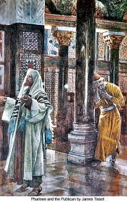

Slide 8
Luke 18: 13,14
But the tax collector stood at a distance. He would not even look up to heaven, but beat his breast and said, 'God, have mercy on me, a sinner.'
"I tell you that this man, rather than the other, went home justified before God. For everyone who exalts himself will be humbled, and he who humbles himself will be exalted."

Slide 9
To proclaim the year of the LORD's favor
and the day of vengeance of our God,
to comfort all who mourn,
and provide for those who grieve in Zion—
to bestow on them a crown of beauty
instead of ashes,
the oil of gladness
instead of mourning,
and a garment of praise
instead of a spirit of despair.
They will be called oaks of righteousness,
a planting of the LORD
for the display of his splendor.
Isa 61:2,3

Slide 10
Then they cried to the LORD in their trouble,
and he saved them from their distress.
He brought them out of darkness and the deepest gloom and broke away their chains.
  Let them give thanks to the LORD for his unfailing love and his wonderful deeds for men Ps 107 13-15

Slide 11
