Slide 1

The Struggle against Demons

Slide 2
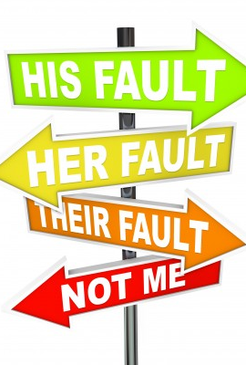
You are called to face up to and fight against your demons, without blaming either someone else or your past.
“This is the great work of a person: always to take the blame for one’s own sins before God and to expect temptation to one’s last breath.”
This Photo by Unknown Author is licensed under CC BY-NC-ND

Slide 3

The first step in personal change can only come from within. Assuming responsibility for your life, and doing something about it.
This Photo by Unknown Author is licensed under CC BY-SA-NC

Slide 4

If my devils leave me, then my angels will too.
There can be no gain without pain.
Amma Theodora said: “Let us strive to enter by the narrow gate. Just as the trees cannot bear fruit if they have not stood before the winter’s storms, so it is with us. This present age is a storm; and it is only through many trials and temptations that we can obtain an inheritance in the kingdom of heaven.”

Slide 5
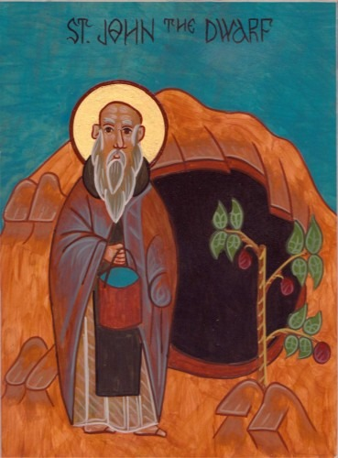
One of the Fathers asked Abba John the Dwarf: “What is a monk?” He replied: “A monk is toil. The monk toils in everything. That is what a monk is.”

Slide 6
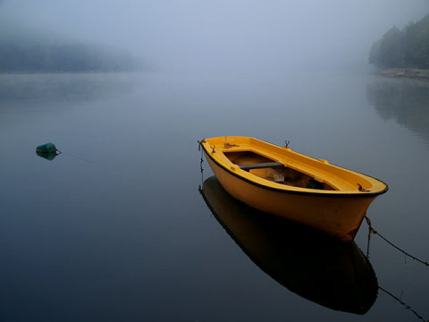
We come to self-knowledge through stillness and silence, through attentiveness and watchfulness.
When words are abandoned, a new awareness arrives. Silence awakens us from dullness of awareness, from dimness of vision.
Having withdrawn to the desert, Abba Arsenius . . . heard a voice saying to him: “Arsenius, flee; be silent; pray always. These are the source of sinlessness.”
Silence is also the first duty of love : The first requirement for survival within community.
This Photo by Unknown Author is licensed under CC BY-SA-NC

Slide 7
Silence is a way of dying-within ourselves and in the presence of others.
Abba Alonius said: “If I had not destroyed myself completely, I would not have been able to rebuild and reshape myself again.”
In struggling against what we are not, we are in fact seeking to discover what we truly are.
It is not that we may be tempted to think that we are more than we actually are; it is, unfortunately, then that we tolerate being less than we truly are called to be.

Slide 8
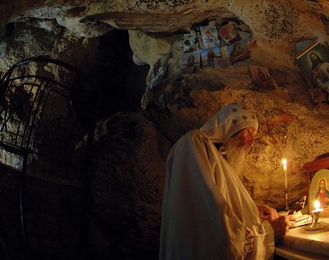
“ Truly you are blessed, Abba Arsenius, for you wept for yourself in this world. One who does not weep here below will weep eternally hereafter. So it is impossible not to weep, either voluntarily or when compelled through suffering.”
Few comprehend that tears of brokenness, as symbols of imperfection, are in fact the sole way of spiritual progress.

