Slide 1
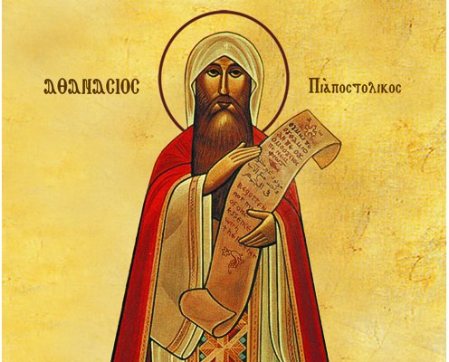
On the Incarnation
God’s solution to man’s dilemma
By St Athanasius
Notes:
NOTE:
To change the image on this slide, select the picture and delete it. Then click the Pictures icon in the placeholder to insert your own image.

Slide 2
Consequences of the Fall
1
We became corruptible, kicked out of paradise (prone to sin)
2
We lost the indwelling of the Holy Spirit, (the special grace)
3
We became mortal, liable to death
4
Low morality
Lost the knowledge of God

Slide 3
So why the Incarnation?
For the Word, realizing that in no other way would the corruption of human beings be undone except, simply, by dying, yet being immortal and the Son of the Father the Word was not able to die, for this reason He takes to himself a body capable of death, in order that it, participating in the Word who is above all, might be sufficient for death on behalf of all, and through the indwelling Word would remain incorruptible, and so corruption might henceforth cease from all by the grace of the resurrection. Whence, by offering to death the body he had taken to Himself, as an offering holy and free of all spot, He immediately abolished death from all like him, by the offering of a like.

Slide 4
So why the Incarnation?
For being above all, the Word of God consequently, by offering his own temple and his bodily instrument as a substitute for all, fulfilled in death that which was required; and, being with all through the like [body], the incorruptible Son of God consequently clothed all with incorruptibility in the promise concerning the resurrection. And now the very corruption of death no longer holds ground against human beings because of the indwelling Word, in them through the one body.
Athanasius, On the Incarnation, Ch. 9

Slide 5
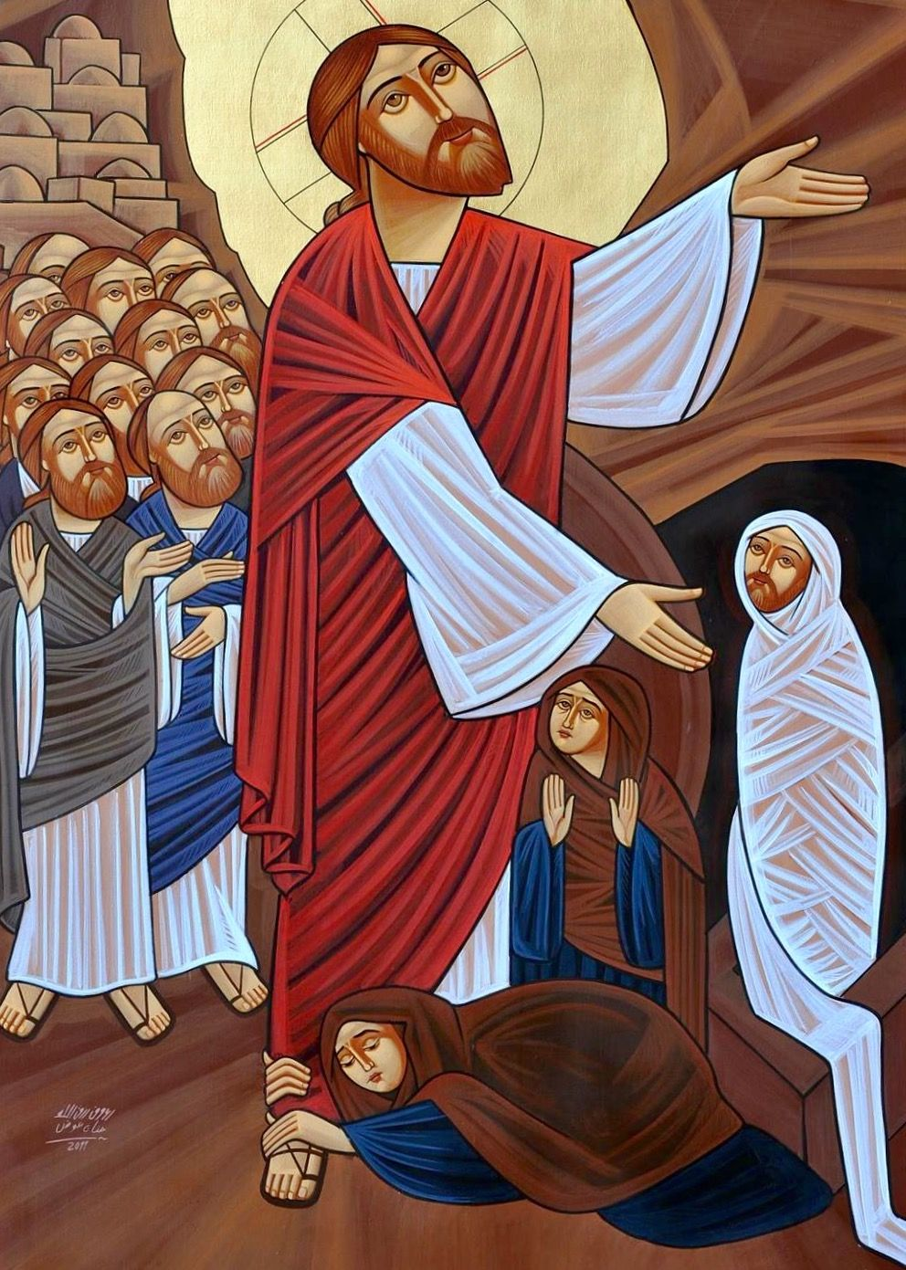
1 Corinthians 15:21-22
^{“21} For since by man came death, by Man also came the resurrection of the dead. ²² For as in Adam all die, even so in Christ all shall be made alive.”

Slide 6
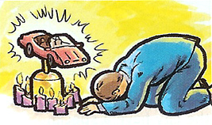
Why the Incarnation?
Men became limited by worshipping what was material and physical having lost the knowledge of the Father
Therefore God also gave them up to uncleanness, in the lusts of their hearts, to dishonor their bodies among themselves, ²⁵ who exchanged the truth of God for the lie, and worshiped and served the creature rather than the Creator, who is blessed forever. Amen.” Romans 1:24-25

Slide 7
God tried a few ways to lead us to the knowledge of our Creator
He gave us the creation “For since the creation of the world His invisible attributes are clearly seen, being understood by the things that are made, even His eternal power and ^{[a]}Godhead, so that they are without excuse,” Romans 1:20
He sent us the Law and the Prophets
a sacred school of the knowledge of God and the conduct of the spiritual life for the whole world. On the Incarnation, Ch. 12

Slide 8
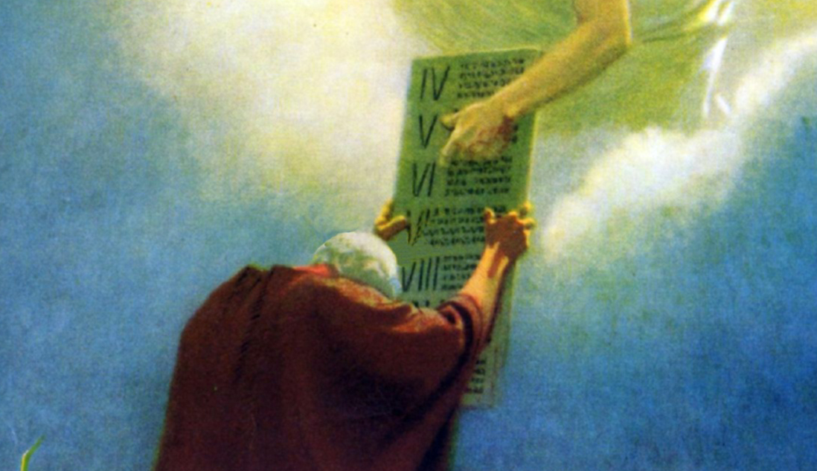
Liturgy of St. Gregory
“You are He who sent to me the prophets, for my sake, I the sick. You gave me the Law as a help……”

Slide 9
What, then, was God to do? Athanasius, On the Incarnation, ch. 13
What else could He possibly do, being God, but renew His Image in mankind, so that through it men might once more come to know Him? And how could this be done save by the coming of the very Image Himself, our Savior Jesus Christ?
Men could not have done it, for they are only made after the Image;
nor could angels have done it, for they are not the images of God.
The Word of God came in His own Person, because it was He alone, the Image of the Father Who could recreate man made after the Image

Slide 10
What then was God to do…
In order to effect this re-creation, however,
He had first to do away with death and corruption. Therefore He assumed a human body, in order that in it death might once for all be destroyed, and that men might be renewed according to the Image. The Image of the Father only was sufficient for this need.

Slide 11
He is the image of the invisible God, the firstborn over all creation. Colossians 1:15
¹⁹ For it pleased the Father that in Him all the fullness should dwell, ²⁰ and by Him to reconcile all things to Himself, by Him, whether things on earth or things in heaven, having made peace through the blood of His cross.²¹ And you, who once were alienated and enemies in your mind by wicked works, yet now He has reconciled ²² in the body of His flesh through death, to present you holy, and blameless, and above reproach in His sight— Colossians 1:19-22

Slide 12
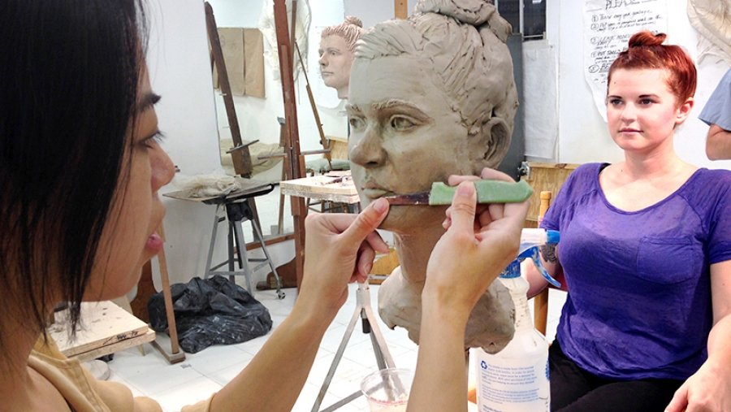
The Renewing of the Image

Slide 13
Summary of what Christ had to do to heal us
On the Incarnation, Ch. 20
We have spoken above in part, as far as was possible and as far as we were able to understand,
the cause of his bodily appearance, that it was not for another to turn what was corruptible to incorruptibility except the Savior Himself, who in the beginning created the universe from nothing;
and that it was not for another to recreate again the “in the image” for human beings, except the Image of the Father;
and that it was not for another to raise up the mortal to be immortal, except our Lord Jesus Christ, who is Life itself;
and that it was not for another to teach about the Father and destroy the worship of idols, except the Word who arranges all things and is alone the true only-begotten Son of the Father.

Slide 14
On the Incarnation, Ch. 20
But since what was required from all still had to be rendered (for, as I said earlier, it was absolutely necessary to die and for this, in particular, he sojourned amongst us), for this reason, after the demonstrations of His divinity from His works, He now offered the sacrifice on behalf of all, delivering His own temple to death in the stead of all, in order to make all not liable to and free from the ancient transgression, and to show Himself superior to death, displaying His own body as incorruptible, the first-fruits of the universal resurrection.

Slide 15
What was required? And Who required it?
Death was required since is it was the natural law of sin
For the law of the Spirit of life in Christ Jesus has made me free from the law of sin and death. ³ For what the law could not do in that it was weak through the flesh, God did by sending His own Son in the likeness of sinful flesh, on account of sin: He condemned sin in the flesh, ⁴ that the righteous requirement of the law might be fulfilled in us who do not walk according to the flesh but according to the Spirit. Romans 8:2-4

