Slide 1
Intimacy Anorexia
Giving is the life of Christ part 1

Slide 2
Trust =Vulnerability = Intimacy
The kind of connection that two people can have when there are no barriers between them – emotionally, intellectually, and spiritually

Slide 3
Trust =Vulnerability = Intimacy
Intimacy is not needing to defend yourself against the other person because you know they have your best interests at heart.

Slide 4
Tools for the starving The intimacy anorexic is armed with a set of powerful tools that they use to prevent others (including spouses) from getting close to them.
This Photo by Unknown Author is licensed under CC BY-SA

Slide 5
Busy – When someone is constantly busy with things – committees, work, programs, and tasks there’s no time to get to know who they really are. Blame – When the other person is blamed they may feel guilt or shame and as a result retreat giving the anorexic more time to avoid intimacy. Withholding Love – Intimacy anorexics often don’t like physical touch. They don’t want to be so close that they might be seen.
This Photo by Unknown Author is licensed under CC BY-SA

Slide 6
Withholding Praise – By withholding praise from someone you’re depriving them of the lifeblood they need to grow and to reach in. The result is that intimacy anorexics can prevent their spouses from reaching in by only sharing negatives or nothing at all. Withholding Sex – In a married relationship an intimacy anorexia often withholds sex since it’s a necessarily intimate time that’s uncomfortable for the person. Withholding Spiritually – One of our most sensitive relationships is the relationship we have with our creator. People who withhold this from their spouse because to reveal it makes them and the relationship vulnerable.
This Photo by Unknown Author is licensed under CC BY-SA

Slide 7
Criticism – Humans don’t like constant criticism – particularly when it’s not constructive. An anorexic will use criticism to keep people at bay. Anger – Some use their anger to scare off others. If you’re afraid of their anger then you won’t want to be near them. Silence – The old saying “It takes two to tango” is even more true of conversations. A person will avoid even answering questions that might lead to an intimate exchange. Sometimes it’s known the glass wall.
This Photo by Unknown Author is licensed under CC BY-SA

Slide 8
Controlling Money – If you can keep control of your spouse by managing or controlling the money then you might be able to keep them away at the threat of losing their money supply. Required Mindreading – The intimacy anorexic will often require that their spouse read their mind as to what they want. They’ll be chastised when they fail and reprimanded when they ask for what the person wants. In this way they can complain that their spouse never gives them what they want. Victimhood – The anorexic loves to play the role of the victim. This brings the spouse into the position of trying to come along side and support them. This is a useful distraction for a while as it prevents seeing more of who the person is.
This Photo by Unknown Author is licensed under CC BY-SA

Slide 9
Causes of the Intimacy Anorexic
Sexual Trauma
Opposite Gender Parent Issues
Sexual Addiction

Slide 10
Fears of the Intimacy Anorexic
Lack of Safety
Hidden Flaws
Loss of Control
Acknowledging Sexuality

Slide 11
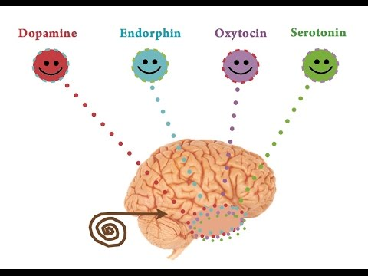
The Intimacy of Sex

Slide 12
“Starve the Dog”

Slide 13
Withholding
They are withholding themselves from others

Slide 14
