Slide 1
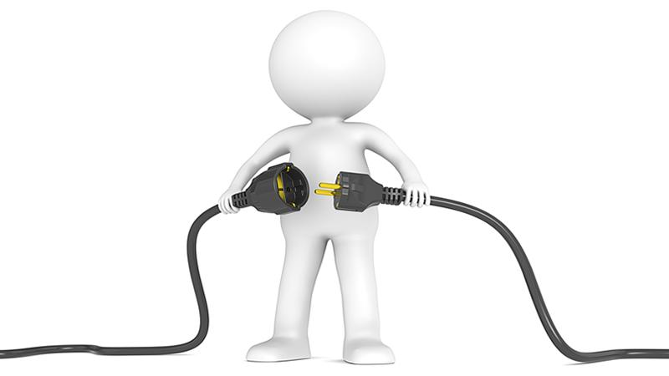

Plugging in the unplugged!!!
The Feast of Epiphany 2020

Slide 2
Questions to be answered
What was the case before of the fall?
What happened after the fall?
What was The promise of the Good God?
Why Christ received the Spirit first?
But he received it, How?
A. To restore us to the Sonship of God
B. Transfashioning our human nature unto its olden state
6. Summary

Slide 3
1. The status before the fall
I mean man, was formed from the beginning in incorruption. And the cause of his incorruption and of his abidance in all virtue was evidently that the Spirit from God indwelt him; for He breathed upon his face the breath of life, as it is written.

Slide 4
2. What happened after the fall
But he having from that ancient deceit turned aside unto sin, then by degrees in succession received much advance thereto, along with the remaining good things he suffers the loss of the Spirit and so at length became not only subject to corruption but also prone to all sin.

Slide 5
3. What was The promise the good God?
But when the Framer of all designed (doing exceeding excellently) to gather up all things in Christ, and willed to recover again the nature of man to its pristine state, He promises along with the rest to give anew to it the Holy Spirit also, for no otherwise was it possible to get back to unshaken stability in good things. He defines therefore the time of the Descent of the Spirit upon us, and promises saying, In those days (those of the Saviour that is) I will pour out (to wit of My Spirit) upon all flesh.

Slide 6
4. Why Christ received the Spirit first?
But since the time of this munificence brought the Only Begotten upon earth with Flesh, that is, made Man of a woman according to the Holy Scripture, God the Father began to give again the Spirit, and Christ first received the Spirit as First-fruits of the renewed nature. For John bare record saying, I saw the Spirit descending from Heaven and It abode upon Him.

Slide 7
5. But he received it , How?
But He received It, how? for we must need to investigate what is said. Was it then as not having? we say not so, God forbid. For the Spirit is the Son's Own, and not supplied from without, as the things from God come to us from without, but exists in Him naturally even as in the Father, and through Him proceeds to the saints, apportioned by the Father as beseems each. But He is said to have received, in that He became Man, and it befits man to receive

Slide 8
a. To restore us into Sonship
For Him Who God before ages was begotten of Him, He says that He has this day begotten, that in Him He may receive us into sonship, for the whole human nature was in Christ, in that He was Man: so is He said to the Son who has His Own Spirit, to give It, that we in Him may gain the Spirit

Slide 9
b. Transfashioning our human nature unto its olden state
For this reason therefore does He take hold of the seed of Abraham, as it is written, and in all things was made like unto His brethren. The Only-Begotten therefore receives the Holy Ghost not for Himself (for His and in Him and through Him is the Spirit,) but, since He, having been made Man, had our whole nature in Himself, that He might uplift it all transfashioning it unto its olden state

Slide 10
Summary
For since our forefather Adam being turned aside by deceit into disobedience and sin, did not preserve the grace of the Spirit, and thus in him the whole nature lost at last the God-given good, needs did God the "Word Who knows not turning, become Man, in order that by receiving as Man He might preserve the Good permanently to our nature.

Slide 11
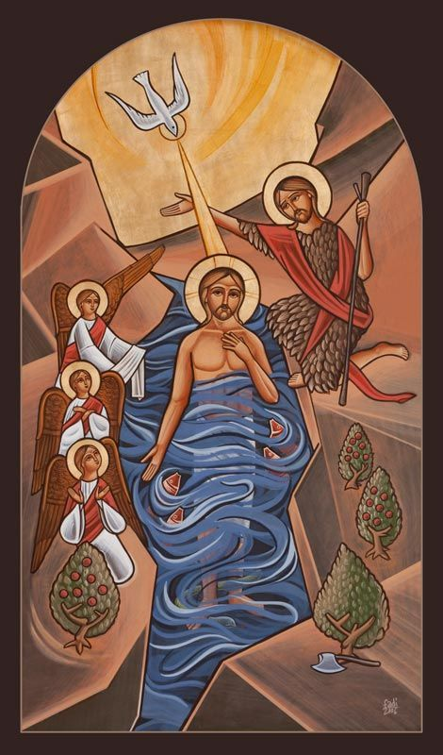
He preserved the Good permanently to our nature.
St Cyril the great
The Feast of Epiphany 2020

