Slide 1
Giving With Your Words

Slide 2
James 3:2
“For we all stumble in many things. If anyone does not stumble in word, he is a perfect man, able also to bridle the whole body.”

Slide 3
Love with your words
My mouth, my words, they direct where I go
My mouth also can destroy what I have
And my mouth displays who I really am

Slide 4

My mouth directs where I go

Slide 5
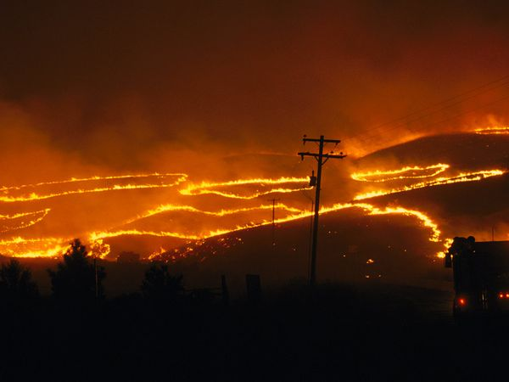
Words can destroy what I have

Slide 6

our words, display who we are

Slide 7
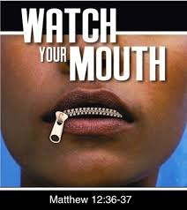
Matthew 12:34
“For out of the abundance of the heart the mouth speaks.”

Slide 8
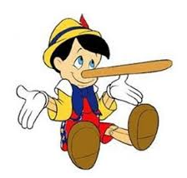
1. Love people with honest words.

Slide 9
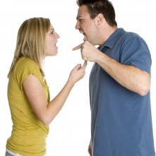
Jesus always responded out of honesty not irritation

Slide 10
Proverbs 27:5
“An open rebuke is better than hidden love.”

Slide 11
1 Corinthians 13:6
“Love does not delight in evil but rejoices with the truth.”

Slide 12
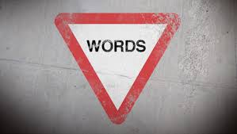
Love people with careful words.

Slide 13
Ephesians 4:26-27
“In your anger do not sin. Do not let the sun go down while you’re still angry, and do not give the devil a foothold.”

Slide 14
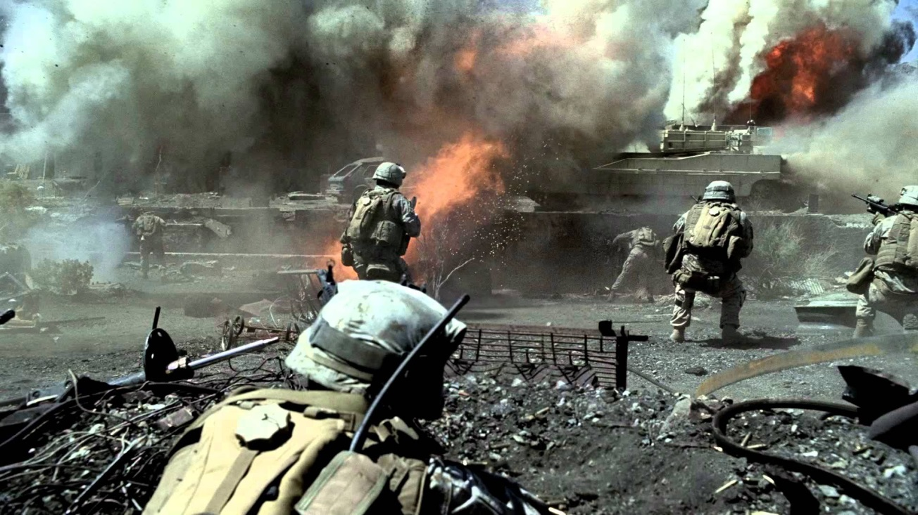
Communication can be a battlefield

Slide 15
Proverbs 21:23
“ Whoever guards his mouth and tongue keeps his soul from troubles.”

Slide 16
Proverbs 17:28
“Even a fool is counted wise when he holds his peace; When he shuts his lips, he is considered perceptive.”

Slide 17
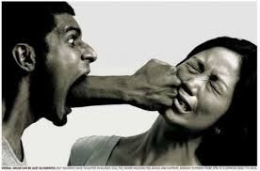
You love people with building words.

Slide 18
Ephesians 4:29
“Do not let any unwholesome talk come out of your mouths, but only what is helpful for building others up according to their needs.”

Slide 19
5 ways of speaking
Kind words
Gentle Words
Pleasant words
Honest words
Wise words

