Slide 1
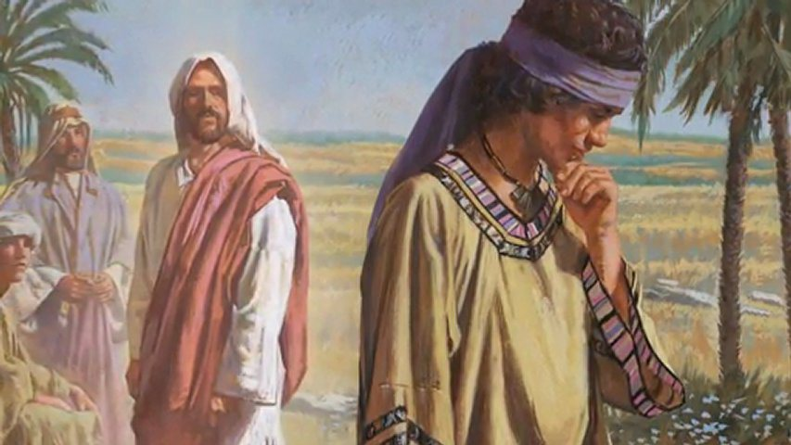
For my Sake and the Gospel’s
4th Sunday Hatour

Slide 2
St John Saba
There is no one, in whose soul and bones, love of Christ is, who can stand the filth of the detestable lust... Whoever has his mind captivated by the sweetness of the God of all, could be captivated by any of the lusts of this world.

Slide 3
Pauline Epistle
11 To the present hour we both hunger and thirst, and we are poorly clothed, and beaten, and homeless. 12 And we labor, working with our own hands. Being reviled, we bless; being persecuted, we endure; 13 being defamed, we entreat. We have been made as the filth of the world, the off scouring of all things until now. 1 Cor 4:11-13

Slide 4
Catholic Epistle
3 As His divine power has given to us all things that pertain to life and godliness, through the knowledge of Him who called us by glory and virtue, 4 by which have been given to us exceedingly great and precious promises, that through these you may be partakers of the divine nature, having escaped the corruption that is in the world through lust. 2 Pet 1:3,4

Slide 5
Acts
6 But when they did not find them, they dragged Jason and some brethren to the rulers of the city, crying out, “These who have turned the world upside down have come here too. Acts 17:6

Slide 6
Psalm
Know that the Lord, He is God; It is He who has made us, and not we ourselves; We are His people and the sheep of His pasture. Ps 100:3

Slide 7
For My Sake
29 So Jesus answered and said, “Assuredly, I say to you, there is no one who has left house or brothers or sisters or father or mother or wife or children or lands, for My sake and the gospel’s, 30 who shall not receive a hundredfold now in this time houses and brothers and sisters and mothers and children and lands, with persecutions and in the age to come, eternal life. Mk 10:29,30

Slide 8
St John Saba
The consummation of commandments is the cross, namely, forgetting and forsaking worldly lusts; together with a yearning and desire for departure, saying with St. Paul: “For I am hard pressed between the two, having a desire to depart and be with Christ, which is far better” (Phil. 1:23).

Slide 9
Count them as Rubbish
7 But what things were gain to me, these I have counted loss for Christ. 8 Yet indeed I also count all things loss for the excellence of the knowledge of Christ Jesus my Lord, for whom I have suffered the loss of all things, and count them as rubbish, that I may gain Christ. Phil 3:7,8

Slide 10
St Ambrose
[It is Christ Himself who is proclaiming that through the priest: “This is My Body.”]

