Slide 1
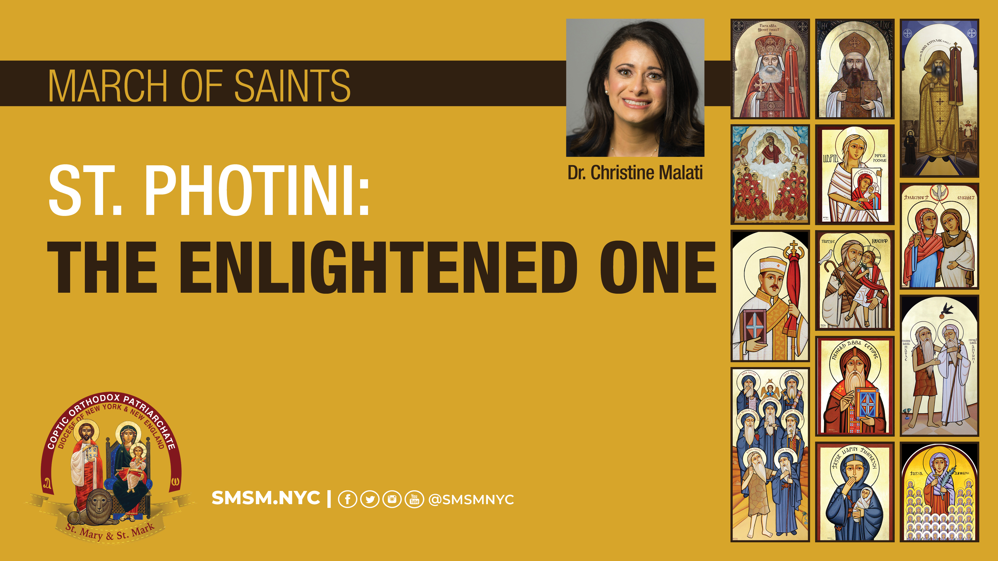

Slide 2
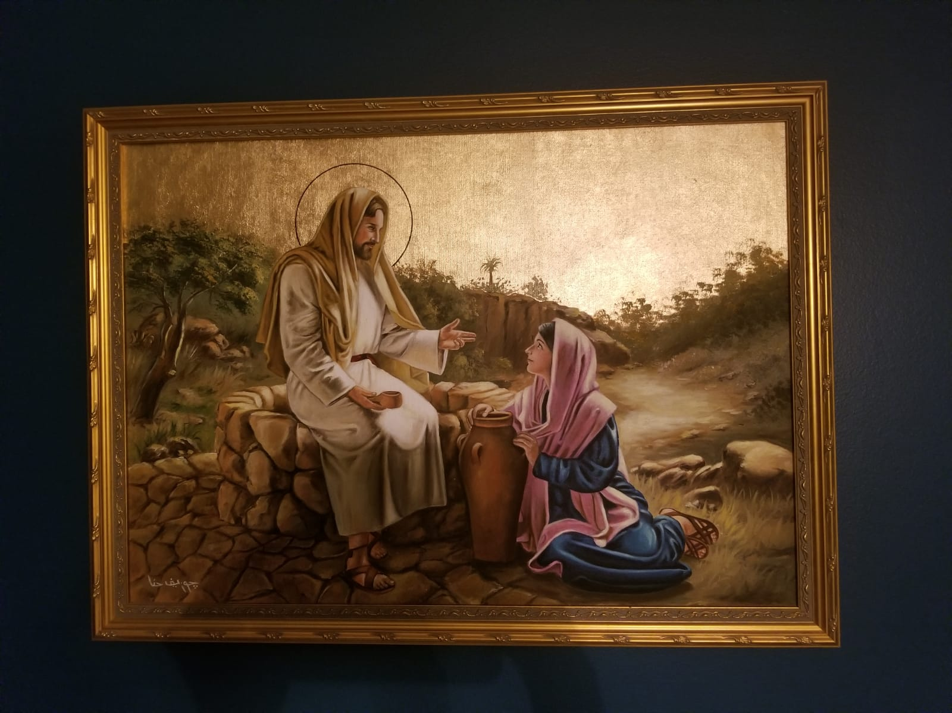
Painted by Mr. Joseph Hanna of St. Mark Cathedral, Cairo. Nov 2010. From private collection of CY Malati.

Slide 3
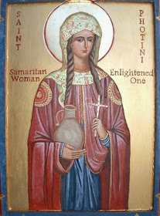
Outline
Geographical and cultural context
John 4:1-42 (Please grab your bibles and Agpeyas!)
Relevance in the Coptic Orthodox Christian lectionary
Great Lent, Holy Fifty Days, Pentecost
Lessons learned
From the encounter at the well (Gospel of John)
From the life of St. Photini, an evangelist and martyr (Antiochian Orthodox Synaxarion)
Source: http://sainttheo.blogspot.com/

Slide 4
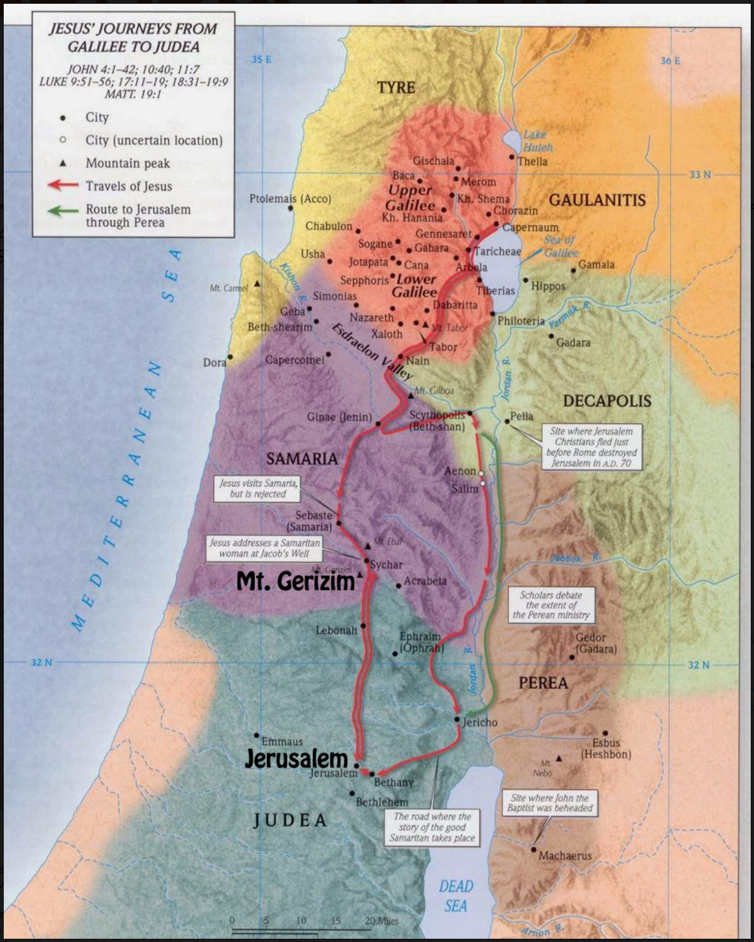
Geographical & Cultural Context
After King Solomon died, the Kingdom was divided in two.
Southern Kingdom or Judea
Place of Worship: Jerusalem
Northern Kingdom or Samaria
Place of Worship: Mt. Gerizim
Captured by the Assyrians
Worshipping according to Jewish tradition and incorporated Assyrian religious practices. Comingling with Assyrian society (marriage, worship)
He had to pass through Samar′ia. John 4:4
Source: http://sundaygospeltrivia.blogspot.com/

Slide 5
Geographical & Cultural Context
After King Solomon died, the Kingdom was divided in two.
Southern Kingdom or Judea
Place of Worship: Jerusalem
Northern Kingdom or Samaria
Place of Worship: Mt. Gerizim
Captured by the Assyrians
Worshipping according to Jewish tradition and incorporated Assyrian religious practices. Comingling with Assyrian society (marriage, worship)
He had to pass through Samar′ia. John 4:4 (RSV)
Source: http://sundaygospeltrivia.blogspot.com/

Slide 6
Geographical & Cultural Context
After King Solomon died, the Kingdom was divided in two.
Southern Kingdom or Judea
Place of Worship: Jerusalem
Northern Kingdom or Samaria
Place of Worship: Mt. Gerizim
Captured by the Assyrians
Worshipping according to Jewish tradition and incorporated Assyrian religious practices. Comingling with Assyrian society (marriage, worship)
He had to pass through Samar′ia. John 4:4 (RSV)
Source: http://sundaygospeltrivia.blogspot.com/

Slide 7
Geographical & Cultural Context
Destination
After King Solomon died, the Kingdom was divided in two.
Southern Kingdom or Judea
Place of Worship: Jerusalem
Northern Kingdom or Samaria
Place of Worship: Mt. Gerizim
Captured by the Assyrians
Worshipping according to Jewish tradition and incorporated Assyrian religious practices. Comingling with Assyrian society (marriage, worship)
He had to pass through Samar′ia. John 4:4 (RSV)
Sychar
Start
Source: http://sundaygospeltrivia.blogspot.com/

Slide 8
John 4:1-9 (RSV)
Character Legend
Narrator
Jesus Christ
Samaritan Woman
Disciples
Samaritans
¹Now when the Lord knew that the Pharisees had heard that Jesus was making and baptizing more disciples than John ²(although Jesus himself did not baptize, but only his disciples), ³he left Judea and departed again to Galilee. ⁴He had to pass through Samar′ia. ⁵So he came to a city of Samar′ia, called Sy′char, near the field that Jacob gave to his son Joseph. ⁶Jacob’s well was there, and so Jesus, wearied as he was with his journey, sat down beside the well. It was about the sixth hour.
⁷There came a woman of Samar′ia to draw water. Jesus said to her, “Give me a drink.” ⁸For his disciples had gone away into the city to buy food.
⁹The Samaritan woman said to him, “How is it that you, a Jew, ask a drink of me, a woman of Samar′ia?” For Jews have no dealings with Samaritans.

Slide 9
John 4:10-15 (RSV)
Character Legend
Narrator
Jesus Christ
Samaritan Woman
Disciples
Samaritans
¹⁰Jesus answered her, “If you knew the gift of God, and who it is that is saying to you, ‘Give me a drink,’ you would have asked him, and he would have given you living water.”
¹¹ The woman said to him, “Sir, you have nothing to draw with, and the well is deep; where do you get that living water? ¹² Are you greater than our father Jacob, who gave us the well, and drank from it himself, and his sons, and his cattle?”
¹³ Jesus said to her, “Every one who drinks of this water will thirst again, ¹⁴ but whoever drinks of the water that I shall give him will never thirst; the water that I shall give him will become in him a spring of water welling up to eternal life.”
¹⁵ The woman said to him, “Sir, give me this water, that I may not thirst, nor come here to draw.”

Slide 10
John 4:16-20 (RSV)
Character Legend
Narrator
Jesus Christ
Samaritan Woman
Disciples
Samaritans
¹⁶Jesus said to her, “Go, call your husband, and come here.”
¹⁷The woman answered him, “I have no husband.”
Jesus said to her, “You are right in saying, ‘I have no husband’; ¹⁸for you have had five husbands, and he whom you now have is not your husband; this you said truly.”
¹⁹The woman said to him, “Sir, I perceive that you are a prophet. ²⁰Our fathers worshiped on this mountain; and you say that in Jerusalem is the place where men ought to worship.”

Slide 11
John 4:21-26 (RSV)
Character Legend
Narrator
Jesus Christ
Samaritan Woman
Disciples
Samaritans
²¹Jesus said to her, “Woman, believe me, the hour is coming when neither on this mountain nor in Jerusalem will you worship the Father. ²²You worship what you do not know; we worship what we know, for salvation is from the Jews.
²³But the hour is coming, and now is, when the true worshipers will worship the Father in spirit and truth, for such the Father seeks to worship him. ²⁴God is spirit, and those who worship him must worship in spirit and truth.”
²⁵The woman said to him, “I know that Messiah is coming (he who is called Christ); when he comes, he will show us all things.”
²⁶Jesus said to her, “I who speak to you am he.”

Slide 12
John 4:27-33 (RSV)
Character Legend
Narrator
Jesus Christ
Samaritan Woman
Disciples
Samaritans
²⁷Just then his disciples came. They marveled that he was talking with a woman, but none said, “What do you wish?” or, “Why are you talking with her?”
²⁸So the woman left her water jar, and went away into the city, and said to the people, ²⁹“Come, see a man who told me all that I ever did. Can this be the Christ?”
³⁰They went out of the city and were coming to him. ³¹Meanwhile the disciples besought him, saying, “Rabbi, eat.”
³²But he said to them, “I have food to eat of which you do not know.”
³³So the disciples said to one another, “Has any one brought him food?”

Slide 13
John 4:34-38 (RSV)
Character Legend
Narrator
Jesus Christ
Samaritan Woman
Disciples
Samaritans
³⁴Jesus said to them, “My food is to do the will of him who sent me, and to accomplish his work.
³⁵Do you not say, ‘There are yet four months, then comes the harvest’? I tell you, lift up your eyes,
and see how the fields are already white for harvest. ³⁶He who reaps receives wages, and gathers
fruit for eternal life, so that sower and reaper may rejoice together. ³⁷For here the saying holds
true, ‘One sows and another reaps.’ ³⁸I sent you to reap that for which you did not labor; others
have labored, and you have entered into their labor.”

Slide 14
John 4:39-42 (RSV)
Character Legend
Narrator
Jesus Christ
Samaritan Woman
Disciples
Samaritans
³⁹Many Samaritans from that city believed in him because of the woman’s testimony, “He told me all that I ever did.”
⁴⁰So when the Samaritans came to him, they asked him to stay with them; and he stayed there two days. ⁴¹And many more believed because of his word.
⁴²They said to the woman, “It is no longer because of your words that we believe, for we have heard for ourselves, and we know that this is indeed the Savior of the world.”

Slide 15
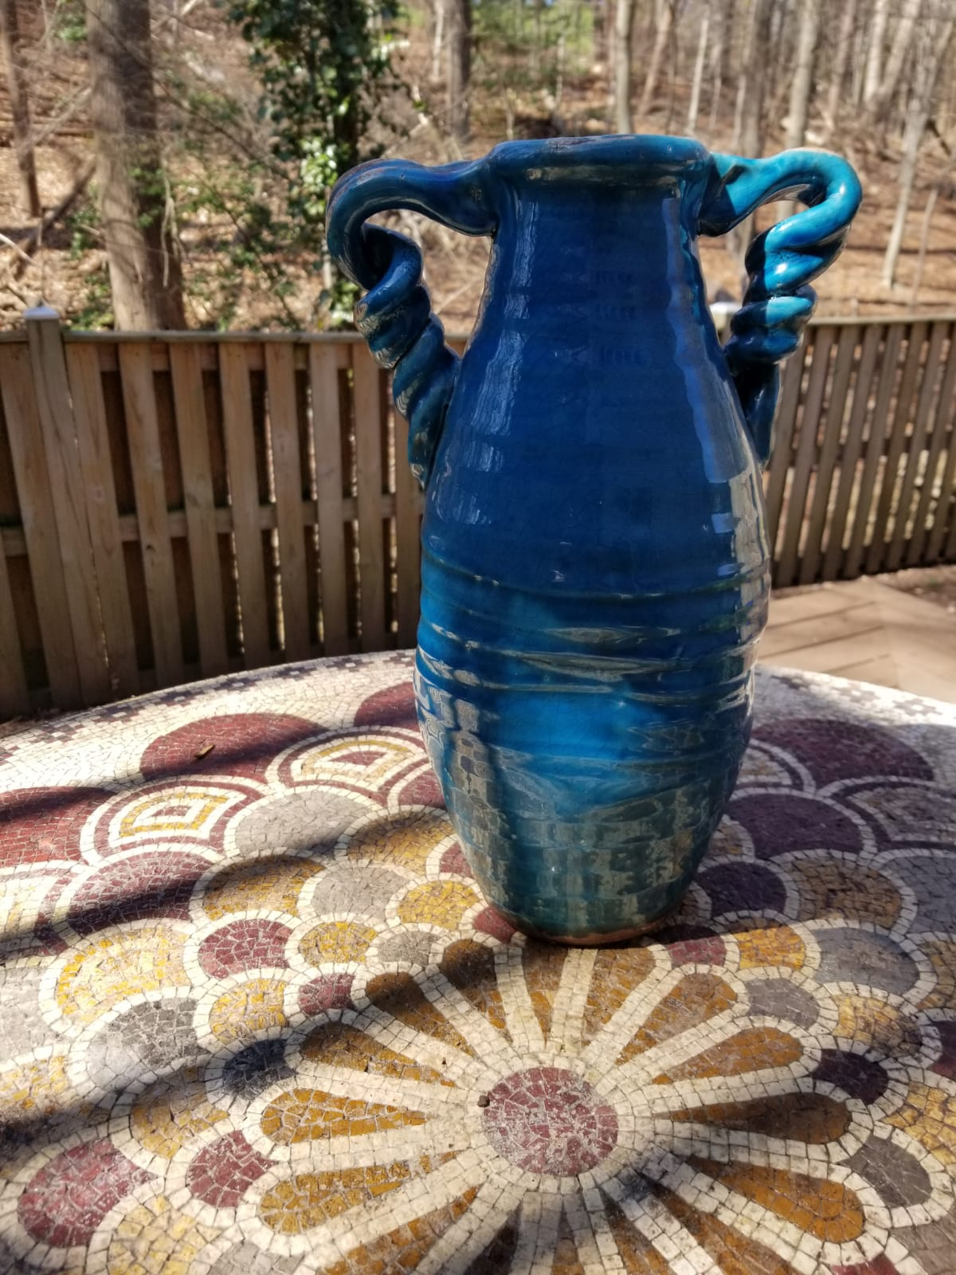
Relevance in the Coptic Orthodox Church
First Time – Great Lent (v 4:1-42)
Joy in repentance
²⁸ So the woman left her water jar, and went away into the city, and said to the people.
Second Time – Holy Fifty Days (v 4:1-42)
Joy in the resurrection
²⁹Come, see a man who told me all that I ever did. Can this be the Christ?
Third Time – Kneeling Prayers of Feast of Pentecost (v 4:1-24)
Joy in true worship
²⁴God is spirit, and those who worship him must worship in spirit and truth.
Source: Private Collection of CY Malati.
Sources: PF Mikhail. Putting Joy into Practice: Seven Ways to Lift Your Spirit from the Early Church.

Slide 16
Lessons from the Encounter at the Well
Humanity and Divinity of Jesus Christ
⁶…and so Jesus, wearied as he was with his journey, sat down beside the well…
²⁶Jesus said to her, “I who speak to you am he.”
In Greek, Ego emmi, I AM. Also referenced when God revealed Himself to Moses. Exodus 3:14
Intentionality, love, acceptance, trust of Jesus Christ
Connection with the Crucifixion
The Thrice Blessed His Holiness Pope Shenouda of Blessed Memory in his book, Seven Words of Our Lord on the Cross, indicates the thirst of Christ for the salvation of the world when Christ says, “I thirst.”

Slide 17
Origen Commentary on John
Her confession is not the result of painful reprimand or confronting her with her shameful self. It is
the result of His love. This arouses her conscience and reveals to her the reality of the Lord.
Consequently, she becomes trustful and admits the truth about her personal life as she realizes that
He can heal her wounds and restore her spiritual health.

Slide 18
St. Ephrem the Syrian Commentary on Tatian’s Diatessaron
John 4:26 “I Who Speak to You Am He”
JESUS’ GRADUAL REVELATION OF HIMSELF. If you are a king, why are you asking water from me?
It was not thus that he had first revealed himself to her, but rather first as a Jew, and then as a
prophet, and after that as the Messiah. From degree to degree he led her and placed her on the
highest degree. She first saw him as someone thirsting; and then as Jew; then as a prophet, and
after that as God. As someone thirsting, she persuaded him; as a Jew, she recoiled from him, as a
learned one, she interrogated him, as a prophet she was reprimanded, and as the Messiah, she
worshiped him.

Slide 19
Christ reveals Himself gradually
Stage 1: Jew
The Jews and Samaritans considered each other as enemies
Stage 2: Sir
The Samaritan woman respects Jesus Christ
Stage 3: Prophet
Deut 18:18 “I will raise up for them a Prophet like you from among their brethren.” Samaritans believed Moses was the final prophet until Christ returns.
Stage 4: Messiah, the Savior of the World
³⁹…He told me all that I ever did.
WHO IS JESUS TO YOU?

Slide 20
St. Cyril of Alexandria Commentary on the Gospel of John
GENDER EQUALITY IN THE GOSPEL
He shows here, as the one Creator of all, that he does not give men only this life through faith but
imparts this faith to women as well. Let him that teaches in the church follow this pattern and not
refuse to help women. For in all things one must not follow one‘s own will but the service of
preaching.

Slide 21
The reaction of the Samaritan Woman
Her Knowledge of the Samaritan version of the Torah
²⁵The woman said to him, “I know that Messiah is coming (he who is called Christ); when he comes, he will show us all things.”
Her Humility and Enlightenment
Contrast with the Pharisees. In John 12:39-40 Therefore they could not believe. For Isaiah again said, “He has blinded their eyes and hardened their heart, lest they should see with their eyes and perceive with their heart, and turn for me to heal them.”
Contrast with St. Peter
Her Focus on Christ in her Evangelism
²⁸So the woman left her water jar, and went away into the city, and said to the people, ²⁹“Come, see a man who told me all that I ever did. Can this be the Christ?”

Slide 22
The reaction of the Samaritan Woman
Her Knowledge of the Samaritan version of the Torah
²⁵The woman said to him, “I know that Messiah is coming (he who is called Christ); when he comes, he will show us all things.”
Her Humility and Enlightenment
Contrast with the Pharisees. In John 12:39-40 Therefore they could not believe. For Isaiah again said, “He has blinded their eyes and hardened their heart, lest they should see with their eyes and perceive with their heart, and turn for me to heal them.”
Contrast with St. Peter
Her Focus on Christ in her Evangelism
²⁸So the woman left her water jar, and went away into the city, and said to the people, ²⁹“Come, see a man who told me all that I ever did. Can this be the Christ?”

Slide 23
St. Augustine of Hippo Tracate on John
What could she do now but leave her water pot, and run to preach the gospel? She cast out lust, and hastened to proclaim the truth.

Slide 24
St. Romanus Melodus Kontakion of the Woman of Samaria
But when the Merciful One was near the spring,…Then the woman of Samaria, coming from her
native village, Sichar, arrived, and she had her urn on her shoulders; And who would not call blessed
the arrival and departure of this woman? For she departed in filth; she entered into the figure of the
church as blameless; She departed, and she drew out life like a sponge. She departed bearing water;
she became a bearer of God; And who does not bless This woman; or rather who does not revere
her, the type of the nations As she brings Exceeding great joy and redemption?

Slide 25
Origen Commentary on John
He also uses the woman as an apostle, as it were, to those in the city. His words to her are so forceful that she
leaves her water jar to go to the city and tells them to her fellow townspeople.…I think there was a definite
purpose why the Evangelist recorded that the woman left her water jar and went into the city. At the literal
level, then, this shows the tremendous eagerness of the Samaritan woman, who forsakes her water jar and is
more concerned for how she may benefit the multitude than for her more humble duty related to material
things.

Slide 26
The reaction of the Samaritan Woman
Her Knowledge of the Samaritan version of the Torah
²⁵The woman said to him, “I know that Messiah is coming (he who is called Christ); when he comes, he will show us all things.”
Her Humility and Enlightenment
Contrast with the Pharisees. In John 12:39-40 Therefore they could not believe. For Isaiah again said, “He has blinded their eyes and hardened their heart, lest they should see with their eyes and perceive with their heart, and turn for me to heal them.”
Contrast with St. Peter
Her Focus on Christ in her Evangelism
²⁸So the woman left her water jar, and went away into the city, and said to the people, ²⁹“Come, see a man who told me all that I ever did. Can this be the Christ?”

Slide 27
Origen Commentary on John
For she was very benevolently moved and wished to announce the Christ to her fellow citizens by bearing
witness to the one who told her ―all I ever did. And she invites them to behold a man whose speech is greater
than man, for his appearance to the eye was human. So must we, too, therefore, forgetting things that are
more material in nature and leaving them behind, be eager to impart to others the benefit of which we have
been partakers. For by recording the woman‘s commendation for those capable of reading with understanding,
the Evangelist challenges us to this goal.

Slide 28
Synaxarion of the Antiochian Orthodox Church Commemorated on February 26, March 20, and the “Sunday of the Samaritan Woman”
Remembered as the first to proclaim the Gospel of Christ, as a holy martyr, and as equal to the apostles
Lived during the reign of Emperor Nero in the first century Palestine
Baptized by the disciples at Pentecost and named St. Photini
Traveled and lived in Carthage after Sts. Peter and Paul were martyred
Impacted and converted many
The Samaritans
Two sons (Sts. Victor/Photinus and Joses)
Five sisters (Sts. Anatole, Photo, Photis, Paraskeve, and Kyriake)
St. Domnina (daughter of Emperor Nero) and her servants
St. Sebastian (Friend and fellow solider with St. Victor)

Slide 29
Synaxarion of the Antiochian Orthodox Church Commemorated on February 26, March 20, and the “Sunday of the Samaritan Woman”
Emperor Nero gave order to flay the skin from St. Photini and throw her down a well.
Well → Prison for 20 days
Nero had St. Photini brought to him and asked if she would now relent and offer sacrifice to the idols.

Slide 30
Synaxarion of the Antiochian Orthodox Church Commemorated on February 26, March 20, and the “Sunday of the Samaritan Woman”
St. Photini spat in his face, and laughing at him, said, “O most impious of the blind, you profligate and stupid man! Do you think me so deluded that I would consent to renounce my Lord Christ and instead offer sacrifice to idols as blind as you?”
Hearing such words, Nero gave orders to throw St. Photini down a well, where she surrendered her soul to God in the year 66 AD.
The well which was initially a source of shame, became a source of life and ultimately glory.

Slide 31
Praying for Enlightenment
First Hour of the Prayer Book of Hours (Agpeya)
First Absolution
“…let the light of Your face shine upon us and the light of Your divine knowledge enlighten us. Let us be, the sons of light and the sons of day light…”
Second Absolution
“O God Who causes the light to burst forth, whose sun rises on the righteous and the wicked, who made light to sine on the whole world, enlighten our minds, hearts, and understanding, O Master of all.”
Surround yourself with the saints

Slide 32
Final Thoughts from the Prophet, St. Isaiah
Isaiah 12:3 (SAAS)
You will draw water with gladness from the wells of salvation.
Isaiah 44:2-3 (SAAS)
Thus says the Lord who made you and formed you from the womb, who will help you: ‘You will yet be helped; fear not, Jacob My servant, and Israel, My beloved, whom I chose. For I will give water to the thirsty who walk in a waterless place, I will put My Spirit upon your seed and My blessings upon your children. They will spring up like grass in the midst of the water and like willows by the flowing water.

Slide 33

Leaving the Jar Project
Operating in Kenya and the US (Greater metropolitan Washington DC)
Focused on serving prostitutes and victims of human trafficking by offering physical, mental, and spiritual rehabilitation
Rescue. Rehabilitate. Transition.
For more information, check out their website: www.leaving-the-jar.org

Slide 34
