Slide 1
Journey to Paradise – Part 3
“A Lamp to My Feet”

Slide 2
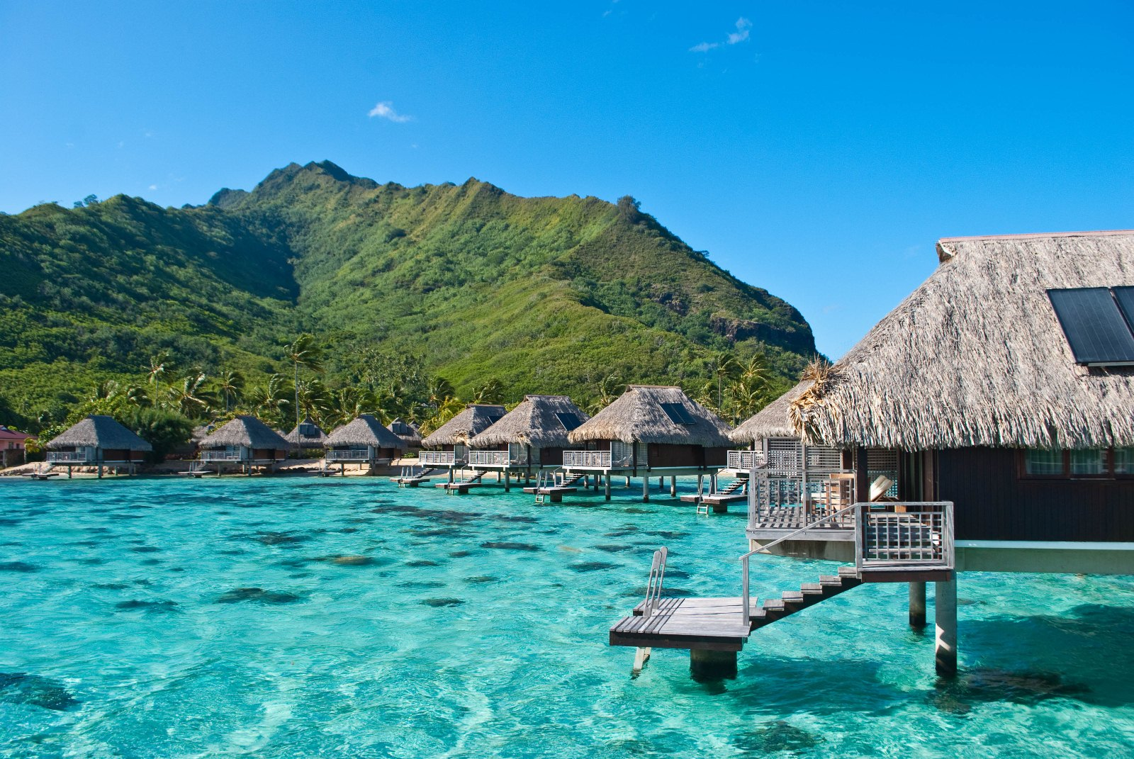

Slide 3
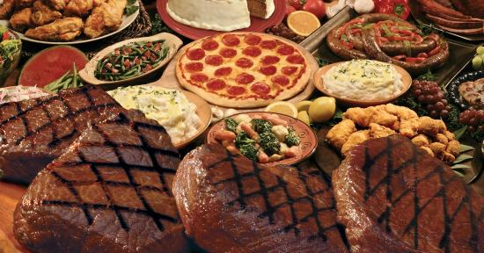

Slide 4
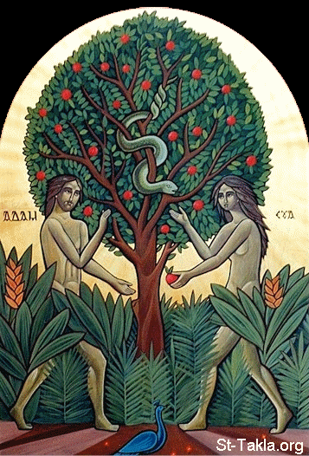

Slide 5
21 I also will no longer drive out before them any of the nations which Joshua left when he died, 22 so that through them I may test Israel, whether they will keep the ways of the Lord, to walk in them as their fathers kept them, or not.” 23 Therefore the Lord left those nations, without driving them out immediately; nor did He deliver them into the hand of Joshua. 1 Now these are the nations which the Lord left, that He might test Israel by them, that is, all who had not known any of the wars in Canaan 2 (this was only so that the generations of the children of Israel might be taught to know war, at least those who had not formerly known it) (Judges 2:21-3:2)

Slide 6
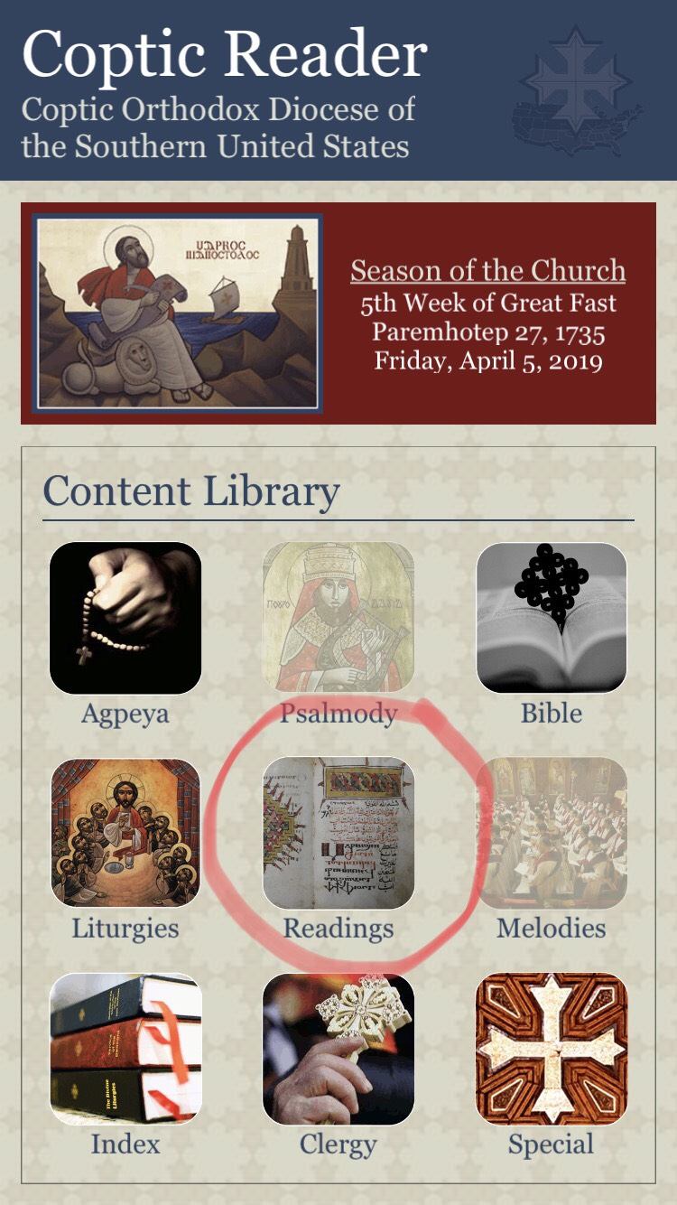
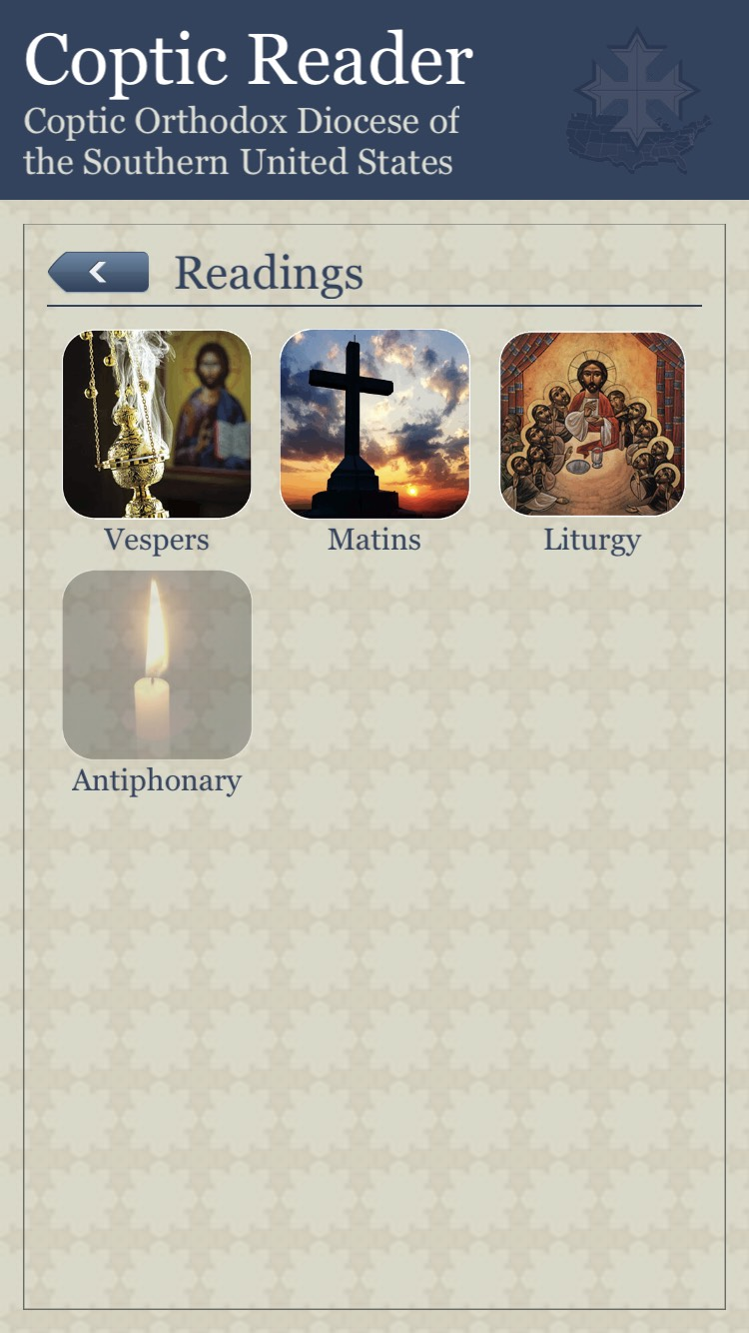

Slide 7
³¹ Then He took the twelve aside and said to them, “Behold, we are going up to Jerusalem, and all things that are written by the prophets concerning the Son of Man will be accomplished. ³² For He will be delivered to the Gentiles and will be mocked and insulted and spit upon. ³³ They will scourge Him and kill Him. And the third day He will rise again.” ³⁴ But they understood none of these things; this saying was hidden from them, and they did not know the things which were spoken. (Luke 18:31-34)

Slide 8
¹³ Now behold, two of them were traveling that same day to a village called Emmaus, which was seven miles from Jerusalem. ¹⁴ And they talked together of all these things which had happened. ¹⁵ So it was, while they conversed and reasoned, that Jesus Himself drew near and went with them. ¹⁶ But their eyes were restrained, so that they did not know Him. ¹⁷ And He said to them, “What kind of conversation is this that you have with one another as you walk and are sad?”

Slide 9
¹⁸ Then the one whose name was Cleopas answered and said to Him, “Are You the only stranger in Jerusalem, and have You not known the things which happened there in these days?”…²¹ But we were hoping that it was He who was going to redeem Israel. Indeed, besides all this, today is the third day since these things happened… ²⁵ Then He said to them, “O foolish ones, and slow of heart to believe in all that the prophets have spoken!

Slide 10
²⁶ Ought not the Christ to have suffered these things and to enter into His glory?” ²⁷ And beginning at Moses and all the Prophets, He expounded to them in all the Scriptures the things concerning Himself. ²⁸ Then they drew near to the village where they were going, and He indicated that He would have gone farther. ²⁹ But they constrained Him, saying, “Abide with us, for it is toward evening, and the day is far spent.” And He went in to stay with them.

Slide 11
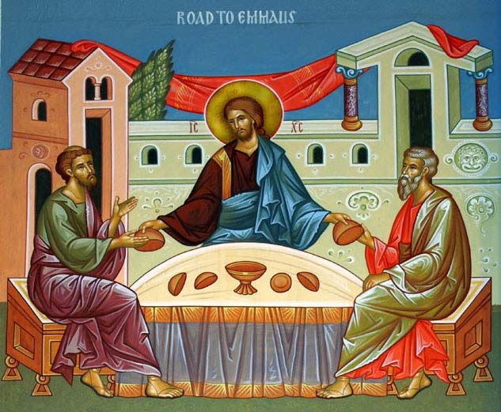
³⁰ Now it came to pass, as He sat at the table with them, that He took bread, blessed and broke it, and gave it to them. ³¹ Then their eyes were opened and they knew Him; and He vanished from their sight. ³² And they said to one another, “Did not our heart burn within us while He talked with us on the road, and while He opened the Scriptures to us?” (Luke 24:13-32)

Slide 12
⁴⁴ Then He said to them, “These are the words which I spoke to you while I was still with you, that all things must be fulfilled which were written in the Law of Moses and the Prophets and the Psalms concerning Me.” ⁴⁵ And He opened their understanding, that they might comprehend the Scriptures. (Luke 24:44,45)

Slide 13
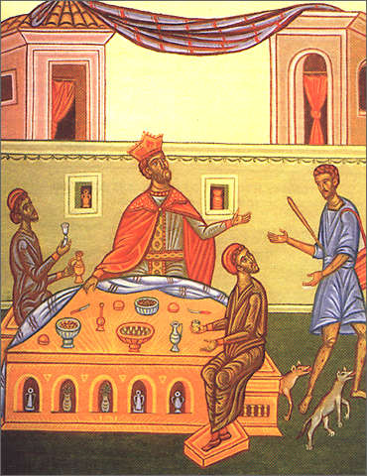
²⁹ Abraham said to him, ‘They have Moses and the prophets; let them hear them.’ ³⁰ And he said, ‘No, father Abraham; but if one goes to them from the dead, they will repent.’ ³¹ But he said to him, ‘If they do not hear Moses and the prophets, neither will they be persuaded though one rise from the dead.’”

Slide 14
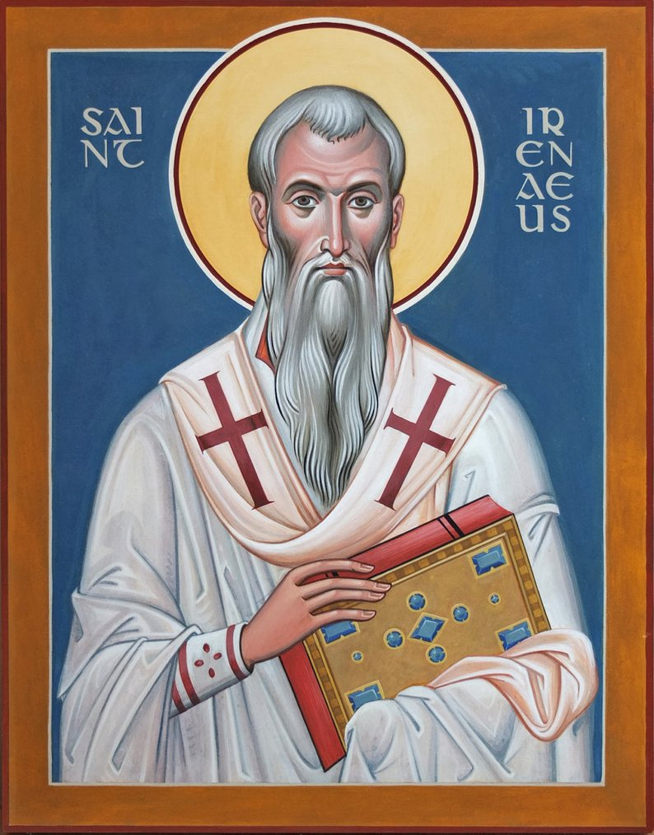
If anyone, therefore, reads the scriptures this way, he will find in them the Word concerning Christ, and a foreshadowing of the new calling. For Christ is the “treasure which was hidden in the field” [Mat. 13:44] [a treasure] hidden in the scriptures, for he was indicated by means of types and parables, which could not be understood by human beings prior to the consummation of those things which had been predicted, that is, the advent of the Lord. (St. Irenaeus, Against Heresies Book 4, Ch. 26 (1))

Slide 15
“Every commandment which I command you today you must be careful to observe, that you may live and multiply, and go in and possess the land of which the Lord swore to your fathers. 2 And you shall remember that the Lord your God led you all the way these forty years in the wilderness, to humble you and test you, to know what was in your heart, whether you would keep His commandments or not. 3 So He humbled you, allowed you to hunger, and fed you with manna which you did not know nor did your fathers know, that He might make you know that man shall not live by bread alone; but man lives by every word that proceeds from the mouth of the Lord. 4 Your garments did not wear out on you, nor did your foot swell these forty years. 5 You should know in your heart that as a man chastens his son, so the Lord your God chastens you. (Deut. 8:1-5)

Slide 16
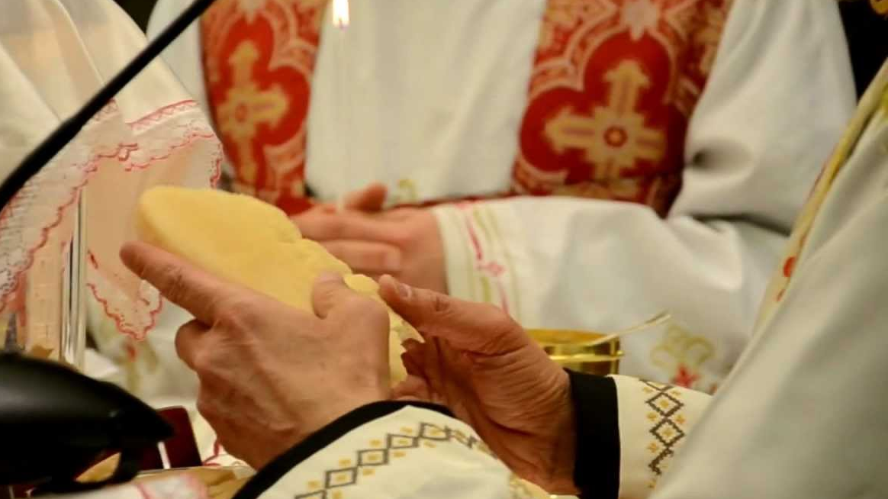
The Fraction of Wisdom
Wisdom is brighter than the sun and all the stars. Wisdom is the Light of the Father existing with Him from eternity...
Wisdom is our Savior Jesus Christ who redeemed us with the sacrifice of His Body, bought us by His bloodshed, and chose us for His eternal kingdom.

Slide 17
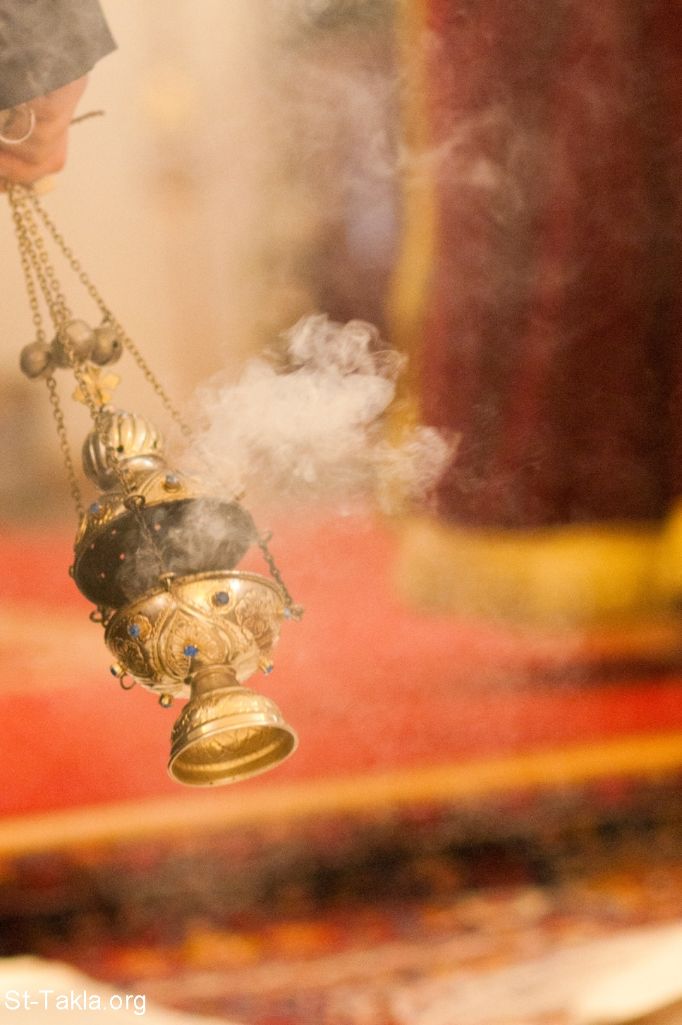
1 Wisdom has built her house, She has hewn out her seven pillars; 2 She has slaughtered her meat, She has mixed her wine, She has also furnished her table. 3 She has sent out her maidens, She cries out from the highest places of the city, 4 “Whoever is simple, let him turn in here!” As for him who lacks understanding, she says to him, 5 “Come, eat of my breadAnd drink of the wine I have mixed. (Prov. 9:1-11)

Slide 18
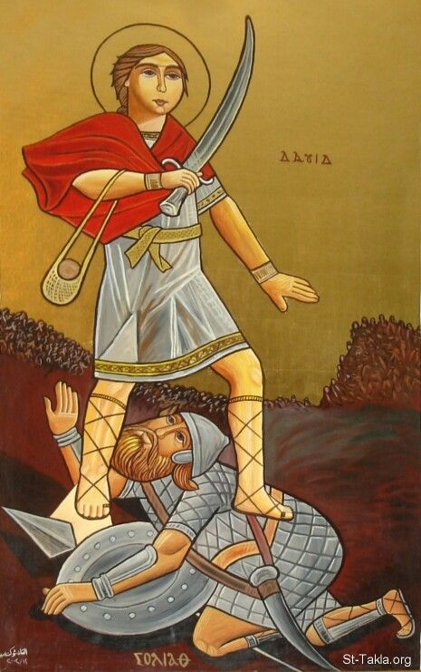
Friday Before Temptation Sunday

Slide 19
Friday Before Temptation Sunday
And the Philistine drew near and presented himself forty days, morning and evening. (1 Sam. 17:16)

Slide 20
Friday Before Temptation Sunday
And the Philistine drew near and presented himself forty days, morning and evening. (1 Sam. 17:16)
Therefore David ran and stood over the Philistine, took his sword and drew it out of its sheath and killed him, and cut off his head with it.(1 Sam. 17:51)

Slide 21
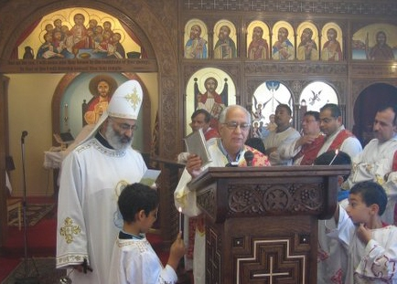
Litany of the Gospel: For You are the life of us all, the salvation of us all, the hope of us all, the healing of us all and the resurrection of us all.
Revive me according to Your word. (Psalm 119:25)
Strengthen me according to Your word. (Psalm 119:28)

Slide 22
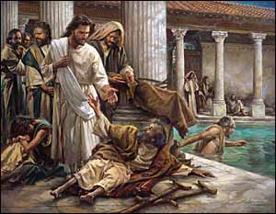
Sunday of the Paralytic at the Pool of Bethesda

Slide 23
Monday Matins:
5 Trust in the Lord with all your heart, And lean not on your own understanding; 6 In all your ways acknowledge Him, And He shall direct your paths. 7 Do not be wise in your own eyes; Fear the Lord and depart from evil. 8 It will be health to your flesh, And strength to your bones. (Proverbs 3:5-8)

Slide 24
Thursday Matins:
20 My son, give attention to my words; Incline your ear to my sayings. 21 Do not let them depart from your eyes; Keep them in the midst of your heart; 22 For they are life to those who find them, And health to all their flesh. 23 Keep your heart with all diligence, For out of it spring the issues of life. 24 Put away from you a deceitful mouth, And put perverse lips far from you. 25 Let your eyes look straight ahead, And your eyelids look right before you. 26 Ponder the path of your feet, And let all your ways be established. 27 Do not turn to the right or the left; Remove your foot from evil. (Proverbs 4:20-27)

Slide 25
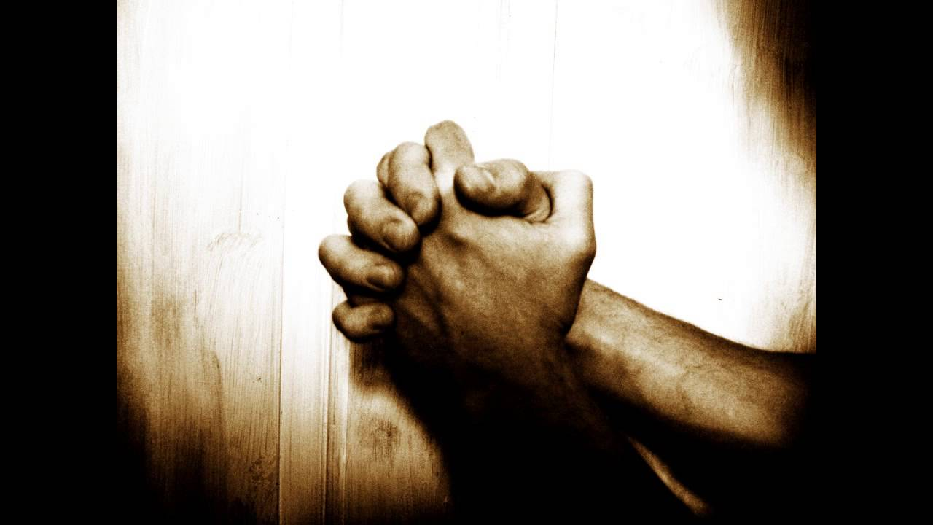
Friday Liturgy
12 Therefore strengthen the hands which hang down, and the feeble knees, 13 and make straight paths for your feet, so that what is lame may not be dislocated, but rather be healed. 14 Pursue peace with all people, and holiness, without which no one will see the Lord: 15 looking carefully lest anyone fall short of the grace of God; lest any root of bitterness springing up cause trouble, and by this many become defiled; (Hebrews 12:12-15)

