Slide 1
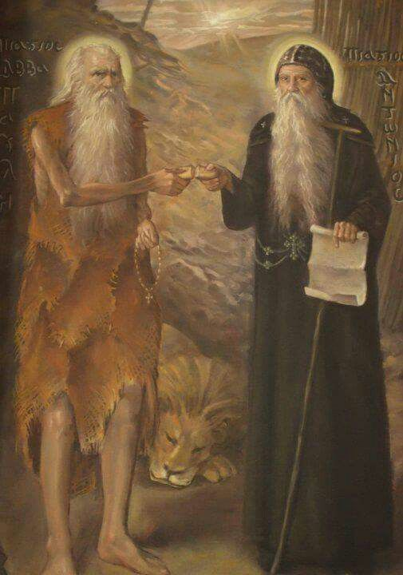
Gleanings of the Desert:
Anger

Slide 2
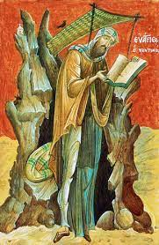
Abba Evagrius the Monk
Anger is by nature designed for waging war with the demons and for struggling with every kind of sinful pleasure. Therefore angels, arousing spiritual pleasure in us and giving us to taste its blessedness, incline us to direct our anger against the demons. But the demons, enticing us towards worldly lusts, make us use anger to fight with men, which is against nature, so that the mind, thus stupefied and darkened, should become a traitor to virtues.

Slide 3
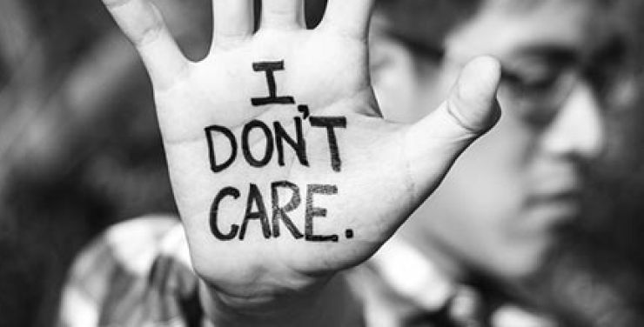
The opposite of love is not anger. The opposite of love is apathy.

Slide 4
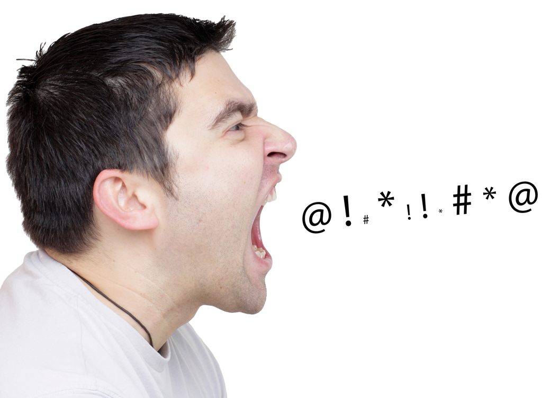
HOW DO YOU TAME YOUR TEMPER?

Slide 5
Resolve to manage it

Slide 6
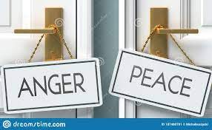
Anger is a choice

Slide 7
Proverbs 29:11
“A fool vents all his feelings, But a wise man holds them back.”

Slide 8
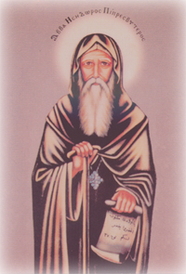
Abba Isidore the Priest
A brother asked Abba Isidore the priest, “Why are the demons so frightened of you?” The old man said to him, “Because, ever since the day I began practicing ascesis, I have striven to prevent anger from reaching my lips.

Slide 9

Remember the cost

Slide 10
Abba Aghathon
“If a man is enslaved by anger, then even if he were to raise the dead, he would not be acceptable to God by virtue of his bondage to the passion of anger.”

Slide 11
Proverbs 29:22
“An angry person stirs up conflict, and a hot-tempered person commits many sins.”

Slide 12
Proverbs 15:18
“A hot-tempered person stirs up conflict.”

Slide 13
Proverbs 14:17
“People with hot tempers do foolish things.”

Slide 14
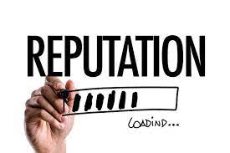
What do you lose?
Your Reputation

Slide 15

. Reflect before reacting.

Slide 16
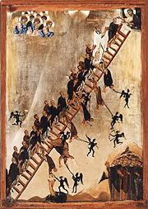
St. John Climacus
“The Ladder of Divine Ascent”
The first step toward freedom from anger is to keep the lips silent when the heart is stirred; the next, to keep thoughts silent when the soul is upset; the last, to be totally calm when unclean winds are blowing.

Slide 17
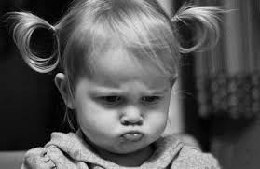
If you hold onto anger, it turns to resentment

Slide 18
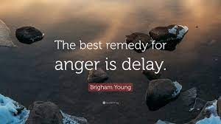

Slide 19
What do you during the delay?
“A man’s wisdom gives yields patience.” Proverbs 19:11

Slide 20
First thing that causes you to get angry is hurt

Slide 21

2nd thing that causes you to get angry is frustration

Slide 22
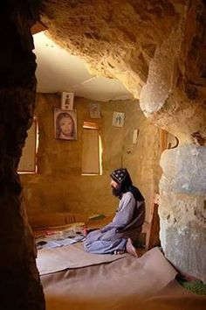
A brother was restless in his community and he was often irritated. So he said, ‘I will go and live somewhere by myself. I will not be able to talk or listen to anyone and so I shall be at peace, and my passionate anger will cease.’ He went out and lived alone in a cave. But one day he filled his jug with water and put it on the ground. Suddenly it happened to fall over. He filled it again, and again it fell. This happened a third time. In a rage he snatched up the jug and smashed it. Coming to his senses, he knew that the demon of anger had mocked him, and he said, ‘Here am I by myself, and he has beaten me. I will return to the community. Wherever you live, you need effort and patience and above all God’s help.’ So he got up, and went back.

Slide 23
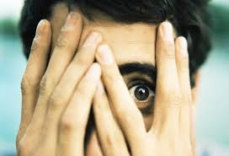
The 3rd thing that causes you get angry is fear

Slide 24
Psalm 141:3
“Set a guard over my mouth, Lord; keep watch over the door of my lips.”

Slide 25
Release my anger appropriately

Slide 26
Ephesians 4:26
“In your anger do not sin: Do not let the sun go down while you are still angry.”

Slide 27
Proverbs 15:1
“A gentle answer turns away wrath, but a harsh word stirs up anger.”

Slide 28

What is the best way to deal with anger?
You don’t suppress it.

Slide 29
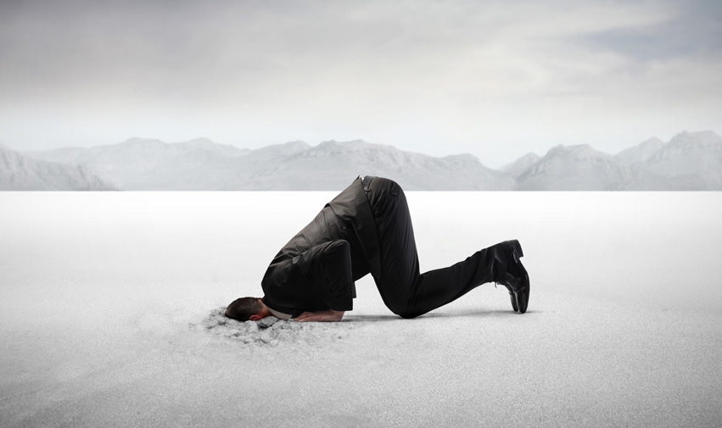
You don’t repress it

Slide 30

Don’t express it.

Slide 31
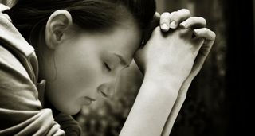
God says the way to deal with your anger is to confess it

Slide 32

Re-pattern your mind

Slide 33
Romans 12:2
“Do not conform to the pattern of this world, but be transformed by the renewing of your mind.”

Slide 34
St. John Climacus
“The Ladder of Divine Ascent)
As with the appearance of light, darkness retreats; so, at the fragrance of humility, all anger and bitterness vanishes.

Slide 35
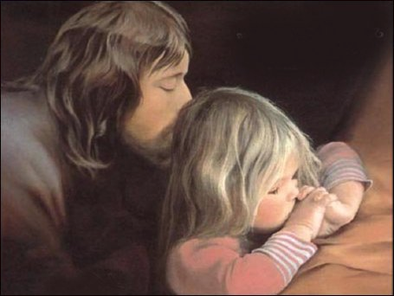
Rely on God’s help.

Slide 36
St. John Climacus, “The Ladder of Divine Ascent”
Wrath is a reminder of hidden hatred, that is to say, remembrance of wrongs. Wrath is a desire for the injury of the one who has provoked you. Irascibility is the untimely blazing up of the heart. Bitterness is a movement of displeasure seated in the soul. Anger is an easily changeable movement of one’s disposition and disfiguration of soul.

Slide 37
Romans 15:5
“May the God who gives endurance and encouragement give you the same attitude of mind toward each other that Christ Jesus had,”

Slide 38
Matthew 12:34
“For the mouth speaks what the heart is full of.”

