Slide 2
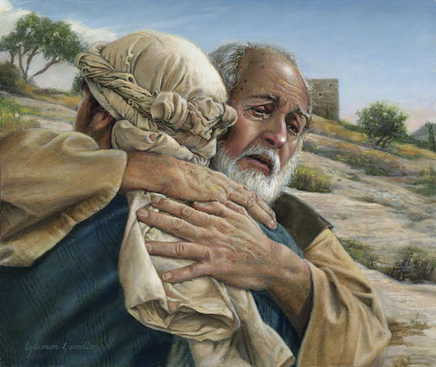
Prodigal Son Coming to Yourself

Slide 3
Luke 15:11
“Then He said: “A certain man had two sons. ¹² And the younger of them said to his father, ‘Father, give me the portion of goods that falls to me.’ So he divided to them his livelihood.”

Slide 4
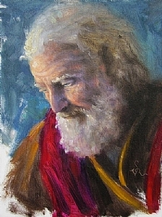
Key word: Father- took responsibility of us and our salvation

Slide 5
His eyes were on the riches of the Father, but not the enjoyment of fellowship with the Father

Slide 6
¹³ And not many days after, the younger son gathered all together, journeyed to a far country, and there wasted his possessions with prodigal living.

Slide 7
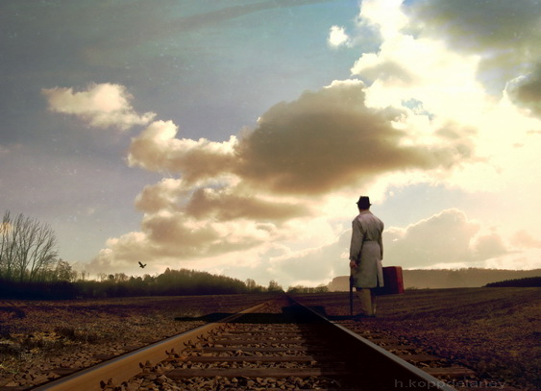
Journeyed to a far country
The life in which God is absent

Slide 8
Revelation 9:2-4
”And he opened the bottomless pit, and smoke arose out of the pit like the smoke of a great furnace. So the sun and the air were darkened because of the smoke of the pit. ³ Then out of the smoke locusts came upon the earth. And to them was given power, as the scorpions of the earth have power.⁴ They were commanded not to harm the grass of the earth, or any green thing, or any tree, but only those men who do not have the seal of God on their foreheads.”

Slide 9
This was a form of battle that the people of God have not contended with before

Slide 10
^{“14} But when he had spent all, there arose a severe famine in that land, and he began to be in want.”

Slide 11
The famine is the spiritual dryness that takes place when we distance ourselves from the grace of God

Slide 12
In times of strength set for yourselves plans for times of weakness

Slide 13
¹⁵ Then he went and joined himself to a citizen of that country, and he sent him into his fields to feed swine. ¹⁶ And he would gladly have filled his stomach with the pods that the swine ate, and no one gave him anything.

Slide 14
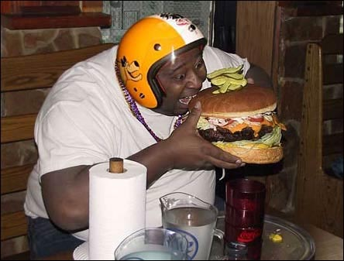
God destroys all the supports of our self-indulgence

Slide 15
¹⁷ “But when he came to himself, he said, ‘How many of my father’s hired servants have bread enough and to spare, and I perish with hunger! ¹⁸ I will arise and go to my father, and will say to him, “Father, I have sinned against heaven and before you, ¹⁹ and I am no longer worthy to be called your son. Make me like one of your hired servants.”’

Slide 16
The first step in turning back to God is coming back to yourself

Slide 17
One of the biggest obstacles to coming to ourselves and admitting our sin is the obstacle of pride

Slide 18
Pride goes before destruction, And a haughty spirit before a fall. Proverbs 16:18

Slide 19
For thus says the High and Lofty One Who inhabits eternity, whose name is Holy: “I dwell in the high and holy place, With him who has a contrite and humble spirit, To revive the spirit of the humble, And to revive the heart of the contrite ones. Isaiah 57:15

Slide 20
²⁰ “And he arose and came to his father. But when he was still a great way off, his father saw him and had compassion, and ran and fell on his neck and kissed him. ²¹ And the son said to him, ‘Father, I have sinned against heaven and in your sight, and am no longer worthy to be called your son.’

Slide 21
Step 2 Resolve to rise from your Fall

Slide 22
Ephesians 2:4-8
“But God, who is rich in mercy, because of His great love with which He loved us, ⁵ even when we were dead in trespasses, made us alive together with Christ (by grace you have been saved), ⁶ and raised us up together, and made us sit together in the heavenly places in Christ Jesus, ⁷ that in the ages to come He might show the exceeding riches of His grace in His kindness toward us in Christ Jesus. ⁸ For by grace you have been saved through faith, and that not of yourselves; it is the gift of God,”

Slide 23
²² “But the father said to his servants, ‘Bring^{[a]} out the best robe and put it on him, and put a ring on his hand and sandals on his feet. ²³ And bring the fatted calf here and kill it, and let us eat and be merry; ²⁴ for this my son was dead and is alive again; he was lost and is found.’ And they began to be merry.
²⁵ “Now his older son was in the field. And as he came and drew near to the house, he heard music and dancing. ²⁶ So he called one of the servants and asked what these things meant. ²⁷ And he said to him, ‘Your brother has come, and because he has received him safe and sound, your father has killed the fatted calf.’

Slide 24
²⁸ “But he was angry and would not go in. Therefore his father came out and pleaded with him. ²⁹ So he answered and said to his father, ‘Lo, these many years I have been serving you; I never transgressed your commandment at any time; and yet you never gave me a young goat, that I might make merry with my friends. ³⁰ But as soon as this son of yours came, who has devoured your livelihood with harlots, you killed the fatted calf for him.’
³¹ “And he said to him, ‘Son, you are always with me, and all that I have is yours. ³² It was right that we should make merry and be glad, for your brother was dead and is alive again, and was lost and is found.’”

