Slide 1
Orthodoxy for Dummies
Synergy: Works and Faith in Orthodoxy

Slide 2
1 corinthians 3:9
“For we are God’s fellow workers;…”

Slide 3
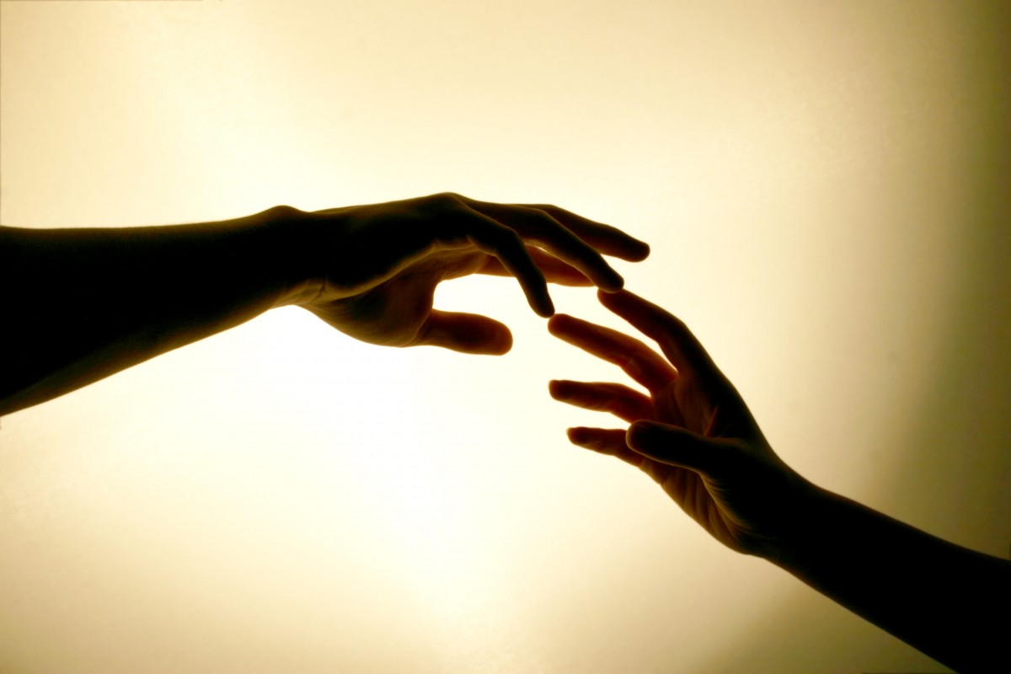
Synergy
God works with us and we work with Him

Slide 4
There are major discrepancies in the Protestant and Catholic beliefs of salvation and the Orthodox understanding of it

Slide 5
The Protestant View
“sola fide” – one is saved through faith alone
A person is “declared righteous” through faith in Christ without having any righteousness on their own- this is a change in legal status

Slide 6
Orthodox response
Christ didn’t come to save us from a bloodthirsty God who required retribution
Christ came to be united to our nature, heal it, so that we would be able to become righteous by His grace working in us in cooperation with our will through the work of the Holy Spirit

Slide 7
James 2:24
“You see then that a man is justified by works, and not by faith only.”

Slide 8
Ephesians 2:8-9
”For by grace you have been saved through faith, and that not of yourselves; it is the gift of God,⁹ not of works, lest anyone should boast.”

Slide 9
“Sola Gratia”
Teaches only God’s grace accomplishes salvation

Slide 10
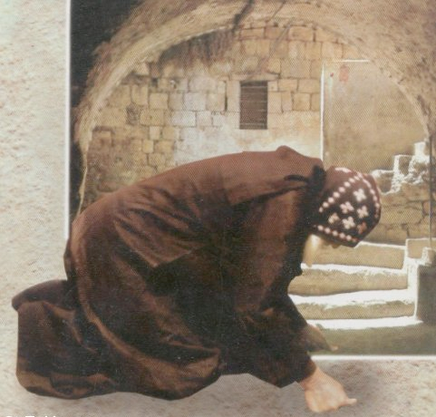
How do we cooperate with God’s Grace
Through ‘Ascesis”- the practice of self-denial
Repentance
Prayers
Fasting
Reading Scripture

Slide 11
1 Corinthians 15:10
“But by the grace of God I am what I am, and His grace toward me was not in vain; but I labored more abundantly than they all, yet not I, but the grace of God which was with me.”

Slide 12
1 corinthians 3:6-7
“I planted, Apollos watered, but God gave the increase. ⁷ So then neither he who plants is anything, nor he who waters, but God who gives the increase.”

Slide 13
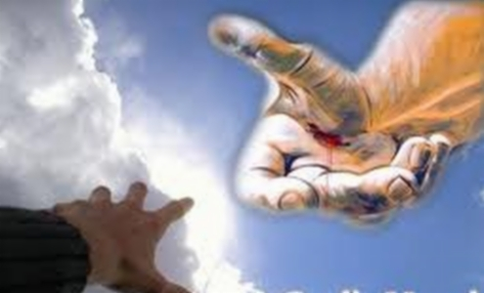
2 Criteria for God’s Salvation to take place
God must reach out to us

Slide 14

2. Our response to God’s reaching out through Faith

Slide 15
What synergy does not do
Synergy does not gain us merit!

Slide 16
Roman Catholic View
“Merit” theology: each good deed “earns” credits towards one’s salvation

Slide 17
Romans 6:23
“For the wages of sin is death, but the gift of God is eternal life in Christ Jesus our Lord.”

Slide 18

God’s gifts are always free gifts and man can never have any claim upon His maker

