Slide 1
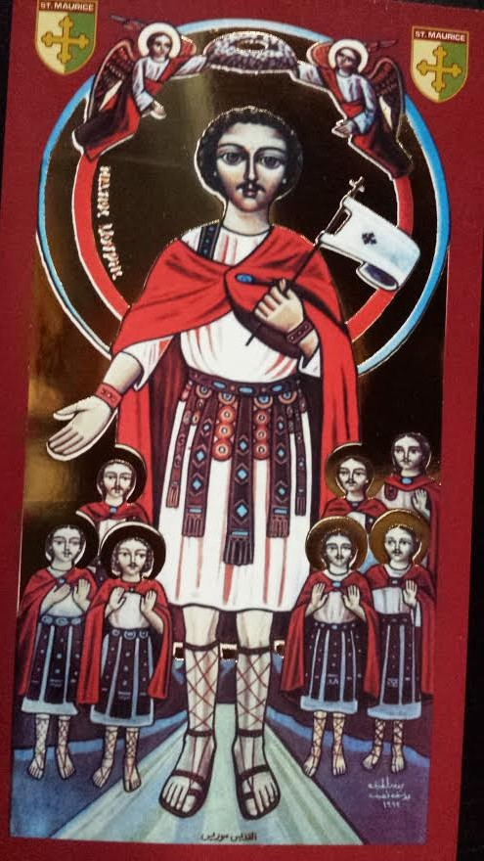

Slide 2
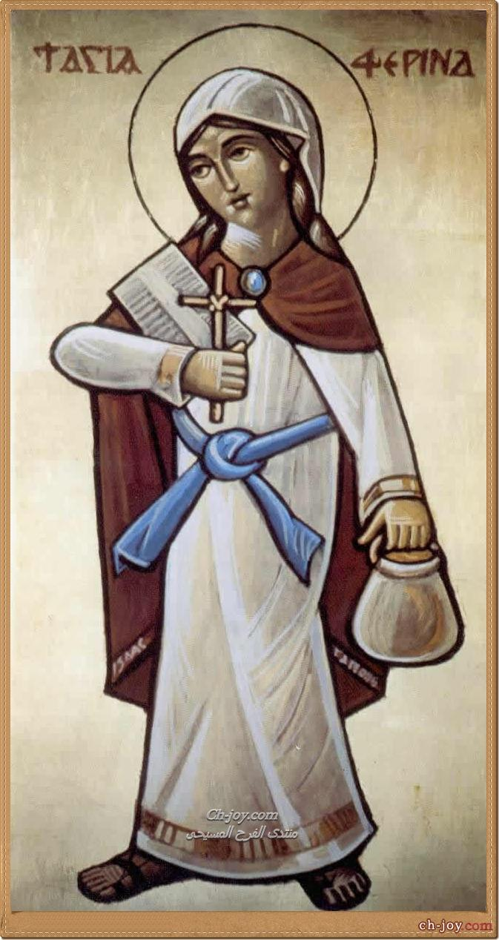

Slide 3
Virtue of Commitment

Slide 4
Who are you committed to?
1. God
2. Each Other
3. Yourself

Slide 5
Standards to dealing with others
Chastity
Successful Life
Strict with Time
Strict with Work
Tithes

Slide 6
Committed to God
Prayer
Tithes
First Fruits
First Promotion

Slide 7
Justifications?
Overcome Excuses
“The way to hell is laid down for you with excuses and justifications in your life”

Slide 8
Commitment to Others
Don’t use others
Put others ahead of yourself

Slide 9
Being Committed
Soul over body
Your surroundings will force you to commit
Live a life of commitment!!

