Slide 1
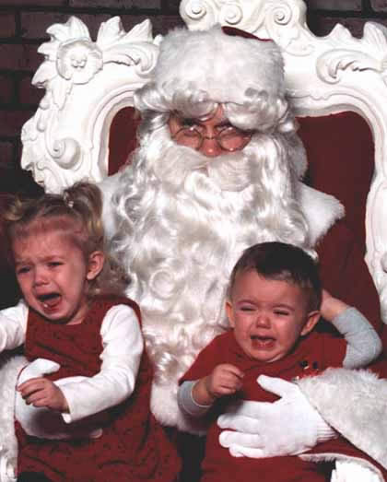
What’s So Special about Christmas?
December 26, 2010

Slide 2
Relevance:

Slide 3
Relevance: God came to earth

Slide 4
Relevance: God came to earth
“He [Jesus Christ] is the image of the invisible God, the firstborn over all creation...All things were created through Him and for Him” Colossians 1:15, 16

Slide 5
Relevance: God came to earth
“For there is one God and one Mediator between God and men, the Man Christ Jesus” 1 Timothy 2:5

Slide 6
Reason:

Slide 7
Reason: He came for my benefit

Slide 8
Reason: He came for my benefit
“I have come that they may have life, and that they may have it more abundantly.” John 10:10

Slide 9
Reason: He came for my benefit
“… He was manifested to take away our sins...” 1 John 3:5

Slide 10
Reason: He came for my benefit
“Mercy and truth have met together; righteousness and peace have kissed.” Psalm 85:10

Slide 11
Reason: He came for my benefit
“Greater love has no one than this, than to lay down one's life for his friends.” John 15:13

Slide 12
Result:

Slide 13
Result: I can know God

Slide 14
Result: I can know God
“For if when we were enemies we were reconciled to God through the death of His Son, much more, having been reconciled, we shall be saved by His life. And not only that, but we also rejoice in God through our Lord Jesus Christ, through whom we have now received the reconciliation.” Romans 5:10-11

Slide 15

The perfect gift

Slide 16
The perfect gift
Accept it!

Slide 17
“Therefore God also has highly exalted Him and given Him the name which is above every name, that at the name of Jesus every knee should bow, of those in heaven, and of those on earth, and of those under the earth, and that every tongue should confess that Jesus Christ is Lord, to the glory of God the Father” Philippians 2:9-11

Slide 18
JESUS IS LORD!
“Therefore God also has highly exalted Him and given Him the name which is above every name, that at the name of Jesus every knee should bow, of those in heaven, and of those on earth, and of those under the earth, and that every tongue should confess that Jesus Christ is Lord, to the glory of God the Father” Philippians 2:9-11

