Slide 1
Surviving the Season
November 14, 2010
Part 1

Slide 2
Is that possible?
“Then the angel said to them, “Do not be afraid, for behold, I bring you good tidings of great joy which will be to all people. For there is born to you this day in the city of David a Savior, who is Christ the Lord.” Luke 2:10-11

Slide 3
The Formula for Survival

Slide 4
The Formula for Survival
“Be anxious for nothing, but in everything by prayer and supplication, with thanksgiving, let your requests be made known to God” Philippians 4:6

Slide 5
The Formula for Survival
WORRY about nothing
“Be anxious for nothing, but in everything by prayer and supplication, with thanksgiving, let your requests be made known to God” Philippians 4:6

Slide 6
The Formula for Survival
WORRY about nothing
PRAY about everything
“Be anxious for nothing, but in everything by prayer and supplication, with thanksgiving, let your requests be made known to God” Philippians 4:6

Slide 7
The Formula for Survival
WORRY about nothing
PRAY about everything
“…casting all your care upon Him, for He cares for you” 1 Peter 5:7

Slide 8
The Formula for Survival
WORRY about nothing
PRAY about everything
“You do not have, because you do not ask” James 4:2

Slide 9
The Formula for Survival
THANK GOD in all things
“…by prayer and supplication, with thanksgiving, let your requests be made known to God” Philippians 4:6

Slide 10
The Formula for Survival
THANK GOD in all things
“In everything give thanks; for this is the will of God in Christ Jesus for you.” 1 Thessalonians 5:18

Slide 11
The Formula for Survival
THINK about the right things
“Finally, brethren, whatever things are true, whatever things are noble, whatever things are just, whatever things are pure, whatever things are lovely, whatever things are of good report…

Slide 12
The Formula for Survival
THINK about the right things
…if there is any virtue and if there is anything praiseworthy—meditate on these things.” Philippians 4:8

Slide 13
The Formula for Survival
THINK about the right things
“And do not be conformed to this world, but be transformed by the renewing of your mind.” Romans 12:2

Slide 14
The Formula for Survival
THINK about the right things
“As a man thinks in his heart, so is he.” Proverbs 23:7

Slide 15
The Result of this Formula?

Slide 16
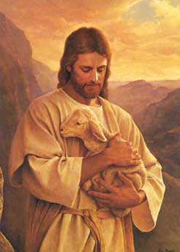
The Result of this Formula?
“…and the peace of God, which surpasses all understanding, will guard your hearts and minds through Christ Jesus.” Philippians 4:7

