Slide 1
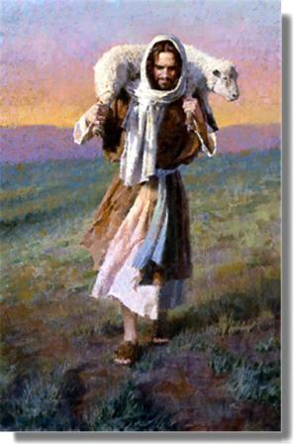
April 10, 2011
The Lord is My Shepherd

Slide 2
Psalm 23
The LORD is my shepherd, I shall not be in want. He makes me lie down in green pastures, he leads me beside quiet waters, he restores my soul. He guides me in paths of righteousness for his name’s sake. Even though I walk through the valley of the shadow of death, I will fear no evil, for you are with me; your rod and your staff, they comfort me.

Slide 3
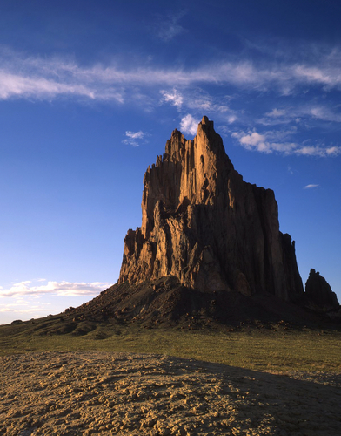
The Pinnacle of Spirituality…

Slide 4
The Pinnacle of Spirituality…
TRUST
“Those who trust in the LORD are like Mount Zion, which cannot be shaken but endures forever.” Psalm 125:1

Slide 5
What does it mean to trust God?
See John 4:46-54

Slide 6
What does it mean to trust God?
HOPE
“When he heard that Jesus had come out of Judea into Galilee, he went to Him and implored Him to come down and heal his son, for he was at the point of death.” John 4:47

Slide 7
What does it mean to trust God?
HOPE: lack of belief in the world
“When he heard that Jesus had come out of Judea into Galilee, he went to Him and implored Him to come down and heal his son, for he was at the point of death.” John 4:47

Slide 8
What does it mean to trust God?
HOPE: lack of belief in the world
OBEDIENCE
“Jesus said to him, “Go your way; your son lives.” So the man believed the word that Jesus spoke to him, and he went his way.” John 4:50

Slide 9
What does it mean to trust God?
HOPE: lack of belief in the world
OBEDIENCE: belief in His Word
“Jesus said to him, “Go your way; your son lives.” So the man believed the word that Jesus spoke to him, and he went his way.” John 4:50

Slide 10
What does it mean to trust God?
HOPE: lack of belief in the world
OBEDIENCE: belief in His Word
TRUST: belief in Him
“And he himself believed, and his whole household.” John 4:53

Slide 11
What does it mean to trust God?
HOPE: lack of belief in the world
OBEDIENCE: belief in His Word
TRUST: belief in Him
I hope → I think → I know

Slide 12
SHOW VIDEO HERE

Slide 13
What does it mean to trust God?
HOPE: lack of belief in the world
OBEDIENCE: belief in His Word
TRUST: belief in Him
I hope → I think → I know

Slide 14
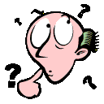
Obeying God ≠ Trusting God

Slide 15
“The LORD God is my strength; He will make my feet like deer’s feet, and He will make me walk on my high hills.”
Habakkuk 3:19

Slide 16
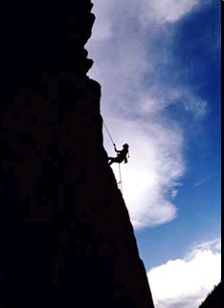
Trust is the only path to
the top of the mountain

Slide 17
Trust is the only path to
the top of the mountain
“Now He did not do many mighty works there because of their unbelief.” Matthew 13:58

Slide 18
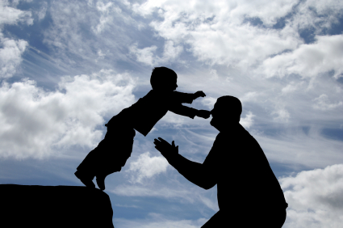
Personal experience
is the only way to gain trust.

Slide 19
Life of Faith, by HH Pope Shenouda
“The believer does not enter into an argument with God about His doing, but accepts all things and confidence in God's wisdom and love.”

Slide 20
Are you ready to trust Him
up the mountain?
“Jesus said to him, “If you can believe, all things are possible to him who believes.” Mark 9:23

