Slide 1
I believe in God but
I trust in money
October 10, 2010
Part 3

Slide 2
“For where your treasure is,
there your heart will be also.”
Luke 12:34

Slide 3
“For where your treasure is,
there your heart will be also.”
Luke 12:34
We trust money to provide:

Slide 4
“For where your treasure is,
there your heart will be also.”
Luke 12:34
We trust money to provide:
HAPPINESS

Slide 5
“For where your treasure is,
there your heart will be also.”
Luke 12:34
We trust money to provide:
HAPPINESS
SECURITY

Slide 6
Money will be the #1 competitor
for our hearts
“For the love of money is a root of all kinds of evil, for which some have strayed from the faith in their greediness, and pierced themselves through with many sorrows.” 1 Timothy 6:10

Slide 7
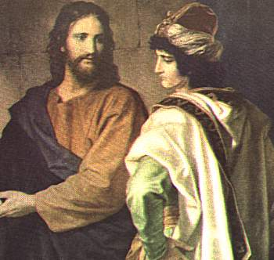
Two Rich Men Encounter Jesus

Slide 8
Two Rich Men Encounter Jesus
“Jesus said to him, “If you want to be perfect, go, sell what you have and give to the poor, and you will have treasure in heaven; and come, follow Me.” Matthew 19:21

Slide 9
Two Rich Men Encounter Jesus
“But when the young man heard that saying, he went away sorrowful, for he had great possessions.” Matthew 19:22

Slide 10
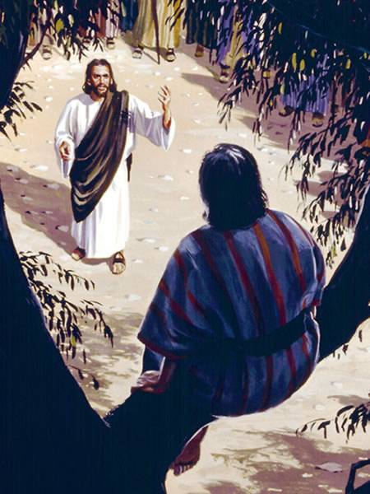
Two Rich Men Encounter Jesus

Slide 11
Two Rich Men Encounter Jesus
“Then Zacchaeus stood and said to the Lord, “Look, Lord, I give half of my goods to the poor; and if I have taken anything from anyone by false accusation, I restore fourfold.” Luke 19:8

Slide 12
One rich man didn’t want to let go of
HIS MONEY, so he lost HEAVEN.
The other rich man didn’t want to let go of JESUS, so he lost his MONEY.

Slide 13
One rich man didn’t want to let go of
HIS MONEY, so he lost HEAVEN.
The other rich man didn’t want to let go of JESUS, so he lost his MONEY.
“No servant can serve two masters; for either he will hate the one and love the other, or else he will be loyal to the one and despise the other. You cannot serve God and mammon [MONEY].” Luke 16:13

Slide 14
When you hold on to Jesus…

Slide 15
When you hold on to Jesus…
You become STRANGELY CONTENT.
“Command those who are rich in this present age not to be haughty, nor to trust in uncertain riches but in the living God, who gives us richly all things to enjoy.” 1 Timothy 6:17

Slide 16
When you hold on to Jesus…
You become irrationally generous, because you recognize that you can use earthly/temporary money to make heavenly/eternal investments

Slide 17
When you hold on to Jesus…
You become irrationally generous, because you recognize that you can use earthly/temporary money to make heavenly/eternal investments
“Let them do good, that they be rich in good works, ready to give, willing to share, storing up for themselves a good foundation for the time to come, that they may lay hold on eternal life.” 1 Timothy 6:18-19

Slide 18
“I believe in God,
but I trust in money”

Slide 19
“I believe in God,
but I trust in money”
“And when you offer the blind as a sacrifice, is it not evil? And when you offer the lame and sick, is it not evil? Offer it then to your governor! Would he be pleased with you? Would he accept you favorably?” says the LORD of hosts.” Malachi 1:8

Slide 20
“I believe in God,
but I trust in money”
“No, but I will surely buy it from you for a price; nor will I offer burnt offerings to the LORD my God with that which costs me nothing.” 2 Samuel 24:24

Slide 21
“He who is faithful in what is least is faithful also in much; and he who is unjust in what is least is unjust also in much. Therefore if you have not been faithful in the unrighteous mammon, who will commit to your trust the true riches?” Luke 16:10-11

Slide 22
“He who is faithful in what is least is faithful also in much; and he who is unjust in what is least is unjust also in much. Therefore if you have not been faithful in the unrighteous mammon, who will commit to your trust the true riches?” Luke 16:10-11
Are you ready for the true riches?

