Slide 1
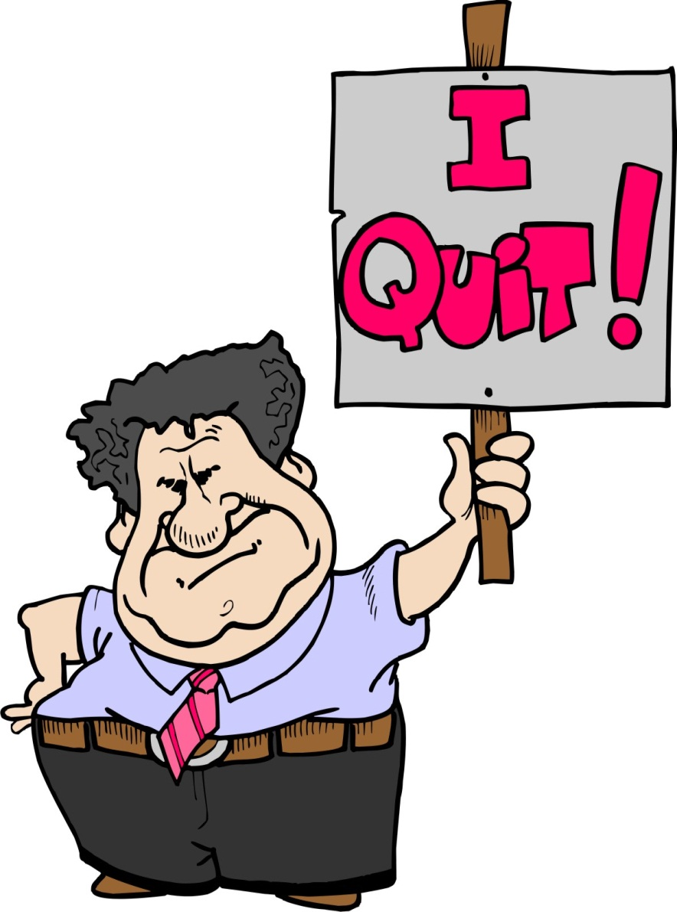
Quit complaining
February 6, 2011
Part 2

Slide 2
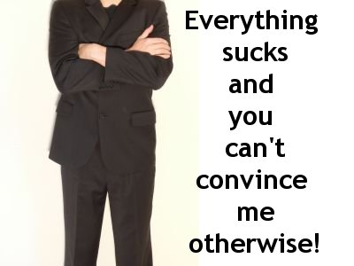
Is complaining really a big deal???

Slide 3
Job 10:1
“I loathe my very life; therefore I will give free rein to my complaint and speak out in the bitterness of my soul.”

Slide 4
Exodus 16:2-3
“Then the whole congregation of the children of Israel complained against Moses and Aaron in the wilderness. And the children of Israel said to them, “Oh, that we had died by the hand of the LORD in the land of Egypt, when we sat by the pots of meat and when we ate bread to the full! For you have brought us out into this wilderness to kill this whole assembly with hunger.”

Slide 5
The Cost of Complaining

Slide 6
The Cost of Complaining
Complaining offends God

Slide 7
The Cost of Complaining
Complaining offends God
“Now when the people complained, it displeased the LORD; for the LORD heard it, and His anger was aroused. So the fire of the LORD burned among them, and consumed some in the outskirts of the camp.” Numbers 11:1

Slide 8
The Cost of Complaining
Complaining offends God
Complaining carries significant consequences

Slide 9
Numbers 14:27-30
“How long shall I bear with this evil congregation who complain against Me? I have heard the complaints which the children of Israel make against Me. Say to them, ‘As I live,’ says the LORD, ‘just as you have spoken in My hearing, so I will do to you: The carcasses of you who have complained against Me shall fall in this wilderness… You shall by no means enter the land which I swore I would make you dwell in.”

Slide 10

Confirmation Bias
“the tendency for people to favor information that confirms their preconceptions or hypotheses regardless of whether the information is true”

Slide 11
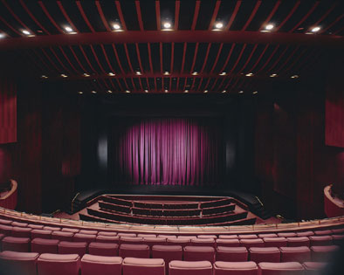
Who’s on center stage?

Slide 12
Restraining our Complaining

Slide 13
Restraining our Complaining
The What?
The Why?
The How?

Slide 14
Restraining our Complaining
The What? DO NOT COMPLAIN
“Do all things without complaining and disputing” Philippians 2:14

Slide 15
Restraining our Complaining
The What? DO NOT COMPLAIN
“Let no corrupt word proceed out of your mouth, but what is good for necessary edification, that it may impart grace to the hearers.” Ephesians 4:29

Slide 16
Restraining our Complaining
The Why?

Slide 17
Restraining our Complaining
The Why? To become like Christ
“Do all things without complaining and disputing, that you may become blameless and harmless, children of God without fault in the midst of a crooked and perverse generation, among whom you shine as lights in the world” Philippians 2:14-15

Slide 18
Restraining our Complaining
The Why? To become like Christ
“For out of the abundance of the heart the mouth speaks.” Matthew 12:34

Slide 19
Restraining our Complaining
The How?

Slide 20
Restraining our Complaining
The How? Choose to rejoice no matter what
“Yes, and if I am being poured out as a drink offering on the sacrifice and service of your faith, I am glad and rejoice with you all. For the same reason you also be glad and rejoice with me.” Philippians 2:17-18

Slide 21
Restraining our Complaining
The How? Choose to rejoice no matter what
“And I thank Christ Jesus our Lord who has enabled me, because He counted me faithful, putting me into the ministry” 1 Timothy 1:12

Slide 22
What? Do not complain
Why? To become like Christ
How? Choose to rejoice no matter what

