Slide 1

Quit making excuses
January 30, 2011
Part 1

Slide 2

As soon as I decide to be different, Satan gives me EXCUSES to stay the same.

Slide 3
Luke 14:16-18
“Then He said to him, “A certain man gave a great supper and invited many, and sent his servant at supper time to say to those who were invited, ‘Come, for all things are now ready.’ But they all with one accord began to make excuses.

Slide 4
Luke 14:19-20
The first said to him, ‘I have bought a piece of ground, and I must go and see it. I ask you to have me excused.’ And another said, ‘I have bought five yoke of oxen, and I am going to test them. I ask you to have me excused.’ Still another said, ‘I have married a wife, and therefore I cannot come.’”

Slide 5
Good intentions
vs
God intentions

Slide 6
Deciding to Be Different

Slide 7
Deciding to Be Different
WHAT does God want to be different?

Slide 8
Deciding to Be Different
WHAT does God want to be different?
WHY does God want it to be different?

Slide 9
Deciding to Be Different
WHAT does God want to be different?
WHY does God want it to be different?
“What then shall we say to these things? If God is for us, who can be against us?” Romans 8:31

Slide 10
Exodus 4:10
Then Moses said to the LORD, “O my Lord, I am not eloquent, neither before nor since You have spoken to Your servant; but I am slow of speech and slow of tongue.”

Slide 11
Exodus 4:11
So the LORD said to him, “Who has made man’s mouth? Or who makes the mute, the deaf, the seeing, or the blind? Have not I, the LORD?

Slide 12
“And the LORD said to Abraham, “Why did Sarah laugh, saying, ‘Shall I surely bear a child, since I am old?’ Is anything too hard for the LORD?” Genesis 18:13-14
“Behold, I am the LORD, the God of all flesh. Is there anything too hard for Me?” Jeremiah 32:27

Slide 13
Exodus 4:12
Now therefore, go, and I will be with your mouth and teach you what you shall say.

Slide 14
Do what you CAN do

Slide 15
Do what you CAN do
“And the LORD said to Moses, “Why do you cry to Me? Tell the children of Israel to go forward.” Exodus 14:15

Slide 16
Do what you CAN do
Trust God to do what you CANNOT do

Slide 17
Do what you CAN do
Trust God to do what you CANNOT do
“And the LORD said to Moses, “Why do you cry to Me? Tell the children of Israel to go forward. But lift up your rod, and stretch out your hand over the sea and divide it. And the children of Israel shall go on dry ground through the midst of the sea.” Exodus 14:15-16

Slide 18
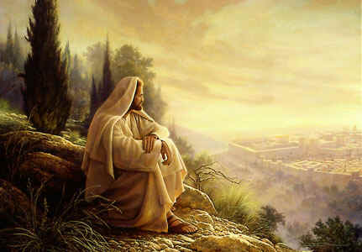
How many times do you think God was ready to do a change, but you weren’t?

Slide 19
“For we walk by faith, not by sight.”
2 Corinthians 5:7

Slide 20
“And He said to me, “My grace is sufficient for you, for My strength is made perfect in weakness.” Therefore most gladly I will rather boast in my infirmities, that the power of Christ may rest upon me… For when I am weak, then I am strong.”
2 Corinthians 12:9-10

