Slide 1
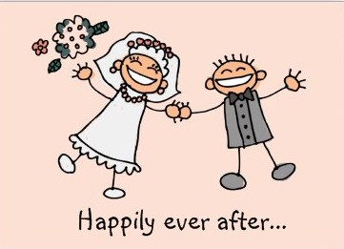
Hosea and gomer
Part 4
July 31, 2011

Slide 2
INSERT VIDEO HERE

Slide 3
Hosea and gomer
Part 4
July 31, 2011

Slide 4

Dating or married?

Slide 5
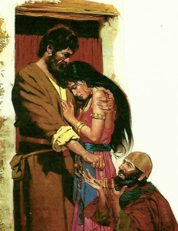
Hosea and gomer

Slide 6
Hosea and gomer
“When the Lord began to speak through Hosea, the Lord said to him, "Go, take to yourself an adulterous wife and children of unfaithfulness, because the land is guilty of the vilest adultery in departing from the Lord." So he married Gomer daughter of Diblaim, and she conceived and bore him a son.” Hosea 1:2-3

Slide 7
Hosea and gomer
“When the Lord began to speak through Hosea, the Lord said to him, "Go, take to yourself an adulterous wife and children of unfaithfulness, because the land is guilty of the vilest adultery in departing from the Lord." So he married Gomer daughter of Diblaim, and she conceived and bore him a son.” Hosea 1:2-3

Slide 8
What I’m missing is better than what I have

Slide 9
What I’m missing is better than what I have
“She said, 'I will go after my lovers, who give me my food and my water, my wool and my linen, my oil and my drink.'” Hosea 2:5

Slide 10
What I’m missing is better than what I have
“Gomer conceived again and gave birth to a daughter. Then the LORD said to Hosea, “Call her Lo-Ruhamah (which means “not loved”), for I will no longer show love to Israel, that I should at all forgive them.” Hosea 1:6

Slide 11
What I’m missing is better than what I have
“After she had weaned Lo-Ruhamah, Gomer had another son. Then the LORD said, “Call him Lo-Ammi (which means “not my people”), for you are not my people, and I am not your God.” Hosea 1:8-9

Slide 12
GOD’S RESPONSE TO ADULTERY

Slide 13
GOD’S RESPONSE TO ADULTERY
Righteous Anger
“She has not acknowledged that I was the one who gave her the grain, the new wine and oil, who lavished on her the silver and gold… "Therefore I will take away my grain when it ripens, and my new wine when it is ready. I will take back my wool and my linen, intended to cover her nakedness. So now I will expose her lewdness before the eyes of her lovers; no one will take her out of my hands.” Hosea 2:8-10

Slide 14
GOD’S RESPONSE TO ADULTERY
Unfailing Love

Slide 15
GOD’S RESPONSE TO ADULTERY
Unfailing Love
“I will punish her for the days she burned incense to the Baals; she decked herself with rings and jewelry, and went after her lovers, but me she forgot,” declares the LORD.” Hosea 2:13

Slide 16
GOD’S RESPONSE TO ADULTERY
Unfailing Love
“Therefore I am now going to allure her; I will lead her into the desert and speak tenderly to her. There I will give her back her vineyards, and will make the Valley of Achor a door of hope.” Hosea 2:14-15

Slide 17
Forgive and love as you’ve been forgiven and loved

Slide 18
Forgive and love as you’ve been forgiven and loved
“The Lord said to me, "Go, show your love to your wife again, though she is loved by another and is an adulteress. Love her as the Lord loves the Israelites, though they turn to other gods…" Hosea 3:1

Slide 19


Slide 20
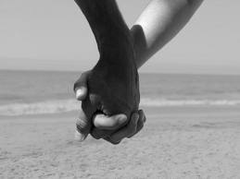

Slide 21
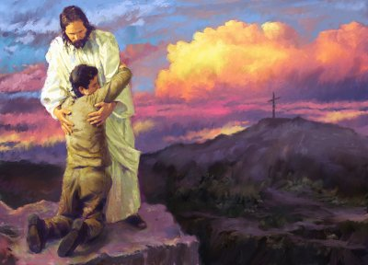
“For you were bought at a price; therefore glorify God in your body and in your spirit, which are God's.”
1 Corinthians 6:20

