Slide 1
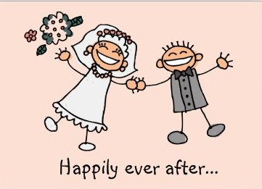
Abraham & Sarah
Part 3
July 24, 2011

Slide 2
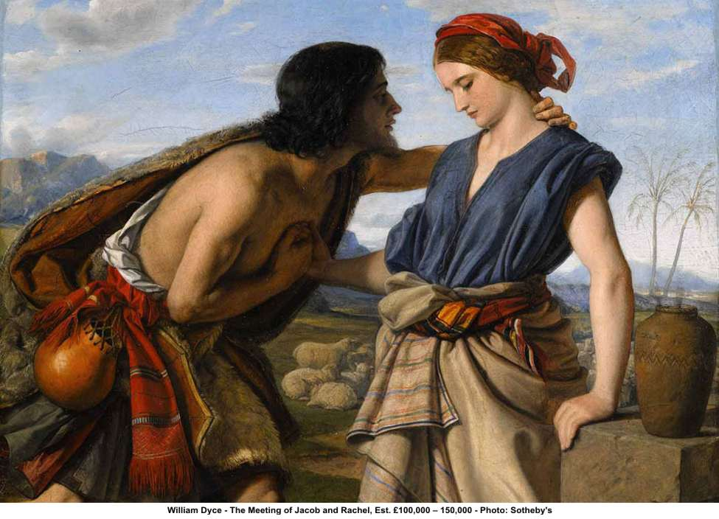
Jacob and Leah/Rachel

Slide 3
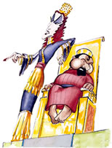
Ahab and Jezebel

Slide 4
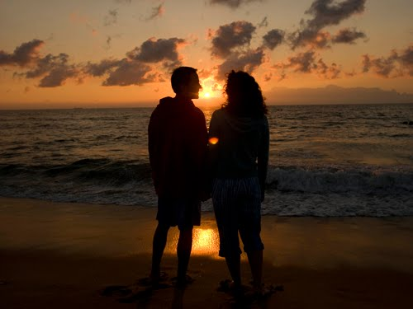
What do you want out of marriage?

Slide 5
heroes of faith:
Abraham & Sarah
“Now the LORD had said to Abram: “Get out of your country, from your family and from your father’s house, to a land that I will show you. I will make you a great nation; I will bless you and make your name great; and you shall be a blessing.” Genesis 12:1-2

Slide 6
heroes of faith:
Abraham & Sarah
“By faith Abraham obeyed when he was called to go out to the place which he would receive as an inheritance. And he went out, not knowing where he was going.” Hebrews 11:8

Slide 7
heroes of faith:
Abraham & Sarah
Or were they???

Slide 8
heroes of faith:
Abraham & Sarah
Or were they???
“If we are faithless, He remains faithful” 2 Timothy 2:13

Slide 9
Faith-less seasons

Slide 10
Faith-less seasons
We fall victim to FEAR
“…he said to Sarai his wife, “Indeed I know that you are a woman of beautiful countenance. Therefore it will happen, when the Egyptians see you, that they will say, ‘This is his wife’; and they will kill me, but they will let you live. Please say you are my sister, that it may be well with me for your sake, and that I may live because of you.” Genesis 12:11-13

Slide 11
Faith-less seasons
We fall victim to FEAR
Either build up in faith
Or tear down in fear

Slide 12
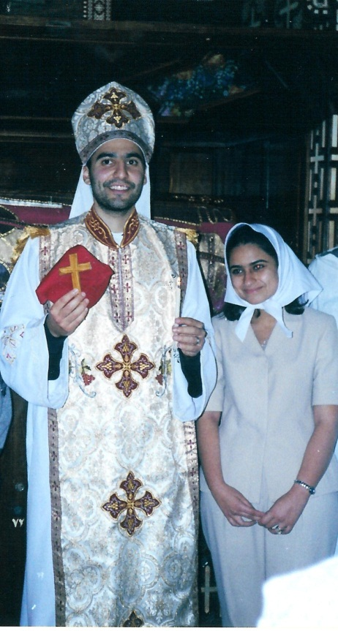
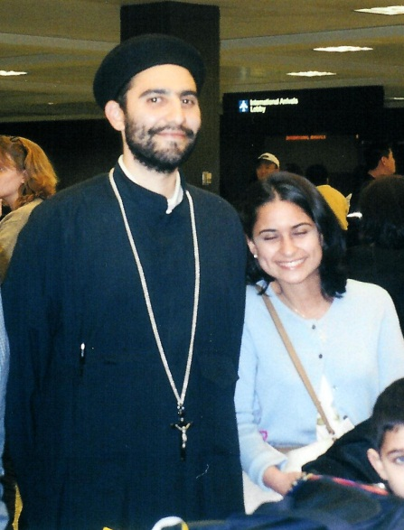

Slide 13
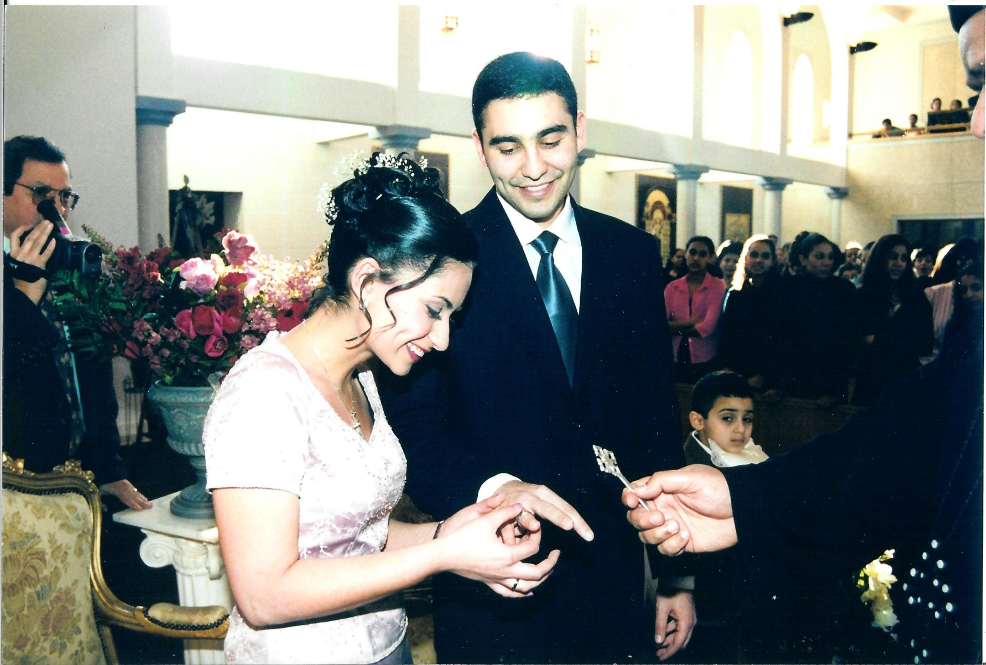

Slide 14
Faith-less seasons
We fall victim to FEAR
Either build up in faith
Or tear down in fear

Slide 15
Faith-less seasons
We get ahead of God
“Now Sarai, Abram’s wife, had borne him no children. And she had an Egyptian maidservant whose name was Hagar. So Sarai said to Abram, “See now, the LORD has restrained me from bearing children. Please, go in to my maid; perhaps I shall obtain children by her.” And Abram heeded the voice of Sarai.” Genesis 16:1-2

Slide 16
Faith-less seasons
We get ahead of God
God is rarely ever early,
but He’s also never late.

Slide 17
Faith-less seasons
We get ahead of God
“For what if some did not believe? Will their unbelief make the faithfulness of God without effect? Certainly not! Indeed, let God be true but every man a liar.” Romans 3:3-4

Slide 18
Faith-less seasons
We don’t believe God will do it for us.

Slide 19
Faith-less seasons
We don’t believe God will do it for us.
“Then God said to Abraham, “As for Sarai your wife, you shall not call her name Sarai, but Sarah shall be her name. And I will bless her and also give you a son by her; then I will bless her, and she shall be a mother of nations; kings of peoples shall be from her…”

Slide 20
Faith-less seasons
We don’t believe God will do it for us.
…Then Abraham fell on his face and laughed, and said in his heart, “Shall a child be born to a man who is one hundred years old? And shall Sarah, who is ninety years old, bear a child?” Genesis 17:15-17

Slide 21
Faith-less seasons
We don’t believe God will do it for us.
“Therefore Sarah laughed within herself, saying, “After I have grown old, shall I have pleasure, my lord being old also?” And the LORD said to Abraham, “Why did Sarah laugh, saying, ‘Shall I surely bear a child, since I am old?’ Is anything too hard for the LORD?” Genesis 18:12-14

Slide 22
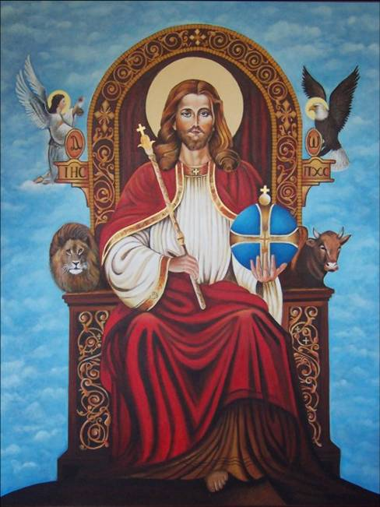
Is anything too hard for the lord?

Slide 23
“And not being weak in faith, he did not consider his own body, already dead (since he was about a hundred years old), and the deadness of Sarah’s womb. He did not waver at the promise of God through unbelief, but was strengthened in faith, giving glory to God, and being fully convinced that what He had promised He was also able to perform.” Romans 4:19-21

