Slide 1
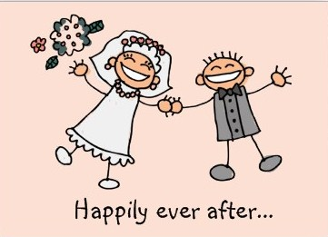
AHAB AND JEZEBEL
Part 2
July 17, 2011

Slide 2
VIDEO – WEEK 2 GOES HERE

Slide 3
AHAB AND JEZEBEL
Part 2
July 17, 2011

Slide 4
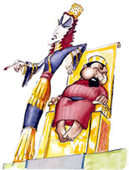
Ahab and Jezebel

Slide 5
Ahab and Jezebel
“There was never anyone like Ahab, who sold himself to do evil in the eyes of the LORD, urged on by Jezebel his wife.” 1 Kings 21:25

Slide 6
Ahab and Jezebel
Ahab represents the PASSIVE husband
Jezebel represents the CONTROLLING wife

Slide 7
The passive husband
“Ahab said to Naboth, "Let me have your vineyard to use for a vegetable garden, since it is close to my palace. In exchange I will give you a better vineyard or, if you prefer, I will pay you whatever it is worth." 1 Kings 21:2

Slide 8
Cheesy 80’s love songs

Slide 9
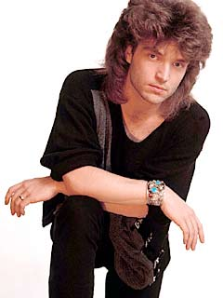
RICHARD MARX “Right Here Waiting for You”

Slide 10
Cheesy 80’s love songs

Slide 11
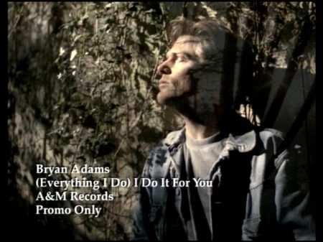
BRYAN ADAMS “(Everything I Do) I Do It For You”

Slide 12
Cheesy 80’s love songs

Slide 13
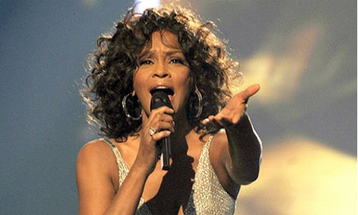
WHITNEY HOUSTON “I Will Always Love You”

Slide 14
The passive husband
“But Naboth replied, "The Lord forbid that I should give you the inheritance of my ancestors." So Ahab went home, sullen and angry because Naboth the Jezreelite had said, "I will not give you the inheritance of my ancestors." He lay on his bed sulking and refused to eat.” 1 Kings 21:3-4

Slide 15
The CONTROLLING WIFE
“His wife Jezebel came in and asked him, "Why are you so sullen? Why won't you eat?" He answered her, "Because I said to Naboth the Jezreelite, 'Sell me your vineyard; or if you prefer, I will give you another vineyard in its place.' But he said, 'I will not give you my vineyard.'" Jezebel his wife said, "Is this how you act as king over Israel? Get up and eat! Cheer up. I'll get you the vineyard of Naboth the Jezreelite." 1 Kings 21:5-7

Slide 16
The CONTROLLING WIFE
Belittles her husband with her words
“Jezebel his wife said, "Is this how you act as king over Israel?” 1 Kings 21:7a

Slide 17
The CONTROLLING WIFE
Belittles her husband with her words
A godly woman makes a weak man strong.
A controlling woman makes a weak man even weaker.

Slide 18
The CONTROLLING WIFE
Belittles her husband with her words
Takes over
“I'll get you the vineyard of Naboth the Jezreelite." 1 Kings 21:7b

Slide 19
The CONTROLLING WIFE
Belittles her husband with her words
Takes over
Pray, pray, pray
and stay out of the way!

Slide 20
God hard wired it in you [MEN]
to be a LEADER!

Slide 21
HUSBAND’S CALL TO LEAD
Provider
Protector
Pastor

Slide 22
HUSBAND’S CALL TO LEAD
“As soon as Jezebel heard that Naboth had been stoned to death, she said to Ahab, "Get up and take possession of the vineyard of Naboth the Jezreelite that he refused to sell you. He is no longer alive, but dead." When Ahab heard that Naboth was dead, he got up and went down to take possession of Naboth's vineyard.” 1 Kings 21:15-16

Slide 23
HUSBAND’S CALL TO LEAD
Then the word of the Lord came to Elijah the Tishbite: "Go down to meet Ahab king of Israel, who rules in Samaria. He is now in Naboth's vineyard, where he has gone to take possession of it. Say to him, 'This is what the Lord says: Have you not murdered a man and seized his property?' Then say to him, 'This is what the Lord says: In the place where dogs licked up Naboth's blood, dogs will lick up your blood — yes, yours!'" 1 Kings 21:17-19

Slide 24
Where have you fallen short?

Slide 25
Where have you fallen short?
“Wives, submit to your own husbands, as to the Lord. For the husband is head of the wife, as also Christ is head of the church… Husbands, love your wives, just as Christ also loved the church and gave Himself for her, that He might sanctify and cleanse her with the washing of water by the word, that He might present her to Himself a glorious church, not having spot or wrinkle or any such thing, but that she should be holy and without blemish.” Ephesians 5:22-27

