Slide 1
How God Builds My Faith
May 1, 2011

Slide 2

"According to your faith, let it be to you.” Matthew 9:29

Slide 3
Life of Faith
“Jesus said to him, ‘If you can believe, all things are possible to him who believes.’” Mark 9:23

Slide 4
Life of Faith
“Jesus said to him, ‘If you can believe, all things are possible to him who believes.’” Mark 9:23
“But without faith it is impossible to please Him” Hebrews 11:6

Slide 5
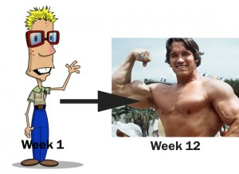
God’s Faith Building Plan

Slide 6
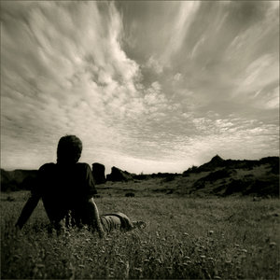
God’s Faith Building Plan
Phase 1: DREAM

Slide 7
God’s Faith Building Plan
Phase 1: DREAM
“Now to Him who is able to do exceedingly abundantly above all that we ask or think, according to the power that works in us” Ephesians 3:20

Slide 8
God’s Faith Building Plan
Phase 2: DECISION

Slide 9
God’s Faith Building Plan
Phase 2: DECISION
“And the Lord said to Moses, Why do you cry to Me? Tell the children of Israel to go forward.” Exodus 14:15

Slide 10

God’s Faith Building Plan
Phase 2: DECISION

Slide 11

God’s Faith Building Plan
Phase 3: DELAY

Slide 12
God’s Faith Building Plan
Phase 3: DELAY
“For the vision is yet for an appointed time; but at the end it will speak, and it will not lie. Though it tarries, wait for it; because it will surely come” Habakkuk 2:3

Slide 13

God’s Faith Building Plan
Phase 4: DIFFICULTY

Slide 14
God’s Faith Building Plan
Phase 4: DIFFICULTY
“In this you greatly rejoice, though now for a little while, if need be, you have been grieved by various trials, that the genuineness of your faith, being much more precious than gold that perishes, though it is tested by fire, may be found to praise, honor, and glory at the revelation of Jesus Christ,” 1 Peter 1:6-7

Slide 15
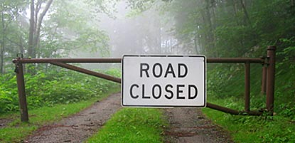
God’s Faith Building Plan
Phase 5: DEAD END

Slide 16
God’s Faith Building Plan
Phase 5: DEAD END
“We were burdened beyond measure, above strength, so that we despaired even of life. Yes, we had the sentence of death in ourselves, that we should not trust in ourselves but in God who raises the dead” 2 Corinthians 1:8-9

Slide 17
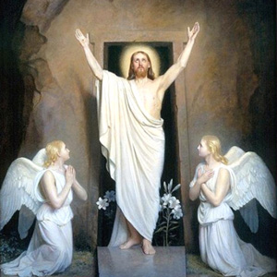
God’s Faith Building Plan
Phase 6: DELIVERANCE
“…who delivered us from so great a death, and does deliver us; in whom we trust that He will still deliver us” 2 Corinthians 1:10

Slide 18
Psalm 27:1-3
“The Lord is my light and my salvation; whom shall I fear? The Lord is the strength of my life; of whom shall I be afraid? When the wicked came against me to eat up my flesh, my enemies and foes, they stumbled and fell. Though an army may encamp against me, my heart shall not fear; though war should rise against me, in this I will be confident.”

Slide 19
God’s Faith Building Plan
Phase 1: DREAM
Phase 2: DECISION
Phase 3: DELAY
Phase 4: DIFFICULTY
Phase 5: DEAD END
Phase 6: DELIVERANCE

