Slide 1
S—L—O—W Down
Surviving the Season – Part 2
November 21, 2010

Slide 2
Effects of a Hurried Lifestyle

Slide 3
Effects of a Hurried Lifestyle
I feel MORE STRESS

Slide 4
Effects of a Hurried Lifestyle
I feel MORE STRESS
I lose MY JOY
“…my days are swifter than a runner; they flee away, they see no good.” Job 9:25

Slide 5
Effects of a Hurried Lifestyle
I feel MORE STRESS
I lose MY JOY
I am LESS PRODUCTIVE
“The plans of the diligent lead surely to plenty, but those of everyone who is hasty, surely to poverty.” Proverbs 21:5

Slide 6
Effects of a Hurried Lifestyle
I feel MORE STRESS
I lose MY JOY
I am LESS PRODUCTIVE
I can’t HEAR GOD
“Be still, and know that I am God.” Psalm 46:10

Slide 7
Slowing Your Pace

Slide 8
Slowing Your Pace
S – STOP the constant push for more

Slide 9
Slowing Your Pace
S – STOP the constant push for more
“Better a handful with quietness than both hands full, together with toil…” Ecclesiastes 4:6

Slide 10
Slowing Your Pace
S – STOP the constant push for more
“A heart at peace gives life to the body, but envy rots the bones.” Proverbs 14:30

Slide 11
Slowing Your Pace
L – LEARN to say no

Slide 12
Slowing Your Pace
L – LEARN to say no
“It is a trap for a man to dedicate something rashly and only later to consider his vows.” Proverbs 20:25

Slide 13
Slowing Your Pace
O – OBEY the 4th commandment

Slide 14
Slowing Your Pace
O – OBEY the 4th commandment
“Six days you shall labor and do all your work, but the seventh day is the Sabbath of the LORD your God.” Exodus 20:9-10

Slide 15
Slowing Your Pace
O – OBEY the 4th commandment
“In vain you rise early and stay up late, toiling for food to eat— for he grants sleep to those he loves.” Psalm 127:2

Slide 16
Slowing Your Pace
W – WAIT for God’s timing

Slide 17
Slowing Your Pace
W – WAIT for God’s timing
“He has made everything beautiful in its time…no one can find out the work that God does from beginning to end.” Ecclesiastes 3:11

Slide 18
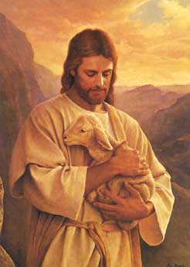
“I have come that they may have life, and that they may have it more abundantly.”
John 10:10

