Slide 1


Part 2: Belief or Commitment?
October 30, 2011

Slide 2

“There was a man of the Pharisees named Nicodemus, a ruler of the Jews. This man came to Jesus by night and said to Him, “Rabbi, we know that You are a teacher come from God; for no one can do these signs that You do unless God is with him.” John 3:1-2

Slide 3
Why by night?
“There was a man of the Pharisees named Nicodemus, a ruler of the Jews. This man came to Jesus by night and said to Him, “Rabbi, we know that You are a teacher come from God; for no one can do these signs that You do unless God is with him.” John 3:1-2

Slide 4
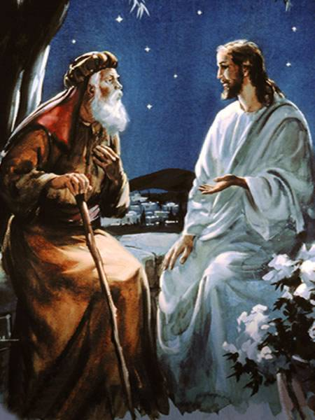
Nicodemus wanted to be a fan/secret admirer, but Jesus wanted a follower.

Slide 5
Diagnosing Fandom
Do you believe in Jesus?
Or do you follow Him?

Slide 6
James 2:19-20
“You believe that there is one God. You do well. Even the demons believe—and tremble! But do you want to know, O foolish man, that faith without works is dead?” James 2:19-20

Slide 7
Believing vs Following
Then He said to them all, “If anyone desires to come after Me, let him deny himself, and take up his cross daily, and follow Me.” Luke 9:23

Slide 8
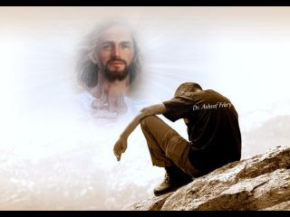
Fans do not want Jesus to interfere in their lives

Slide 9
Fans do not want Jesus to interfere in their lives
“If anyone comes to Me and does not hate his father and mother, wife and children, brothers and sisters, yes, and his own life also, he cannot be My disciple. And whoever does not bear his cross and come after Me cannot be My disciple.” Luke 14:26-27

Slide 10
Fans do not want Jesus to interfere in their lives
“So likewise, whoever of you does not forsake all that he has cannot be My disciple.” Luke 14:33

Slide 11
Has following Jesus
cost you anything?

Slide 12
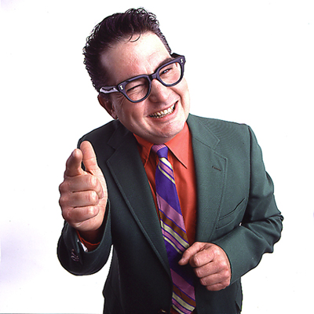
Fans focus only on the benefits of relationship with Jesus, but never the cost of it.

Slide 13
Fans focus only on the benefits of relationship with Jesus, but never the cost of it.
“For whoever desires to save his life will lose it, but whoever loses his life for My sake will find it.” Matthew 16:25

Slide 14
What was the last real sacrifice you made in order to follow Jesus?

Slide 15

Fans want to keep their relationship with Jesus private

Slide 16
Fans want to keep their relationship with Jesus private
“Therefore whoever confesses Me before men, him I will also confess before My Father who is in heaven. But whoever denies Me before men, him I will also deny before My Father who is in heaven.” Matthew 10:32-33

Slide 17
Diagnosing Fandom
Who was the last person you spoke to about your relationship with Jesus?

Slide 18
John 7:45-52
“Then the officers came to the chief priests and Pharisees, who said to them, “Why have you not brought Him?”
The officers answered, “No man ever spoke like this Man!”

Slide 19
John 7:45-52
Then the Pharisees answered them, “Are you also deceived? Have any of the rulers or the Pharisees believed in Him? But this crowd that does not know the law is accursed.”

Slide 20
John 7:45-52
“Nicodemus (he who came to Jesus by night, being one of them) said to them, “Does our law judge a man before it hears him and knows what he is doing?” They answered and said to him, “Are you also from Galilee?”

Slide 21

It’s time to choose

Slide 22
John 19:39
“And Nicodemus, who at first came to Jesus by night, also came, bringing a mixture of myrrh and aloes, about a hundred pounds.”

