Slide 1
Going Up in a Blaze of Glory
August 24, 2011
Part 8
Part 1 - Title

Slide 2
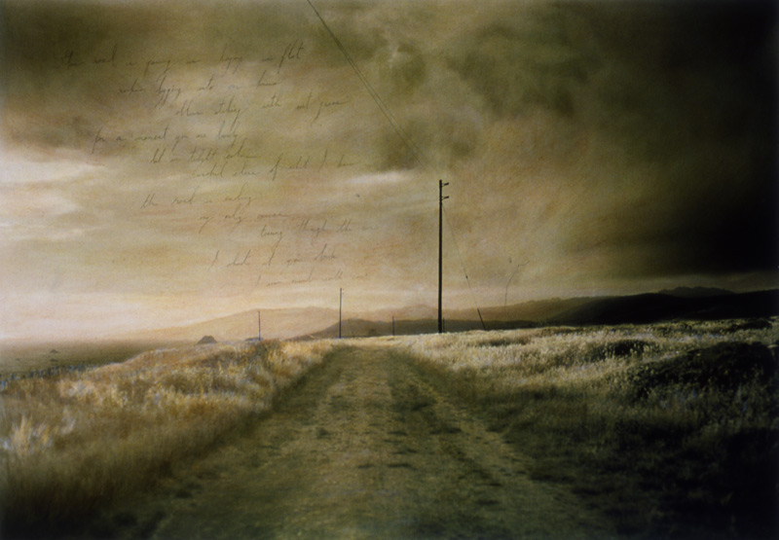
The End of the Road

Slide 3
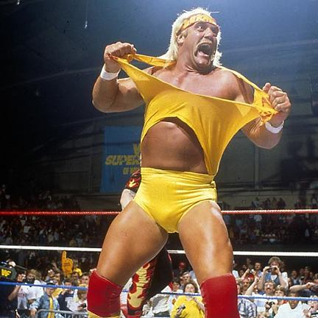
The End of the Road

Slide 4
Death by Whirlwind
See 2 Kings 2:1-6

Slide 5
Final Stops
Gilgal:
Bethel:
Jericho:

Slide 6
Final Stops
Gilgal: place of BEGINNING
Bethel:
Jericho:

Slide 7
Final Stops
Gilgal: place of BEGINNING
Bethel: place of PRAYER
Jericho:

Slide 8
Final Stops
Gilgal: place of BEGINNING
Bethel: place of PRAYER
Jericho: place of BATTLE

Slide 9
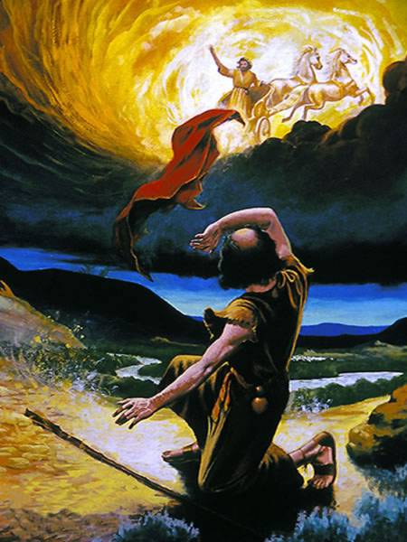
And away he goes…
See 2 Kings 2:7-11

Slide 10
And away he goes…
“But he shall acknowledge the son of the unloved wife as the firstborn by giving him a double portion of all that he has, for he is the beginning of his strength; the right of the firstborn is his.” Deuteronomy 21:17

Slide 11
Out with the old, in with the new
See 2 Kings 2:12-14

Slide 12
Part 1 - Title

Slide 13
Man of God may die,
but God of man never dies.
Part 1 - Title

