Slide 1
How the Mighty Have Fallen
August 10, 2011
Part 6
Part 1 - Title

Slide 2
James 5:17-18
“Elijah was a man with a nature like ours, and he prayed earnestly that it would not rain; and it did not rain on the land for three years and six months. And he prayed again, and the heaven gave rain, and the earth produced its fruit.”

Slide 3
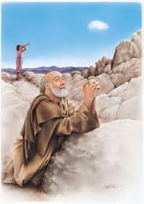
The Drought Ends
See 1 Kings 18:41-46

Slide 4
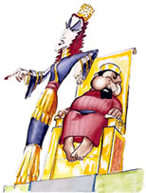
Jezebel Threatens Elijah
See 1 Kings 19

Slide 5
The Fall of our Hero

Slide 6
The Fall of our Hero
He was alone

Slide 7
The Fall of our Hero
He was alone
He was coming off a great victory

Slide 8
The Fall of our Hero
He was alone
He was coming off a great victory
He was feeling sorry for himself

Slide 9
The Fall of our Hero
He was alone
He was coming off a great victory
He was feeling sorry for himself
He was tired and hungry

Slide 10
The Fall of our Hero
He was alone
He was coming off a great victory
He was feeling sorry for himself
He was tired and hungry
He looked away from God and onto circumstances

Slide 11
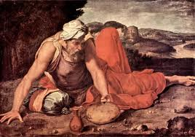
God Restores Elijah
See 1 Kings 19:11-18

Slide 12
