Slide 1
Let the Wonders Begin
July 27, 2011
Part 4
Part 1 - Title

Slide 2
God goes to great lengths to cut us down and refine us…

Slide 3
God goes to great lengths to cut us down and refine us…
…in order to use us mightily!

Slide 4
God goes to great lengths to cut us down and refine us…
…in order to use us mightily!
“Most assuredly, I say to you, he who believes in Me, the works that I do he will do also; and greater works than these he will do, because I go to My Father.” John 14:12

Slide 5
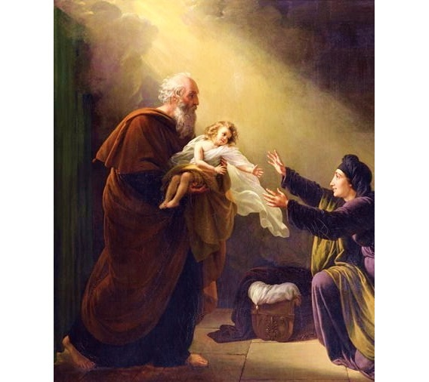
Elijah Revives the Widow’s Son
See 1 Kings 17:17-24

Slide 6
Lessons from the Man of God

Slide 7
Lessons from the Man of God
Rough with king, gentle with widow.

Slide 8
Lessons from the Man of God
Rough with king, gentle with widow.
What doesn’t matter as much as where

Slide 9
Psalm 91:1-4
“He who dwells in the secret place of the Most High shall abide under the shadow of the Almighty. I will say of the LORD, “He is my refuge and my fortress; My God, in Him I will trust. Surely He shall deliver you from the snare of the fowler and from the perilous pestilence. He shall cover you with His feathers, and under His wings you shall take refuge; His truth shall be your shield and buckler.”

Slide 10
Lessons from the Man of God
Rough with king, gentle with widow.
What doesn’t matter as much as where
Talks to God, not about God.

Slide 11
Lessons from the Man of God
Rough with king, gentle with widow.
What doesn’t matter as much as where
Talks to God, not about God.
Relationship based on faith in living God, not manual/formula.

Slide 12
Lessons from the Man of God
Rough with king, gentle with widow.
What doesn’t matter as much as where
Talks to God, not about God.
Relationship based on faith in living God, not manual/formula.
Faces all situations in total faith.

Slide 13
Living by Faith
He brought me here.
He will keep me here.
He will make this place a blessing.
And in His time, He will bring me out of again.

