Slide 1
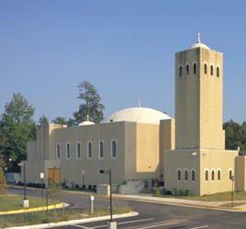
Why I Need the Church
Back to Basics – Part 5
September 12, 2010

Slide 2
We believe…in one Holy
Catholic & Apostolic Church.

Slide 3
Why Did God Create the Church?

Slide 4
Why Did God Create the Church?
“Now, therefore, you are no longer strangers and foreigners, but fellow citizens with the saints and members of the household of God” Ephesians 2:19

Slide 5
Why Did God Create the Church?
“Now, therefore, you are no longer strangers and foreigners, but fellow citizens with the saints and members of the household of God” Ephesians 2:19
The Church is a FAMILY

Slide 6
Why Did God Create the Church?
“so we, being many, are one body in Christ, and individually members of one another.” Romans 12:5
Christianity is not just believing,
it is BELONGING

Slide 7
Where Did the Church Come From?

Slide 8
Where Did the Church Come From?
“For you are a holy people to the LORD your God; the LORD your God has chosen you to be a people for Himself, a special treasure above all the peoples on the face of the earth.” Deuteronomy 7:6

Slide 9
Where Did the Church Come From?
“But you are a chosen generation, a royal priesthood, a holy nation, His own special people, that you may proclaim the praises of Him who called you out of darkness into His marvelous light; who once were not a people but are now the people of God…” 1 Peter 2:9

Slide 10
What is it supposed to look like?

Slide 11
What is it supposed to look like?
Koinonia
“By this we know love, because He laid down His life for us. And we also ought to lay down our lives for the brethren.” 1 John 3:16

Slide 12
What is it supposed to look like?
Koinonia
Body of Christ
“He put all things under His feet, and gave Him to be head over all things to the church, which is His body, the fullness of Him who fills all in all.” Ephesians 1:22-23

Slide 13
What is it supposed to DO?

Slide 14
What is it supposed to DO?
Gather to WORSHIP
“[Let us not be]…forsaking the assembling of ourselves together, as is the manner of some, but exhorting one another, and so much the more as you see the Day approaching.” Hebrews 10:25

Slide 15
What is it supposed to DO?
Gather to WORSHIP
“Then I looked, and I heard the voice of many angels around the throne, the living creatures, and the elders; and the number of them was ten thousand times ten thousand, and thousands of thousands, saying with a loud voice…

Slide 16
What is it supposed to DO?
Gather to WORSHIP
… ‘Worthy is the Lamb who was slain to receive power and riches and wisdom, and strength and honor and glory and blessing!’” Revelation 5:11-12

Slide 17
What is it supposed to DO?
Gather to WORSHIP
Scatter to WITNESS
“Therefore those who were scattered went everywhere preaching the word.” Acts 8:4

Slide 18
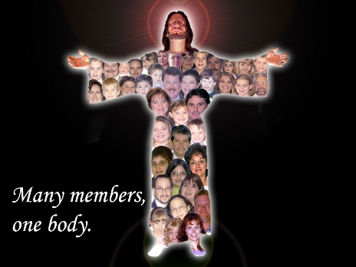
The Church is…

Slide 19
The Church is…
Participation in the Life of Christ

