Slide 1
In the end, God wins
Book of Esther – Part 9
October 27, 2010

Slide 2
Mordecai:
“Yet who knows whether you have come to the kingdom for such a time as this?”
Esther:
“And if I perish, I perish!”

Slide 3
Ready to Avenge
See Esther 9:1-16

Slide 4
Why did they hold back?

Slide 5
Why did they hold back?
SELF-CONTROL
“But the fruit of the Spirit is love, joy, peace, longsuffering, kindness, goodness, faithfulness, gentleness, self-control. Against such there is no law.” Galatians 5:22-23

Slide 6
Why did they hold back?
“For to this you were called, because Christ also suffered for us, leaving us an example, that you should follow His steps: “Who committed no sin, nor was deceit found in His mouth”; who, when He was reviled, did not revile in return; when He suffered, He did not threaten, but committed Himself to Him who judges righteously” 1 Peter 2:21-23

Slide 7
Ready to Celebrate
See Esther 9:17-32

Slide 8
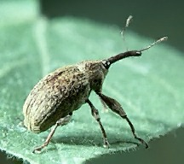
Story of the Boll Weevil

Slide 9
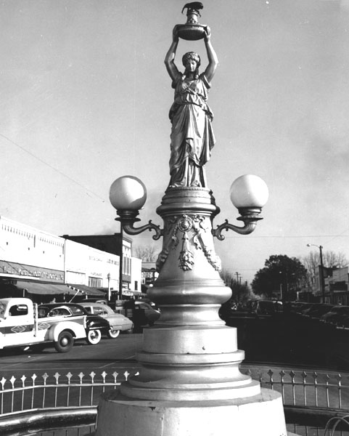
Story of the Boll Weevil

Slide 10
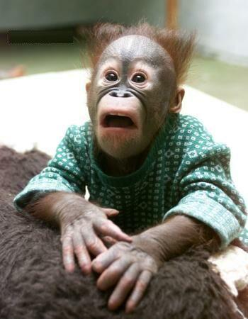
Have you had a boll weevil experience?

Slide 11
Building a boll weevil monument
“And it came to pass, when all the people had completely crossed over the Jordan, that the LORD spoke to Joshua, saying: “Take for yourselves twelve men from the people, one man from every tribe, and command them, saying, ‘Take for yourselves twelve stones from here, out of the midst of the Jordan, from the place where the priests’ feet stood firm.” Joshua 4:1-3

Slide 12
Building a boll weevil monument
“Weeping may remain for a night, but rejoicing comes in the morning.”
Psalm 30:5

Slide 13

Final Lesson: GOD ALWAYS WINS!

Slide 14
Final Lesson: GOD ALWAYS WINS!
“Oh, the depth of the riches both of the wisdom and knowledge of God! How unsearchable are His judgments and His ways past finding out!”
Romans 11:33

